Slide 1
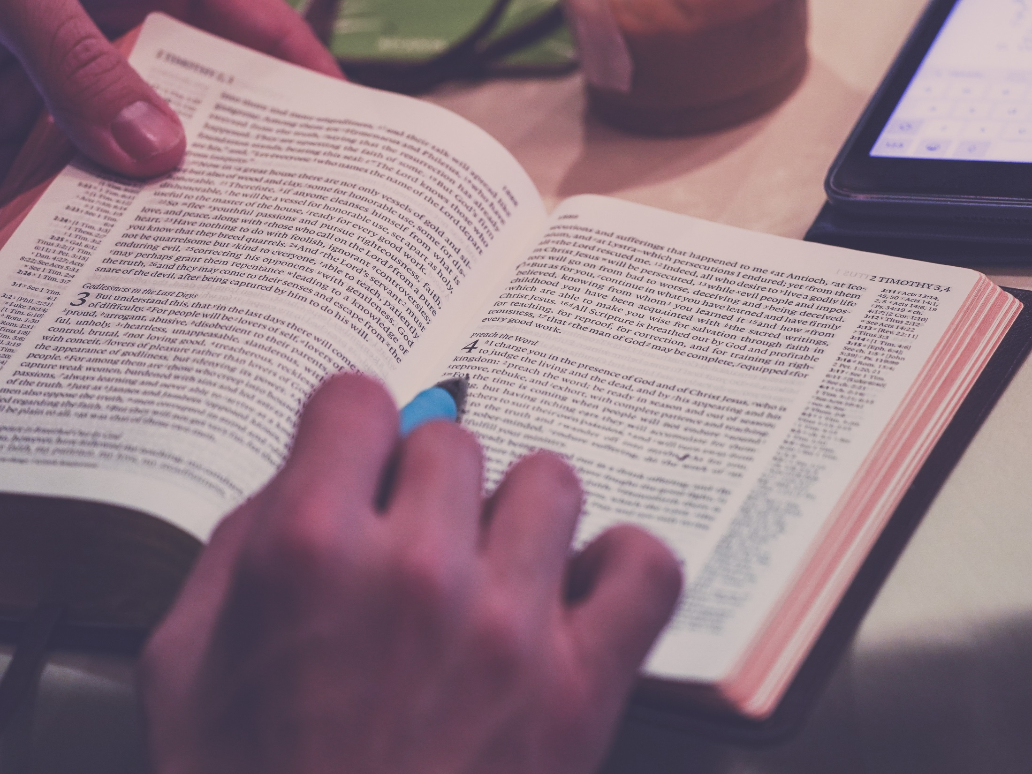
Have someone in your class read this scripture out loud. As you listen, which phrase stands out to you?
When Jesus saw the crowds, he went up the mountain; and after he sat down, his disciples came to him. Then he began to speak, and taught them, saying:
“Blessed are the poor in spirit, for theirs is the kingdom of heaven.
“Blessed are those who mourn, for they will be comforted.
“Blessed are the meek, for they will inherit the earth.
“Blessed are those who hunger and thirst for righteousness, for they will be filled.
“Blessed are the merciful, for they will receive mercy.

Slide 2
“Blessed are the pure in heart, for they will see God.
“Blessed are the peacemakers, for they will be called children of God.
“Blessed are those who are persecuted for righteousness’ sake, for theirs is the kingdom of heaven.
“Blessed are you when people revile you and persecute you and utter all kinds of evil against you falsely on my account.
Rejoice and be glad, for your reward is great in heaven, for in the same way they persecuted the prophets who were before you.

Slide 3
Which phrase stood out to you?
What is God trying to tell us through this scripture?
How can you apply this to your life?

