Slide 2
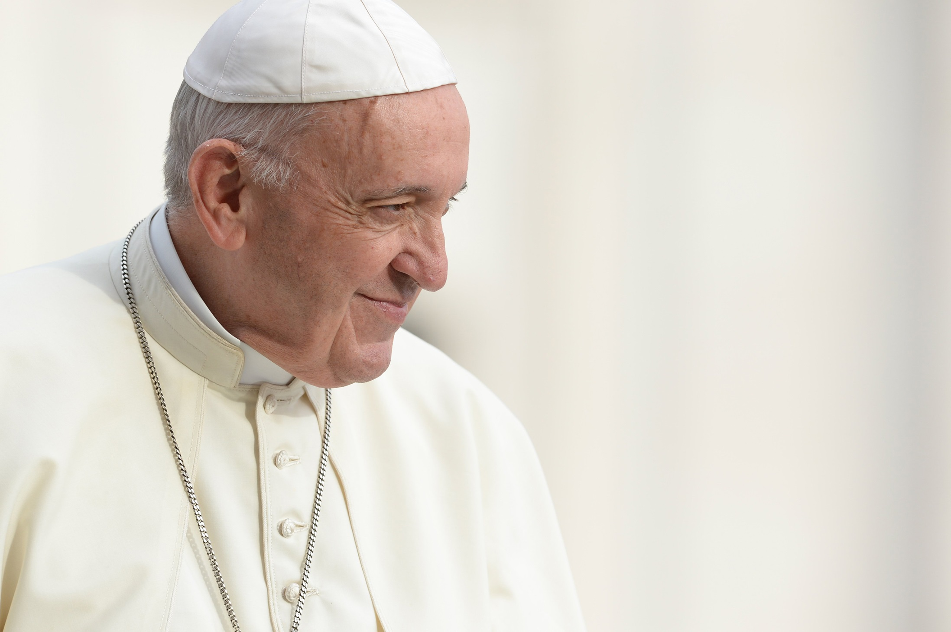
Pope Francis has said that new situations require new energy and commitment.
His new beatitudes challenge us to go out into the world and make a difference.

Slide 3
Which of Pope Francis’ beatitudes will you try to live out today?
— Blessed are those who remain faithful while enduring evils inflicted on them by others and forgive them from their heart.
— Blessed are those who look into the eyes of the abandoned and marginalised and show them their closeness.
— Blessed are those who see God in every person and strive to make others also discover him.
— Blessed are those who protect and care for our common home.
— Blessed are those who renounce their own comfort in order to help others.
— Blessed are those who pray and work for full communion between Christians.

