Slide 1
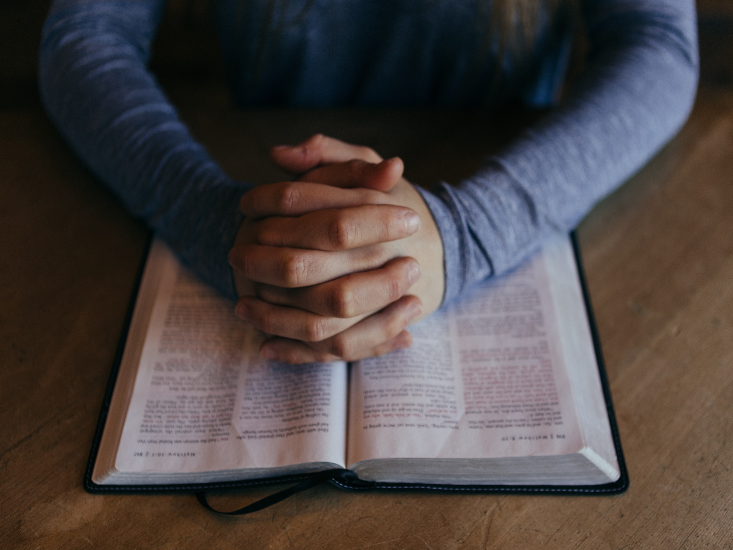
Pope Francis has said that the ‘identity card’ of the saints is found in Jesus’ beatitudes; in the way that they reached out and made Jesus known to others.
Jesus calls us to do the same, tor each out to those around us and make His love known.
Last year we asked Y7 what their Beatitude would be…

Slide 2
Here are some if their ideas:
‘Blessed are those who try to make a change and be the light of the world. ‘
‘Blessed are those who forgive others, may they always be reminded of their kindness.’
‘Blessed are those who help others, even when they themselves are struggling in life.’

Slide 3
What would your Beatitude be?
As you listen to the song, think about how you want to make a change, what your ‘identity card’ would be.

