Slide 1
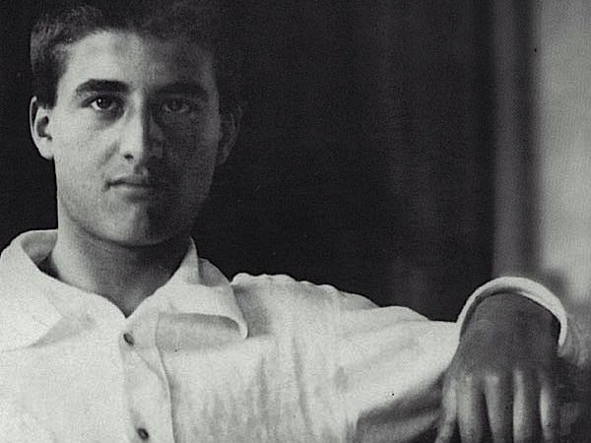
Blessed Pier Giorgio Frassati was born in 1901 to an affluent family in Turin, Italy.
To all those around him, he appeared to be a normal young man. He enjoyed seeing his friends, playing football and hiking.
At the age of 25 he contracted polio and died. Pier Giorgio’s funeral was not only attended by the elite of Turin but by the poor, homeless and poverty stricken.

Slide 2
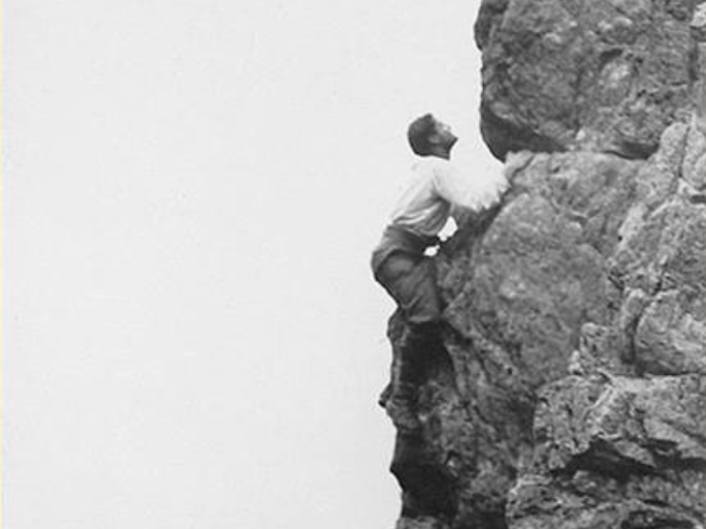
Pier Giorgio’s parents were surprised by this when they found out that Pier Giorgio had been spending much of his time attending to the needs of these people in the city.
They heard stories of a life they didn’t know about: how Pier Giorgio had hiked to a chapel in the mountains to attend mass and how he had given his own shoes to a mother and child who had asked him for help.

Slide 3
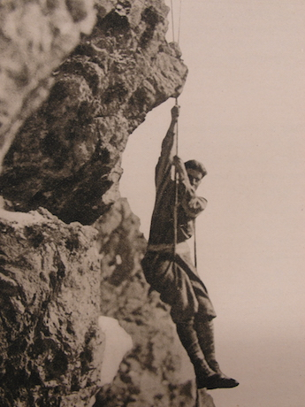
O Father, you gave to the young
Pier Giorgio Frassati the joy of meeting Christ and of living his faith in the service of the poor and the sick;
through his intercession may we, too, walk the path of the beatitudes and follow the example of his generosity, spreading the spirit of the Gospel in society.
Through Christ our Lord,
Amen.

