Slide 1
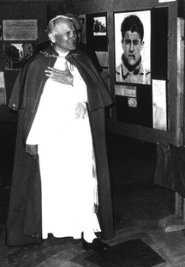
In 1974 Cardinal Wojtyla (who we now know as Pope St John Paul II) visited an exhibition about Pier Giorgio’s life.
He said:
"Go and look at these photographs. Behold the man of the eight beatitudes who bears in himself the grace of the Gospel, the Good News, the joy of salvation offered to us by Christ..."

Slide 2
Pope St John Paul II thought that Pier Giorgio was an excellent example of what it means to live out The Beatitudes.
By his example he proclaims that a life lived in Christ's Spirit, the Spirit of the Beatitudes, is "blessed", and that only the person who becomes a "man or woman of the Beatitudes" can succeed in communicating love and peace to others.

Slide 3
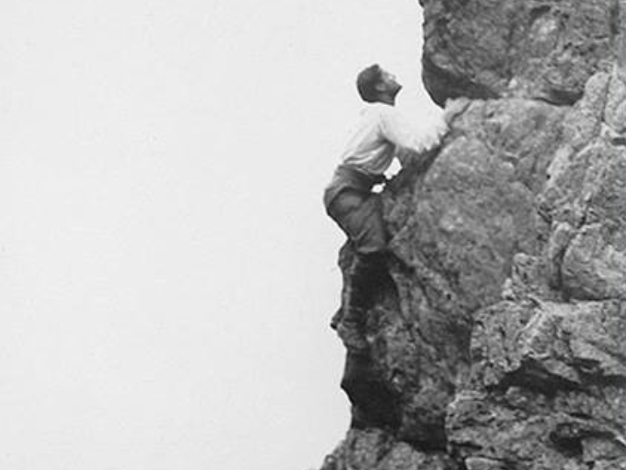
Pier Giorgio favourite saying was ‘Vero L’Alto’ which means ‘to the hights’.
He would say to his friends ‘the higher we go, the better we shall hear the voice of Christ.’
He inspires young people to grow closer to God through prayer, friendship and by authentically living the teachings of Jesus.
How will you live out your faith today?
Pope St John Paul II thought that Pier Giorgio was an excellent example of what it means to live out The Beatitudes.
By his example he proclaims that a life lived in Christ's Spirit, the Spirit of the Beatitudes, is "blessed", and that only the person who becomes a "man or woman of the Beatitudes" can succeed in communicating love and peace to others.

