Slide 1
Today is Red Wednesday. A day where Aid to the Church in Need as us to pray in particular for persecuted Christians around the world.

Slide 2
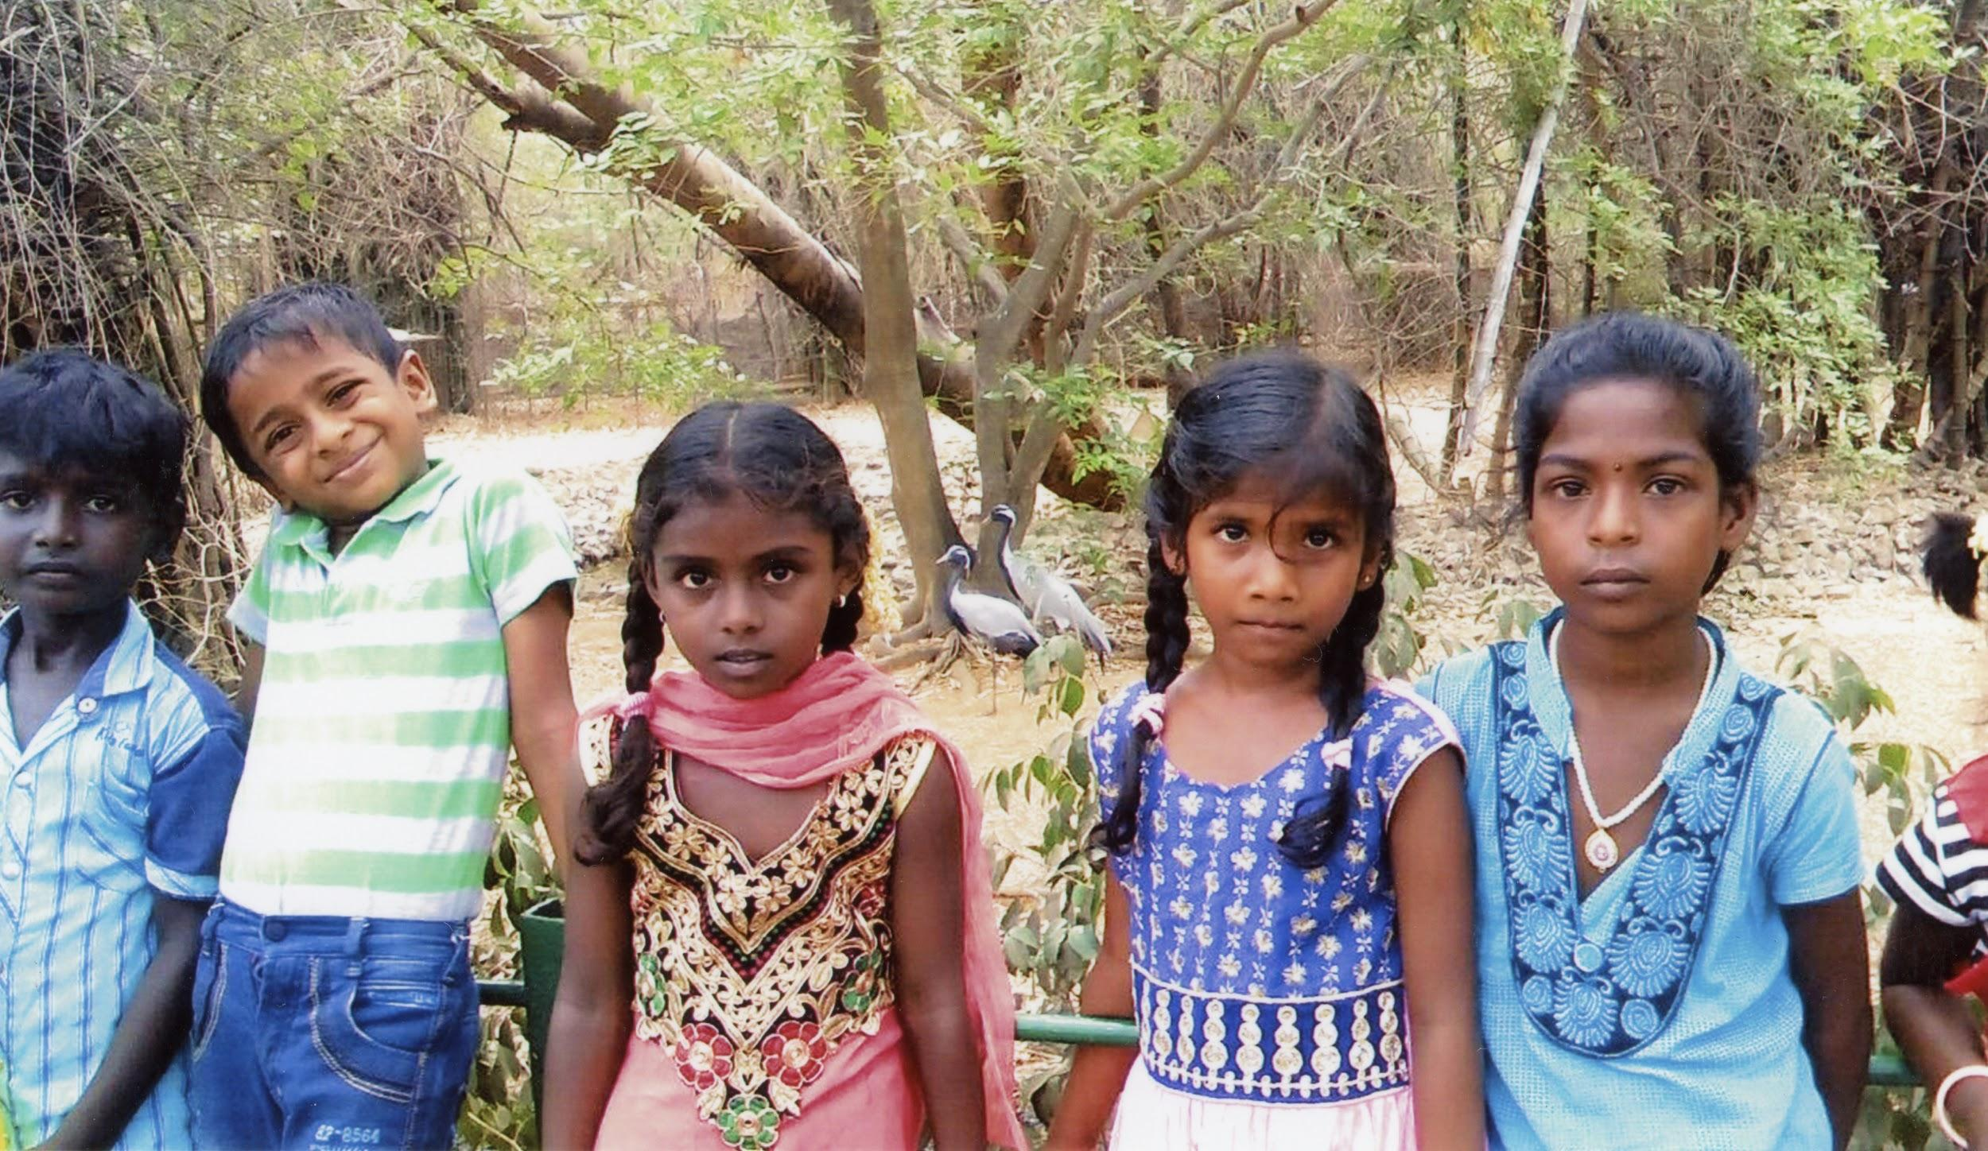
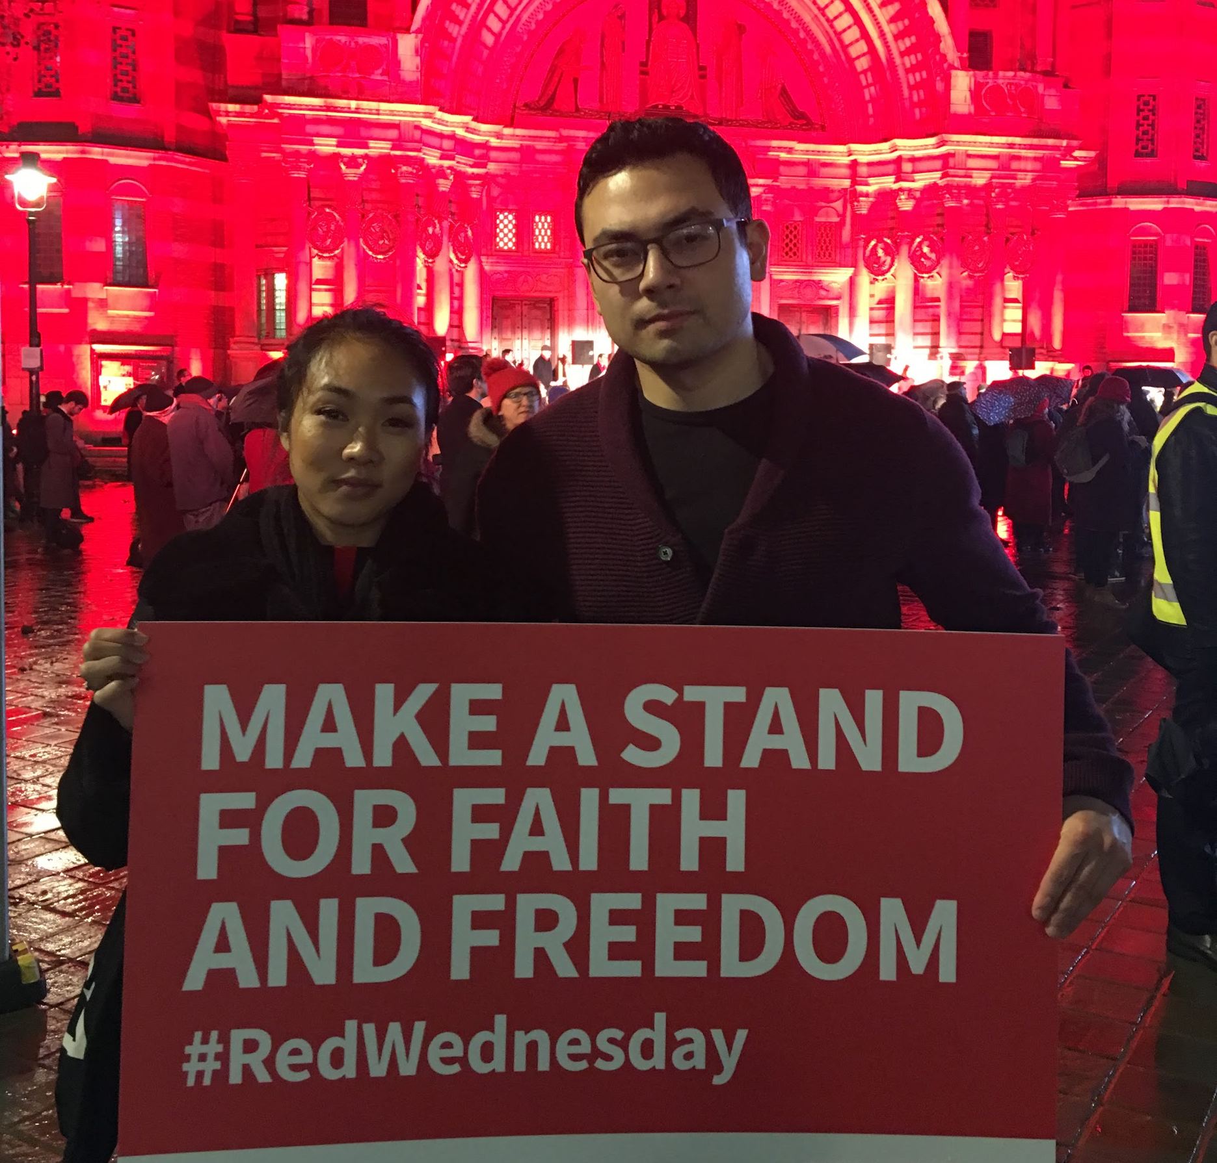
©ACN
©ACN

Slide 3
What are you standing up for today?
Who are you standing with?
What do you stand for?
Let’s stand together today:
#RedWednesday

Slide 4
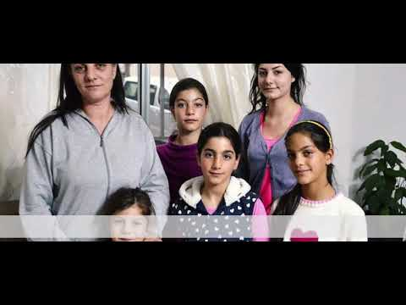

Slide 5
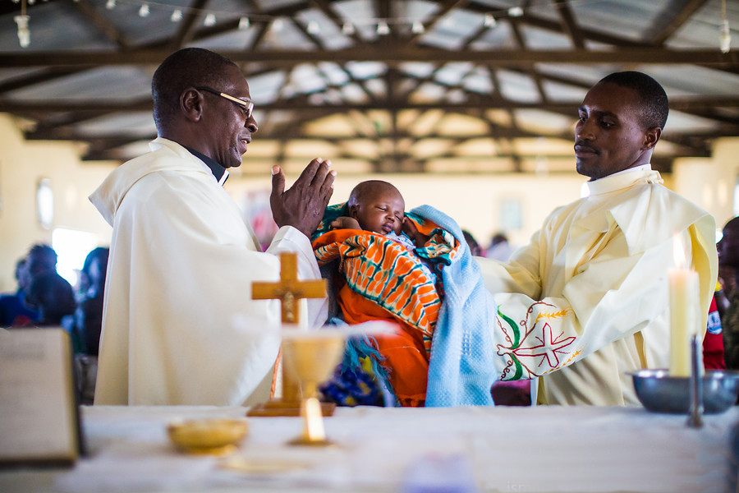
©ismaelmartinezsanches/ACN
Holy Spirit, Inspire in me
What I should think,
What I should say,
What I should leave unsaid,
What I should write,
What I should write,
What I should do
And how I should act
To bring about the good of souls,
The fulfilllemnt of my mission,
And the triumph of the Kingdom of Christ.
Amen

