Slide 1
Stand Together
Holocaust Memorial Day 2020

Slide 2
Millions of people were stripped of their humanity and murdered during the Holocaust and Nazi Persecution. Each person was unique, with their own interests, friends and family.
Thousands of people are using their social media accounts for good by remembering
unique individuals.
Here is one of those stories…

Slide 3
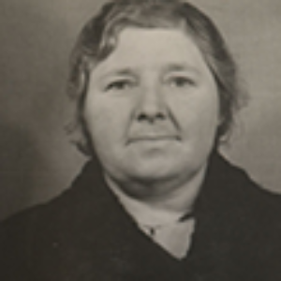
Louisa Gould
Louisa Gould hid a Russian prisoner of war in her home on the island of Jersey. She was arrested and sent to a concentration camp where she ultimately paid with her life.
Louisa welcomed Feodor into her family. She gave him the nickname ‘Bill’, taught him local manners and English with a French accent so the Germans would not believe he was Russian. When asked why she wanted to help ‘Bill’, Louisa reportedly said: ‘I had to do something for another mother’s son.’
But not everyone on the island agreed with Louisa and some of her neighbours wrote a letter to their occupiers informing them about Bill. Fortunately, Louisa was alerted in time and Bill went into hiding.
The Geheime Feldpolizei (German special force) searched Louisa’s house, where they found papers showing that he had been there and labels from Louisa and her sisters from a Christmas present for Bill. The Germans also found Louisa’s forbidden wireless, and she was arrested.
Louisa was sent to prison on 25 May 1944. Days later the Germans searched the house of Louisa’s sister, who sheltered Bill after Louisa, and she too was arrested, along with many others, including Louisa’s brother Harold Le Druillenec, who had simply listened to Louisa’s wireless

