Slide 1
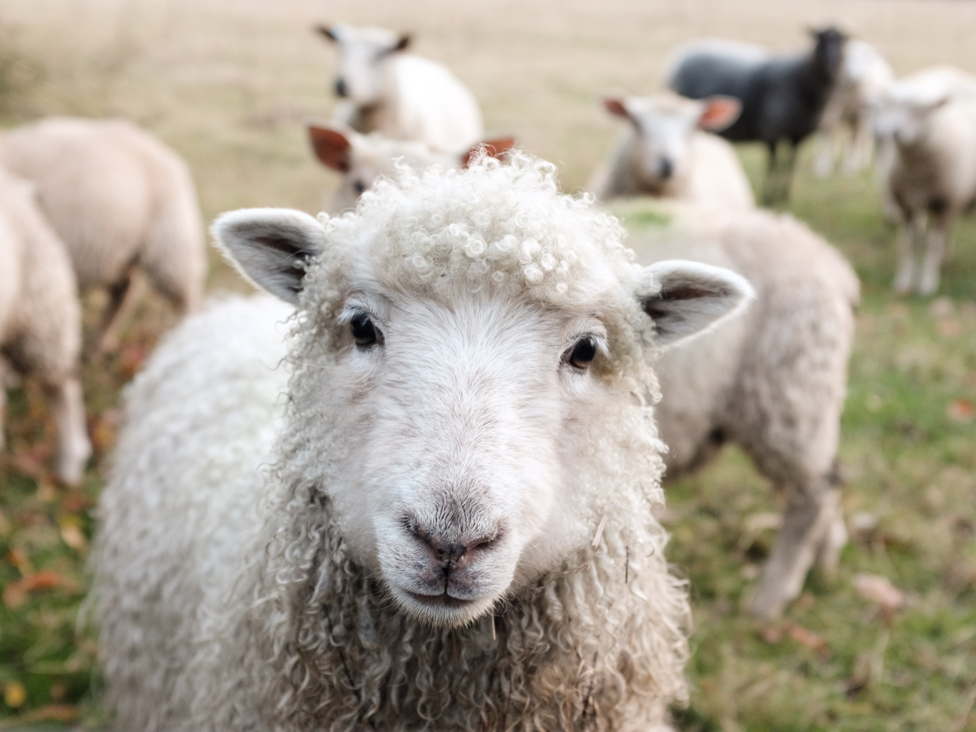
The Parable of the
sheep
and goats

Slide 3
Let us prayer together:
Lord Jesus, help us to follow your call and to put faith into action. Let reflection on your word lead to action in our world.
Amen.

Slide 4
How will you serve others this week?

