Slide 1
The Corporal Works of Mercy
The actions that Jesus spoke about in the Parable of the Sheep and Goats are known as the ‘corporal works of mercy’.
Jesus told us that when we do these thing to our brothers and sisters, we are doing them to Him.

Slide 2
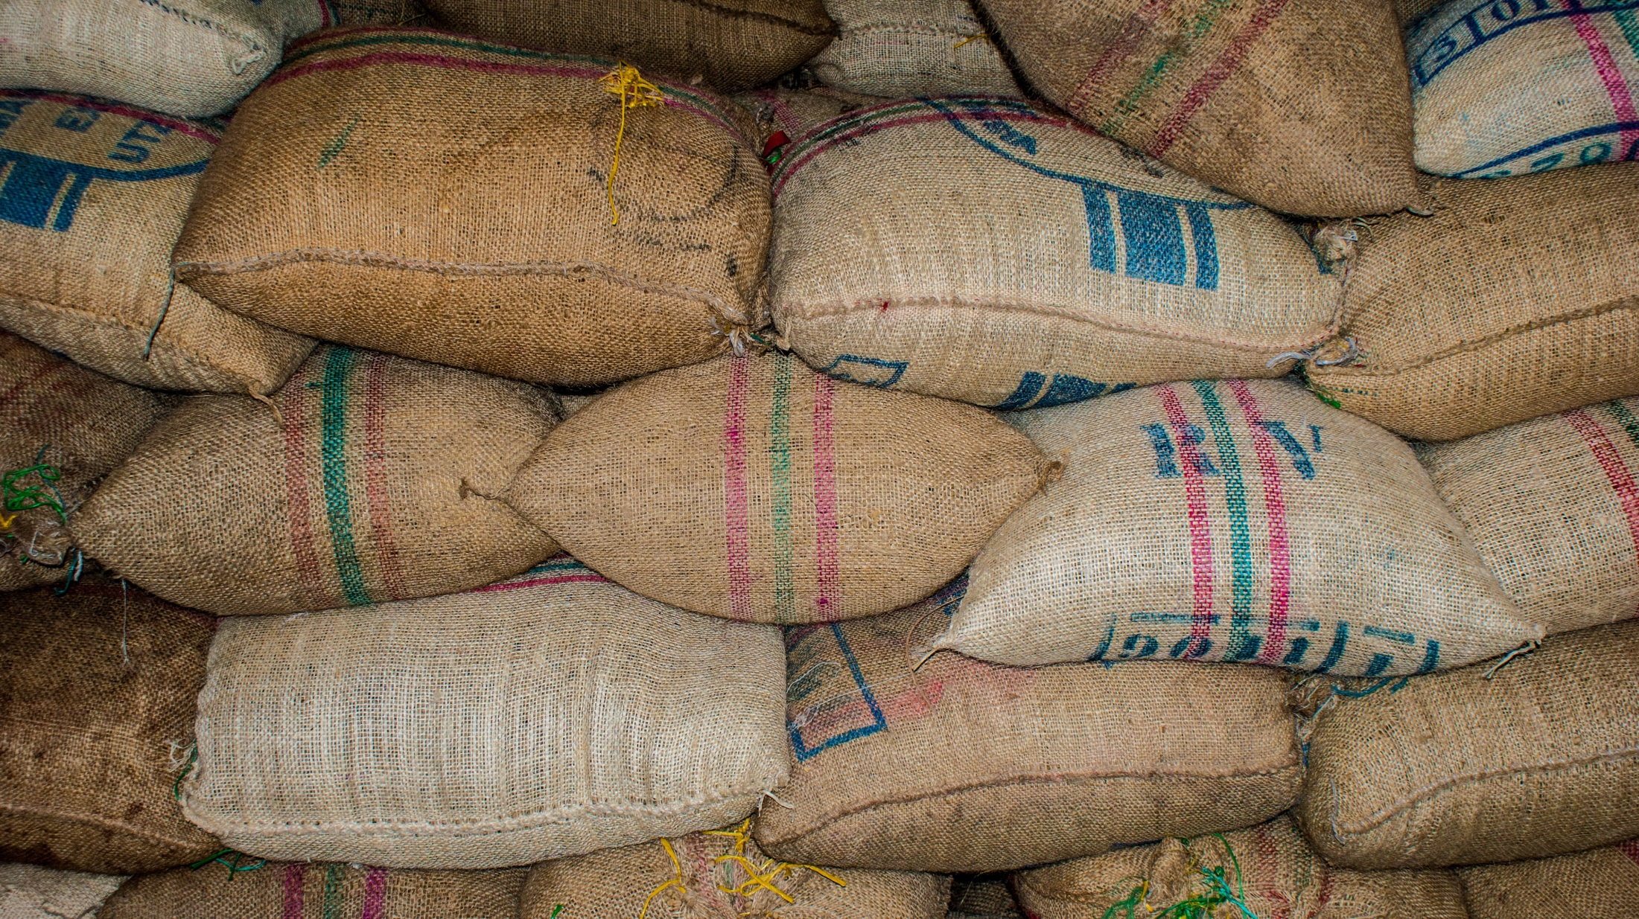
Support a food bank or soup kitchen
Learn more about world hungry and solutions
How will you…
Feed the hungry?
Buy food to give to someone in need
Share your meal with others

Slide 3
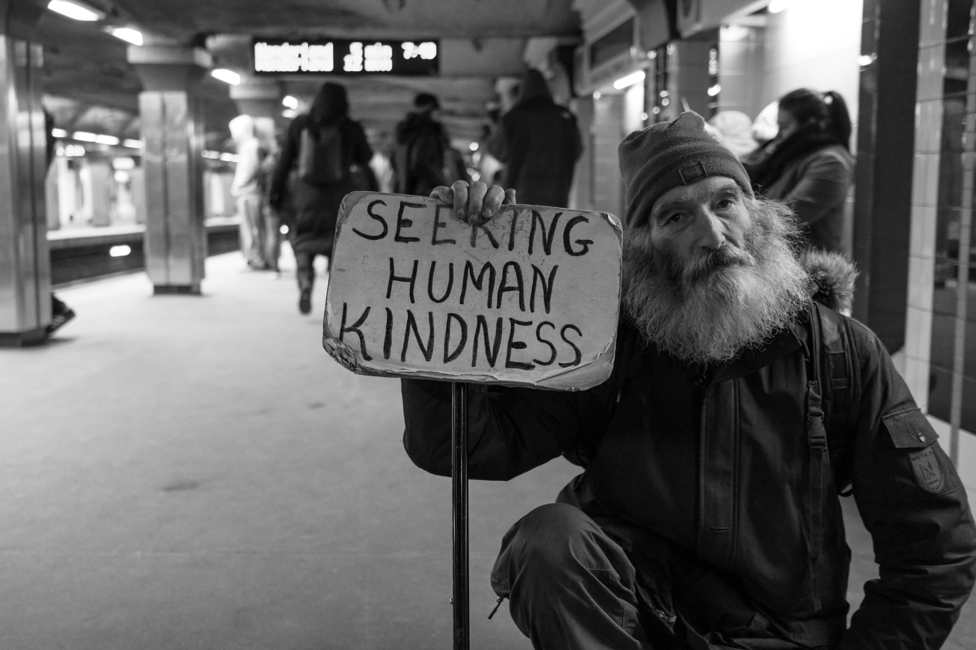
Help a neighbour take care of their home
Support a homeless shelter
How will you…
Shelter the homeless?
Support charities that provide disaster relief
Support a community refugee project

Slide 4
Donate your old clothes to charity
Volunteer at a charity shop
How will you…
Clothe the
naked?
Support ethical fashion
Support the SVP society

Slide 5
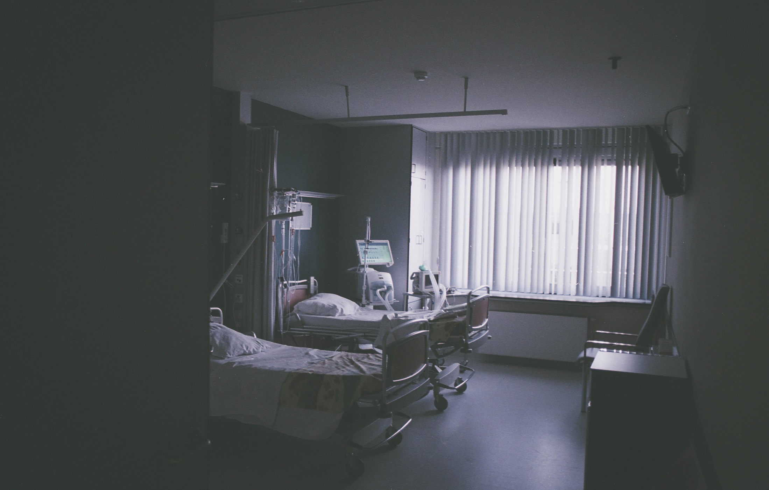
Spend quality time with someone who is housebound
Cook and deliver a meal to someone who is sick
How will you…
Visit the sick?
Send a card to someone who is sick
Volunteer at a hospital

Slide 6
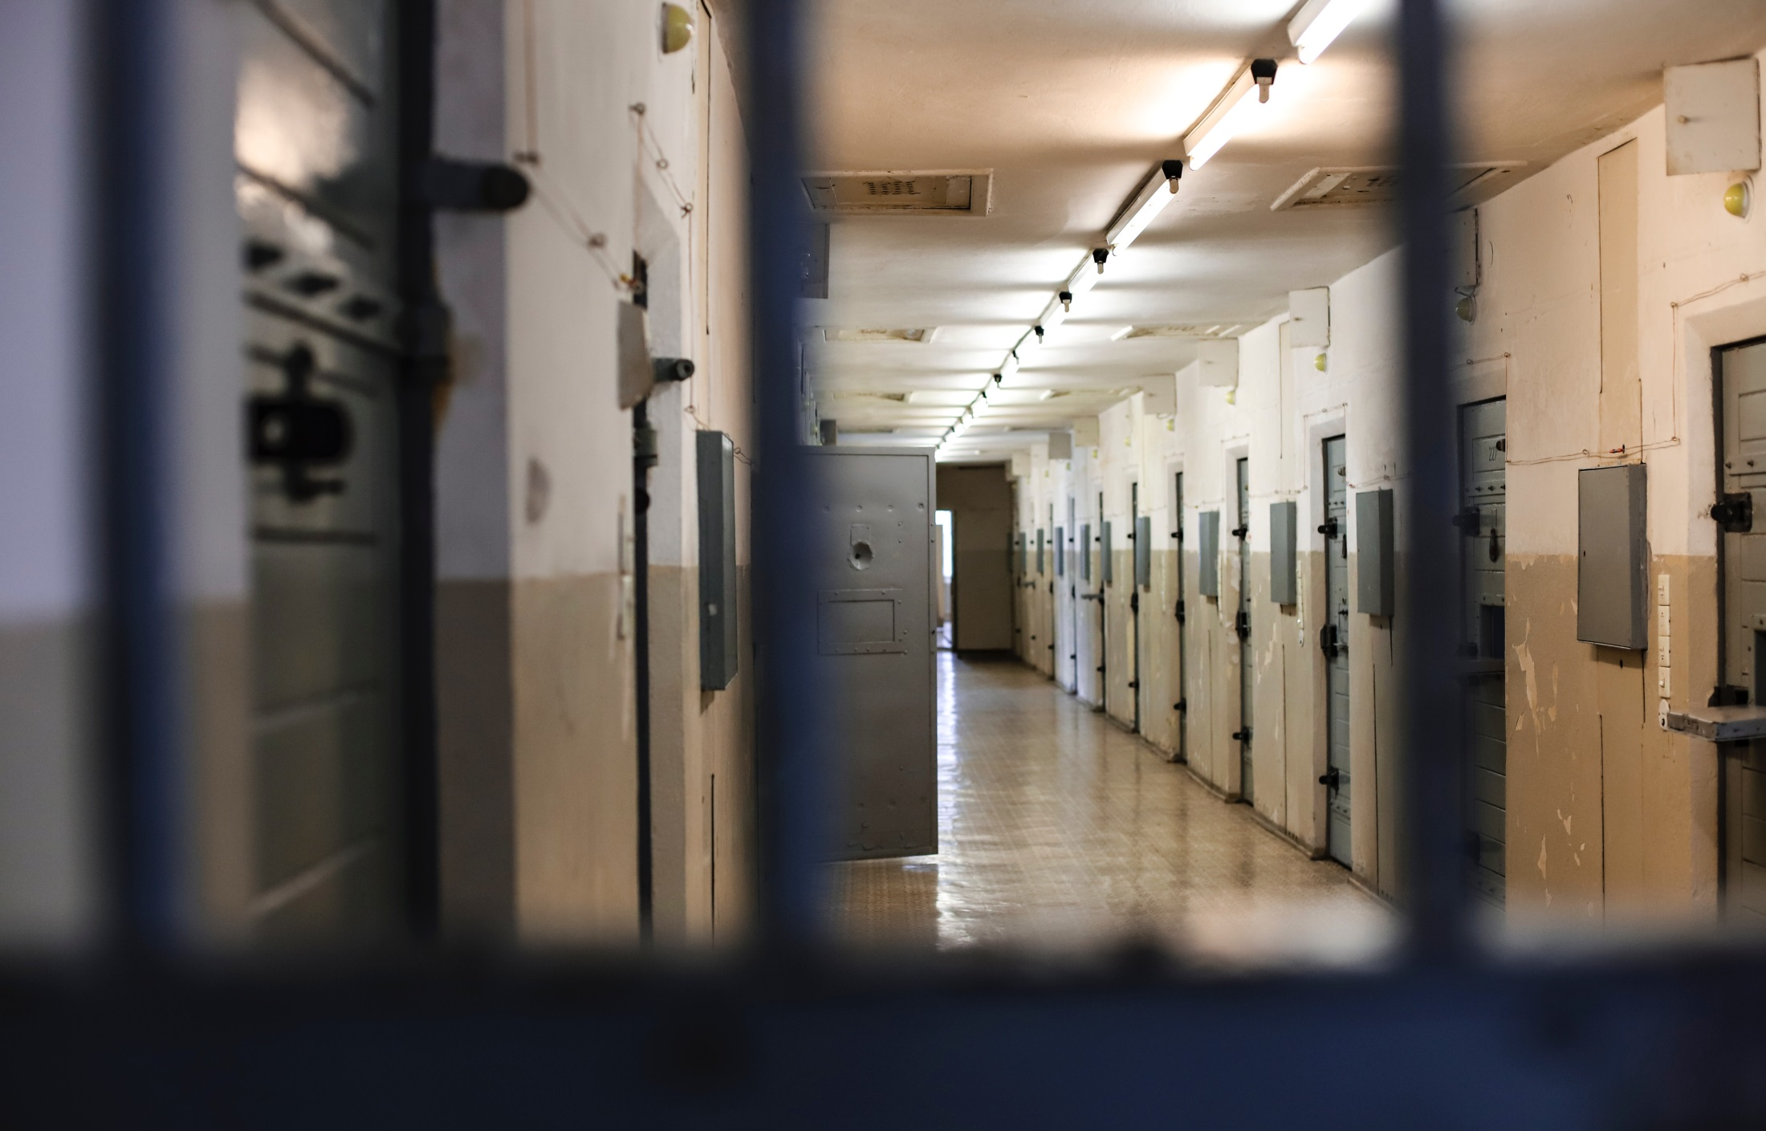
Support a prison ministry
Support Aid to the Church in Need
How will you…
Visit the imprisoned?
Pray for inmates and their families
Support a friend who feels imprisoned by a situation

Slide 7
Donate money to charity
Learn about the work of different charities
How will you…
Give to the poor?
Pray for leaders who make decisions that affect the poor
Pray for those who are in need

Slide 8
Volunteer to maintain a community cemetery
Pray for the dead and their families
How will you…
Bury the dead?
Support a friend who has suffered a bereavement
Send a card to someone who is mourning

Slide 9
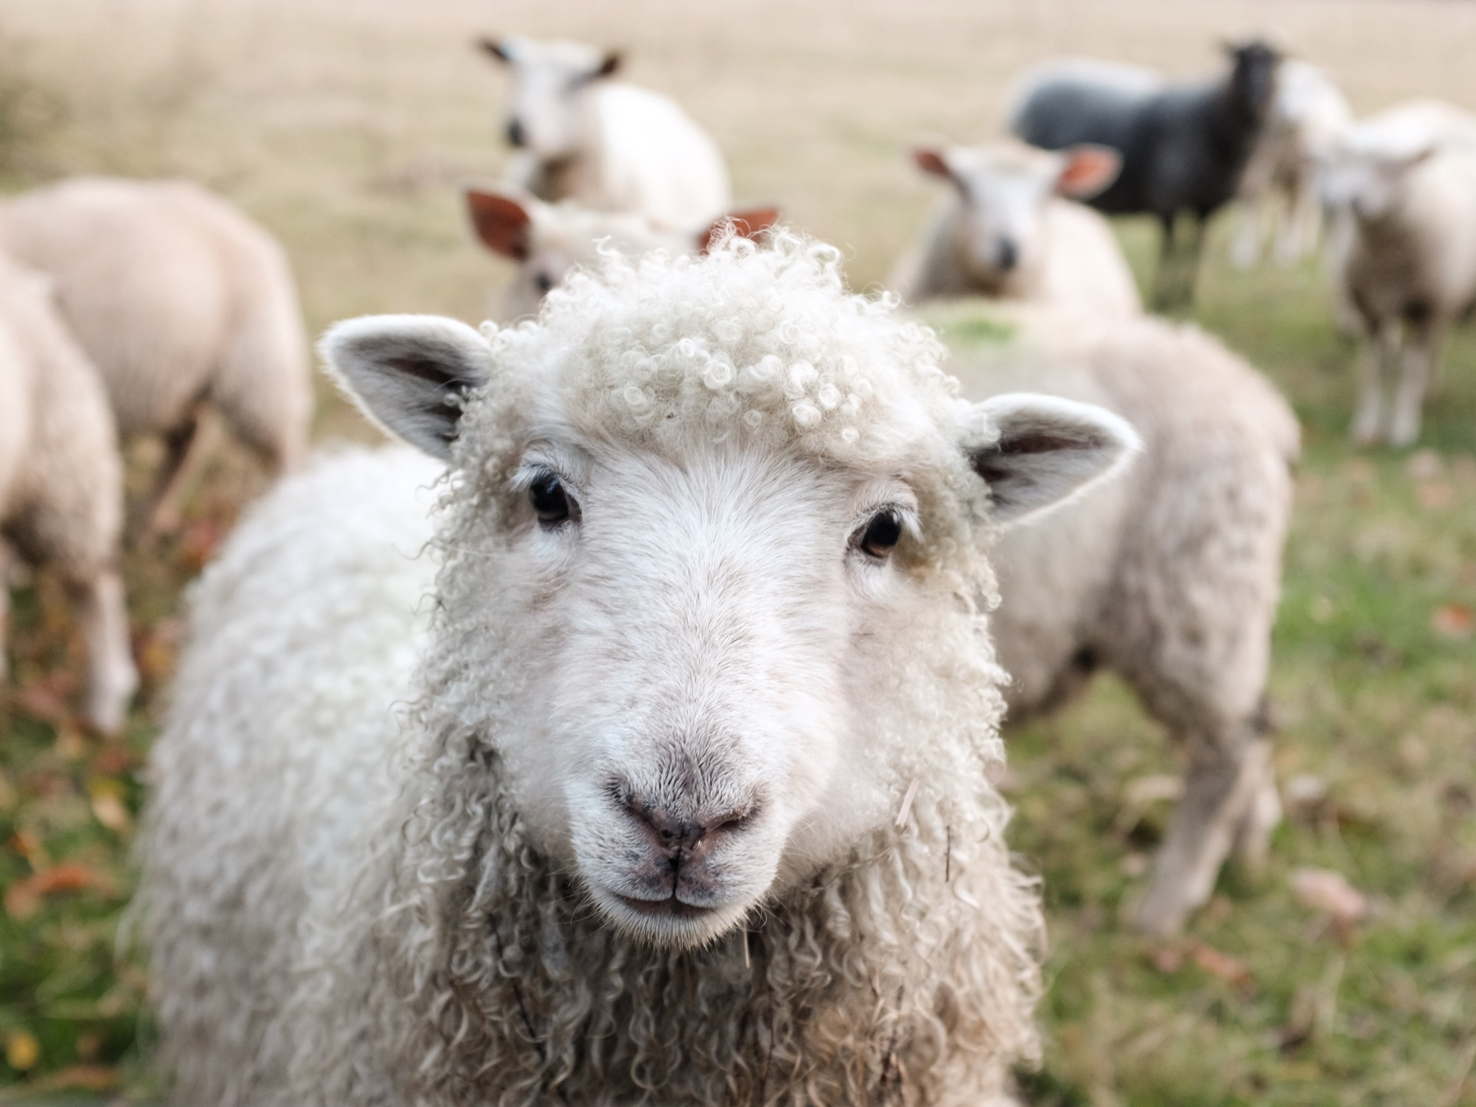
Let us prayer together:
Help me to grow less.
Less concerned by my wants
Less worried by my future
Less blind to others’ suffering
So that you may grow more
More present in my life
Making me More aware of my dignity
More trusting in your providence
More filled with love for all people
God of simplicity and abundance
Give me less and more
Amen.

