Slide 1
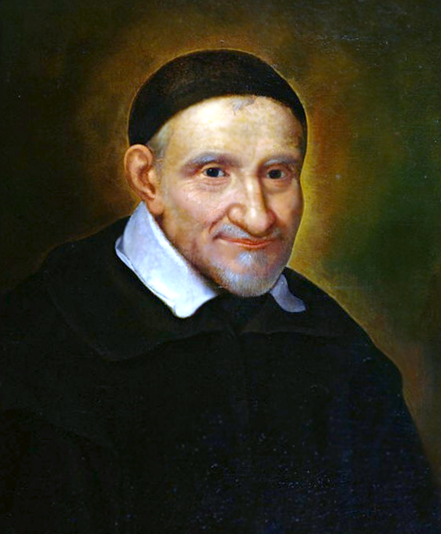
5 facts about Saint Vincent de Paul

Slide 2
5.
St. Vincent de Paul spent the first 20 years of his life seeking fame and wealth.
Vincent de Paul was born to a peasant family in France in 1580. Although he later achieved fame for his dedication to the poor, his early life was spent attempting to escape his humble roots.

Slide 3
4.
St. Vincent de Paul was captured by pirates.
In 1605, Vincent was returning home by boat from a trip. While travelling, he was captured by pirates, who brought him to Tunis in Northern Africa. He was sold into slavery and he remained a slave for two years. During this he prayed that if his life would be spared, he would devote the rest of his life to the service of the poor.

Slide 4
3.
St. Vincent de Paul was a community organiser.
Vincent was shocked by the poverty in his parish. He met with affluent friends and inspired them to organize into groups going from house to house requesting furniture, food and clothing. Soon, churches all over France were using the same techniques Vincent had created to help their neighbours in need.

Slide 5
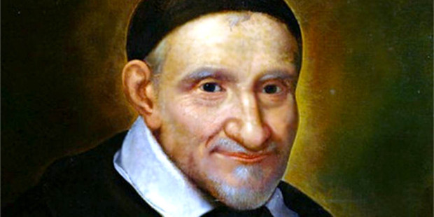
2.
St. Vincent de Paul was a legend in his own time.
As time went on, Vincent became sorry for the mistakes of his youth. He founded a society of priests who devoted their lives to the poor. He spent his life founding hospitals, orphanages and homes for people who were mentally ill. He also devoted his last years to serving prisoners and slaves, sharing with them his story of hope as a former slave himself.

Slide 6
1.
St. Vincent de Paul did NOT found the Society of St. Vincent de Paul.
The Society of St. Vincent de Paul was not founded until more than 150 years after St. Vincent’s death. When Frederic Ozanam founded the Society, he named it after St. Vincent de Paul. Ozanam was devoted to St. Vincent, who is the patron saint of charitable societies, and he modeled the Society on his call to “see Christ in the poor and to be Christ to the poor”. The members of the Society of St. Vincent de Paul continue to honor his life and legacy.

Slide 7
Let us pray together:
May we be inspired by the life of St Vincent de Paul to become more devoted to the lives of others.
Help us to serve others with generosity and humility.
We know that when we serve others we are serving you, Jesus.
Amen

