Slide 1
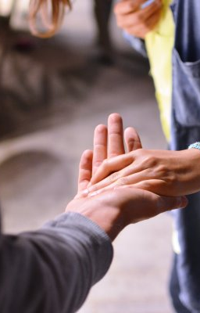
A small act of kindness can go a long way…

Slide 2


Slide 3
Lord I give you my mouth, help me to speak from the heart
Lord I give you my hands, help me to give, receive and build
Lord I give you my eyes, help me to see what is going on
Lord I give you my ears, help me to listen for cries of help
Lord I give you my feet, help me to make the effort to get to people
Lord I give you my heart, help me to show love
Lord you love us so much, help us to remember that by using our heart it keeps others heart’s alive with love.
Amen
(prayer from Youth SVP)

