Slide 1
(Psalm 91)

Slide 2
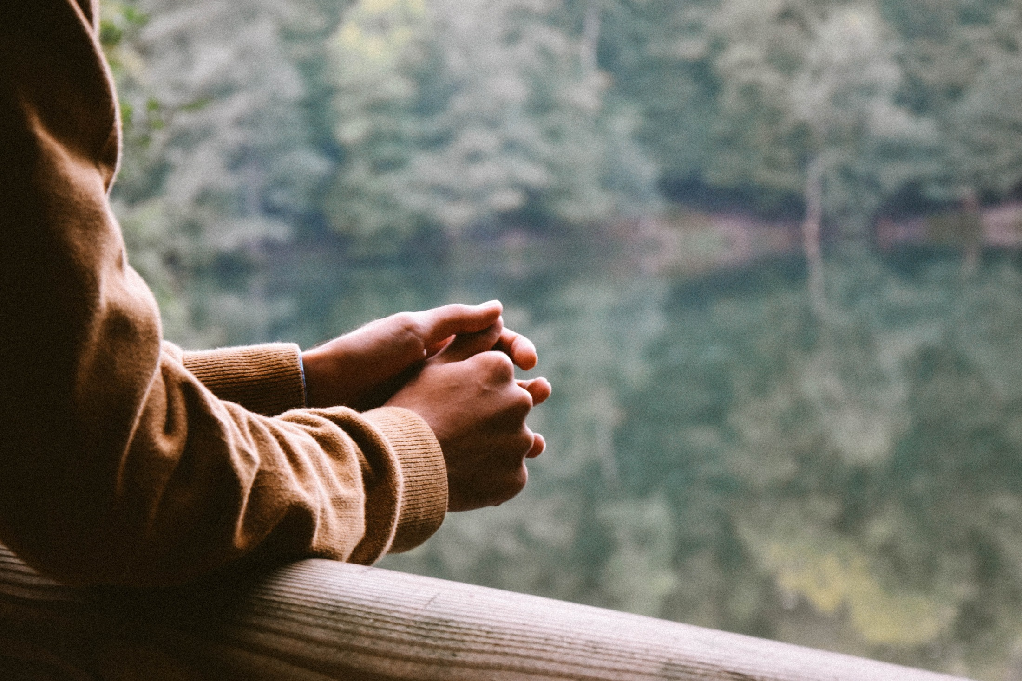
Do I trust God?
Do I take refuge in God when things are hard?
“You will not fear the terror of the night, or the arrow that flies by day, or the pestilence that stalks in darkness, or the destruction that wastes at noonday.” (Psalm 91)

Slide 3
Let us pray together:
Heavenly Father, please strengthen our hearts, and remind us to encourage one another
when the troubles of life
start to overwhelm us.
Please guard our hearts
from any destruction.
Give us the strength up to rise up each day
and fight against the struggles
which seek to weigh us down.
Amen.

