Slide 1
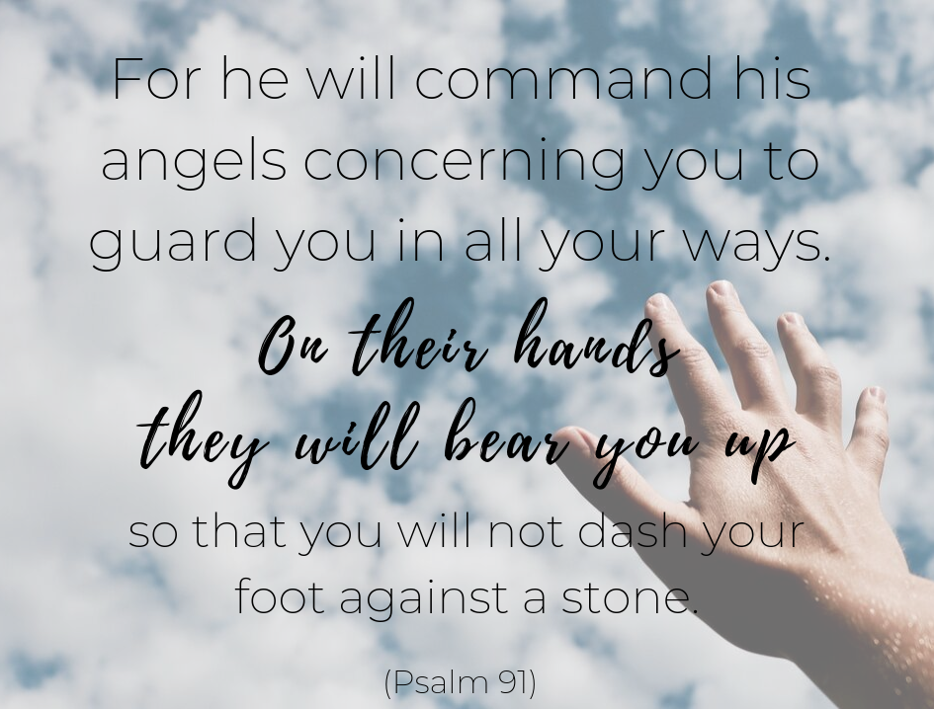

Slide 2
"See that you do not despise one of these little ones, for I say to you that their angels in heaven continually see the face of My Father who is in heaven.”
(Matthew 18:10)
Jesus speaks of how God values each of His children. Because He loves each of us so much, God assigns angels to each of us for our protection. No matter who you are, how low you may feel in life, God doesn’t discriminate who He will take care of. Instead, He tells others to “not despise” one another.
https://www.youtube.com/watch?v=9PugD11k3JU

