Slide 1
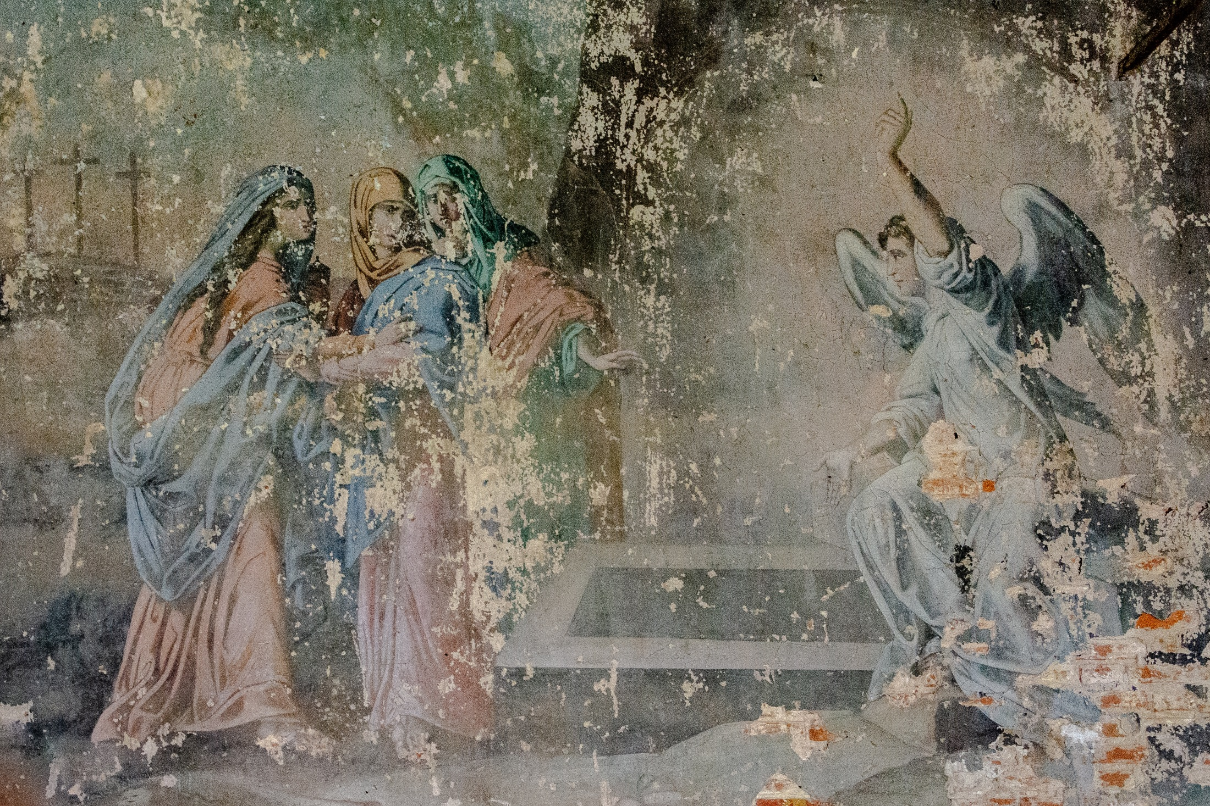
What is
an angel?

Slide 2
Angels aren’t necessarily what we see in painting or in movies.
They don’t have two wings, a halo and a white robe.
Angels exist to do the will of God, to be His messengers, guides and protectors — defenders of God’s truth.

Slide 3
Angels appear in the Bible from beginning to end, from the Book of Genesis to the Book of Revelation.
Angels are protectors. Throughout the Bible angels have keep God’s people out of physical danger.
Angels are messengers. They are sent from Heaven to communicate a message from God.

Slide 4
Angels, just like the Saint in Heaven, can be great examples for us.
How can you be a messenger of God’s truth today?
How will you do the will of God?

