Slide 1
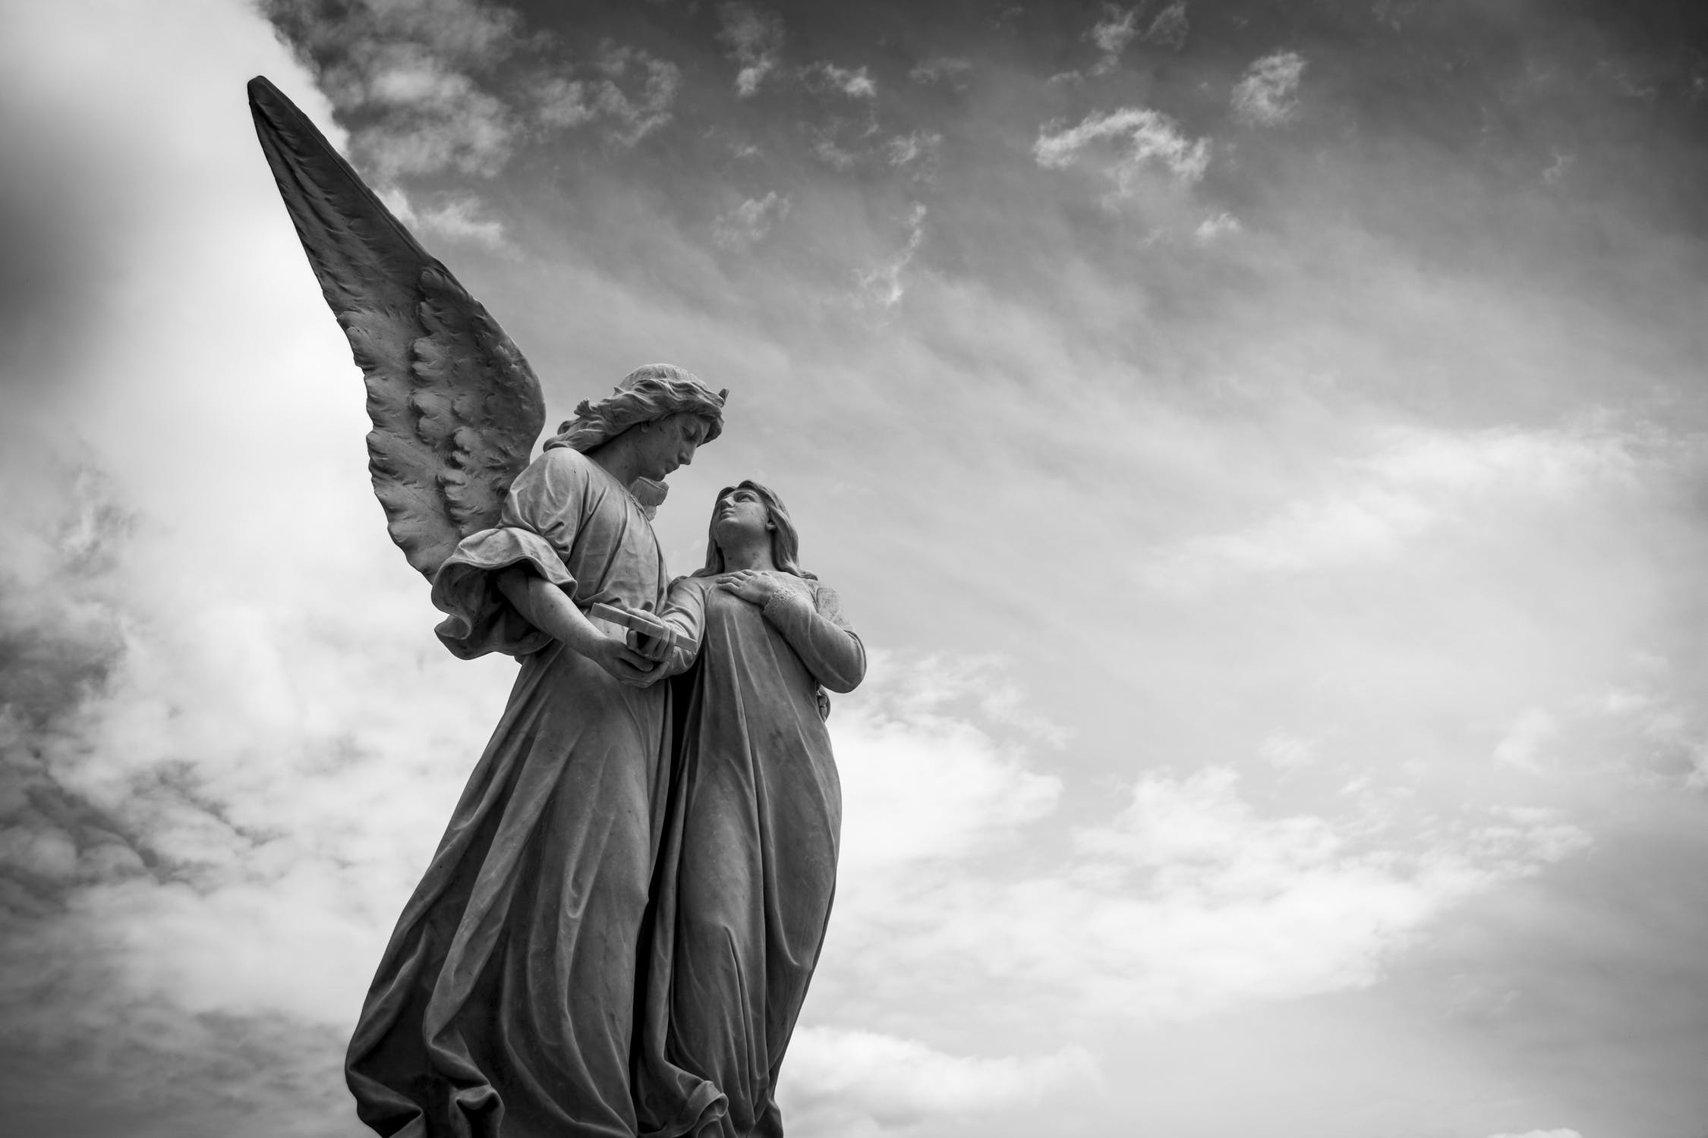
Those who love me,
I will deliver; I will protect those
who know my name. When they call to me,
I will answer them; I will be with them in trouble, I will rescue them
and honour them. With long life
I will satisfy them, and show them my salvation.
(Psalm 91)

Slide 2
Listen to the lyrics of this song.
As you listen, think about a situation you need God’s help in.
Pray for others who feel as though they need rescuing.
https://www.youtube.com/watch?v=9PugD11k3JU

