Slide 2
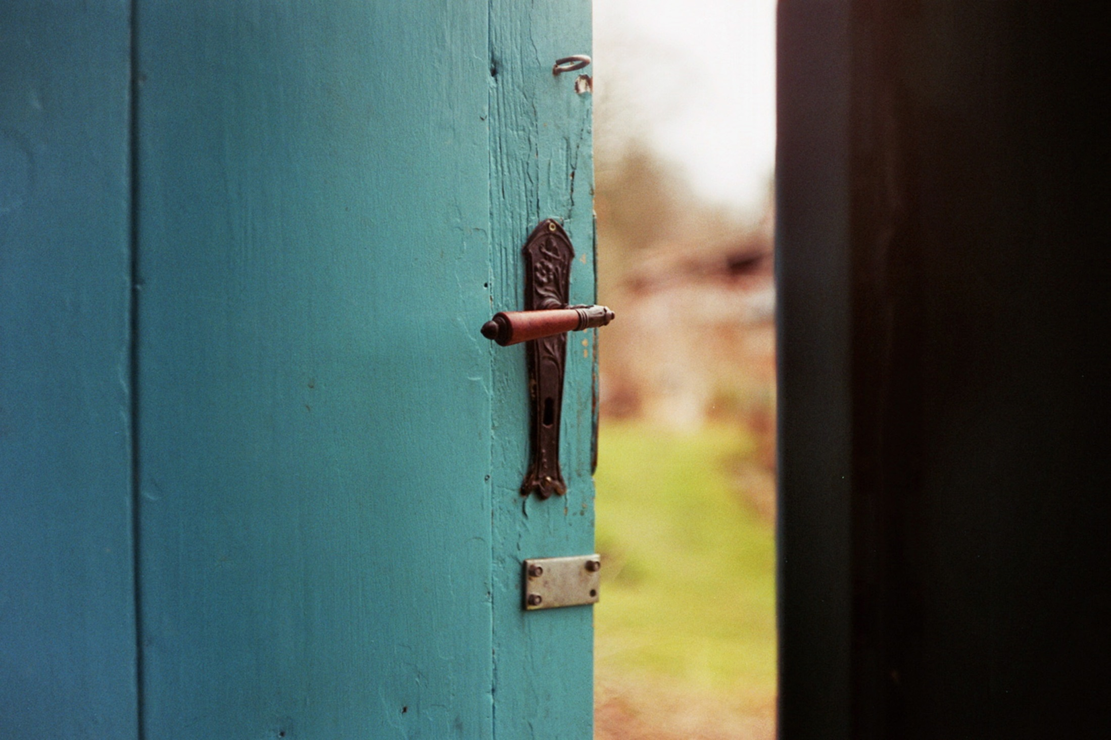
What would it look like if we treated everyone we meet as an angel, one of God’s own messengers?
How can you show hospitality to a stranger this week?

Slide 3
Father in Heaven,
We thank you that you are always there to lead, protect and guide us.
Help us to see all those around us as your beloved creations.
Let us serve one another with love and humility.
Amen

