Slide 1
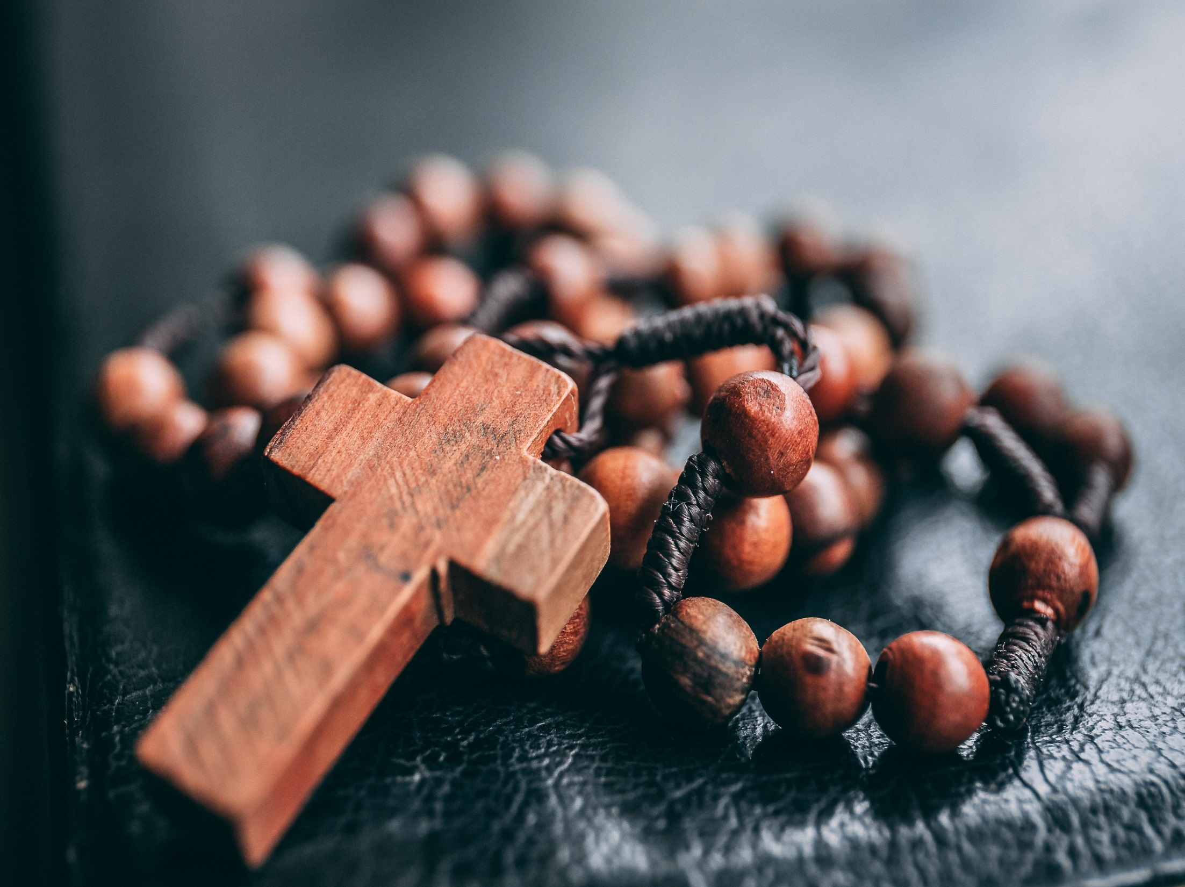
October is
the month of
the rosary

Slide 2
The message Our Lady of Fatima
"I am the Lady of the Rosary. People must say the Rosary. Let them continue saying it every day”.

Slide 3
The prayer was formed in the 12th century. The first person to spread the rosary around was Saint Dominic.

Slide 4
The word ‘rosary’ means crown of roses. We say this prayer to honour Our Lady and to ask her to lead us closer to Jesus.

Slide 5
Let us pray together:
O Lord, awake in our hearts desire to pray the Rosary just as Mary would have wanted us to.

