Slide 1
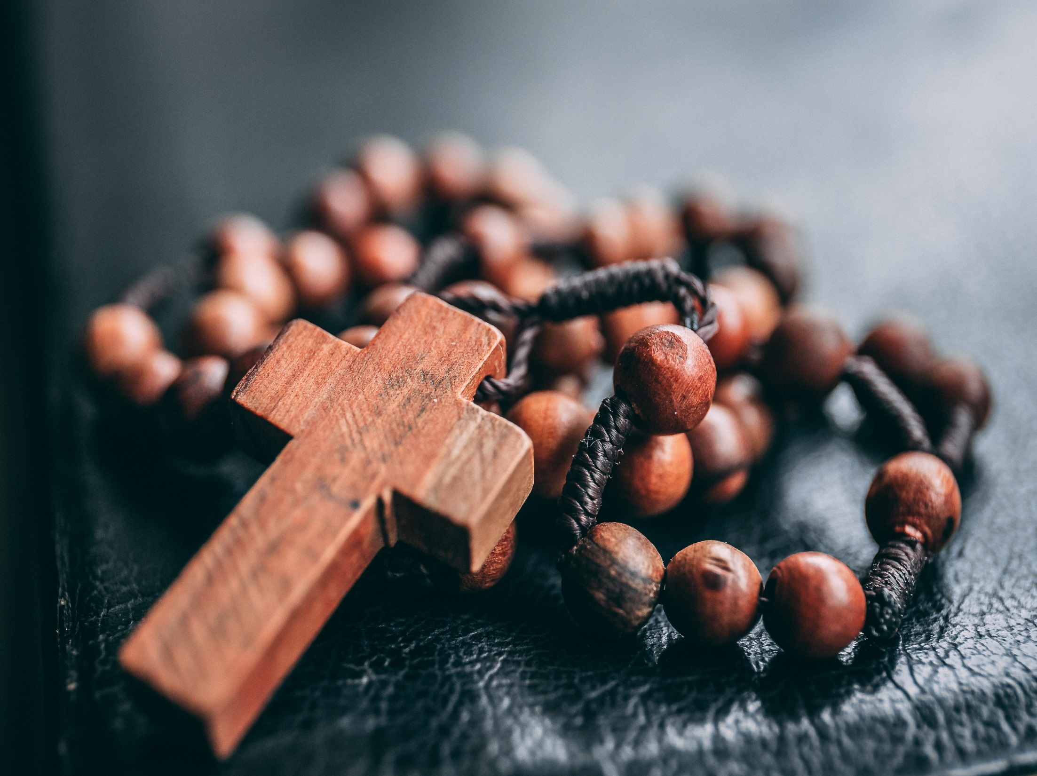
October is
the month of
the rosary

Slide 2
The Rosary is a meditation on the life of Jesus.

Slide 3
Each ‘mystery’ of the rosary is focussed on an event from the Gospel.
As we say the prayers of each ‘decade’ we reflect on this event.
Joyful
The Visitation
The Birth of Jesus
The Presentation
Finding Jesus in the temple
Luminous
Baptism of Jesus
Wedding Feast of Cana
Proclamation of the Kingdom
The Transfiguration
Institution of the Eucharist
Sorrowful
The Agony in the Garden
Scouring at the Pillar
Crowning with Thorns
Carrying of the Cross
The Crucifixion
Glorious
The Resurrection
The Ascension
Descent of Holy Spirit
The Assumption
The Coronation
The Annunciation

Slide 4
With the Rosary we meditate on the mysteries of JOY, of SORROW and of the GLORY of Jesus and Mary.

Slide 5
O Lord, we give you thanks for the rosary, your gift, let this prayer assist us every day of our life. Amen.

