Slide 1
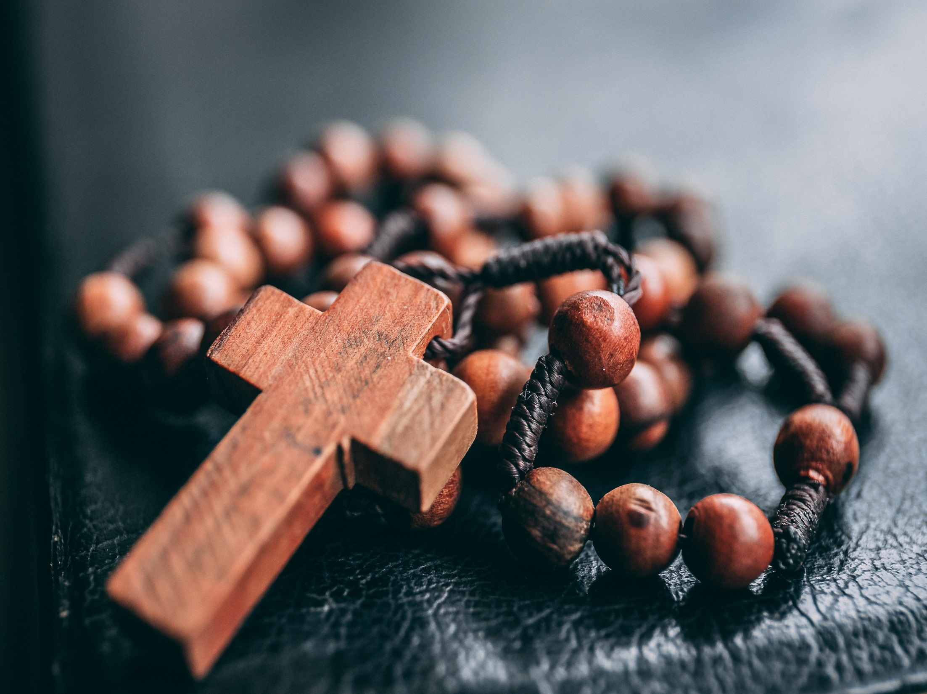
October is
the month of
the rosary

Slide 2
Jesus gave us His own mother.
‘Here is your Mother’
(John 19:27)

Slide 3
The rosary is a heart-felt prayer to a person who loves each one of us just as a mother loves.

Slide 4
The rosary is a repetitive prayer but is a meditation where we can think about the love of Mary for each one of us. By praying the rosary, Mary says to us
“I love you”.

Slide 5
Will you pray the rosary this month?

