Slide 1
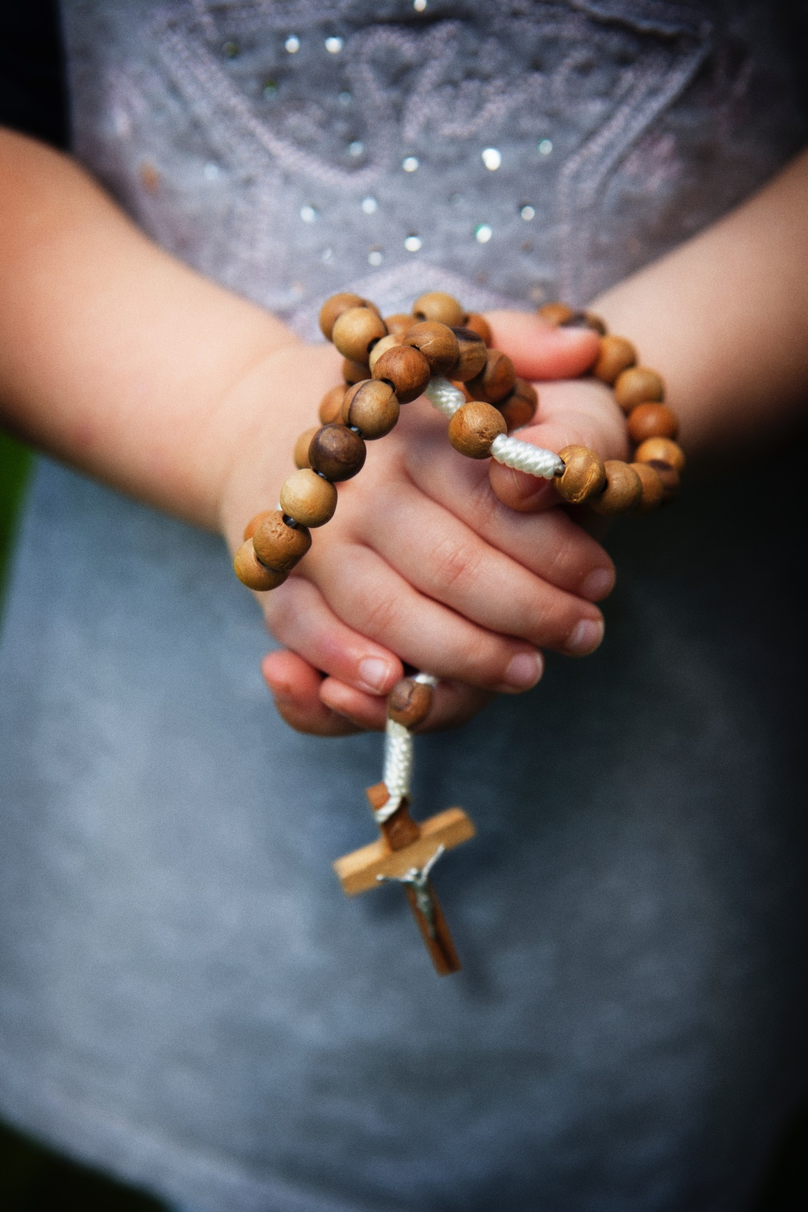
Let’s pray a decade of the Rosary together.

Slide 2
Pray One Our Father:
Our Father, Who art in heaven, Hallowed be Thy Name. Thy Kingdom come. Thy Will be done, on earth as it is in Heaven.
Give us this day our daily bread. And forgive us our trespasses, as we forgive those who trespass against us. And lead us not into temptation, but deliver us from evil. Amen.

Slide 3
Pray Ten Hail Mary’s:
(you could choose 10 volunteers to lead one each)
Hail Mary full of Grace, the Lord is with thee. Blessed are thou among women and blessed is the fruit of thy womb Jesus. Holy Mary Mother of God, pray for us sinners now and at the hour of our death Amen.

Slide 4
Pray One Glory Be:
Glory be to the Father, and to the Son and to the Holy Spirit.
As it was in the beginning, is now, and ever shall be, world without end.
Amen.

