Slide 1
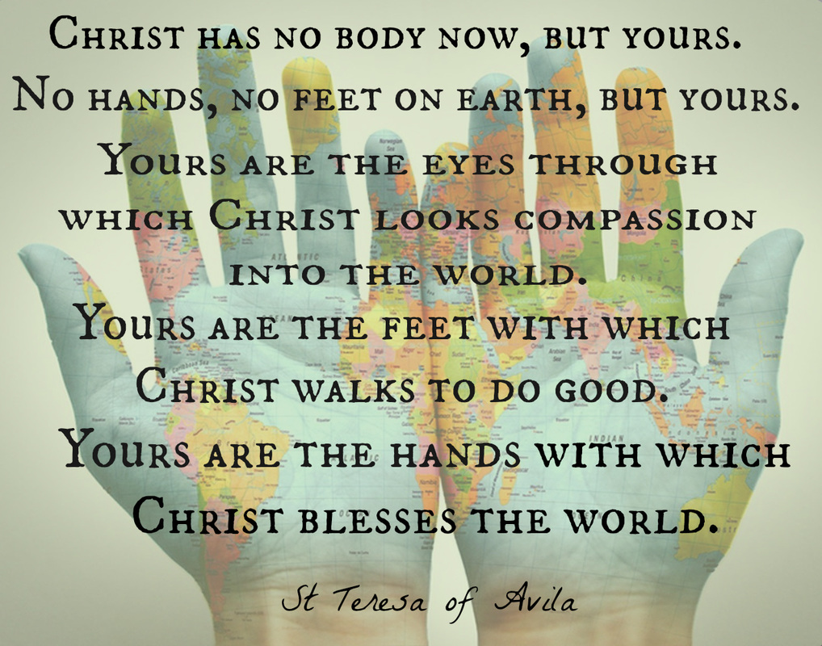

Slide 2
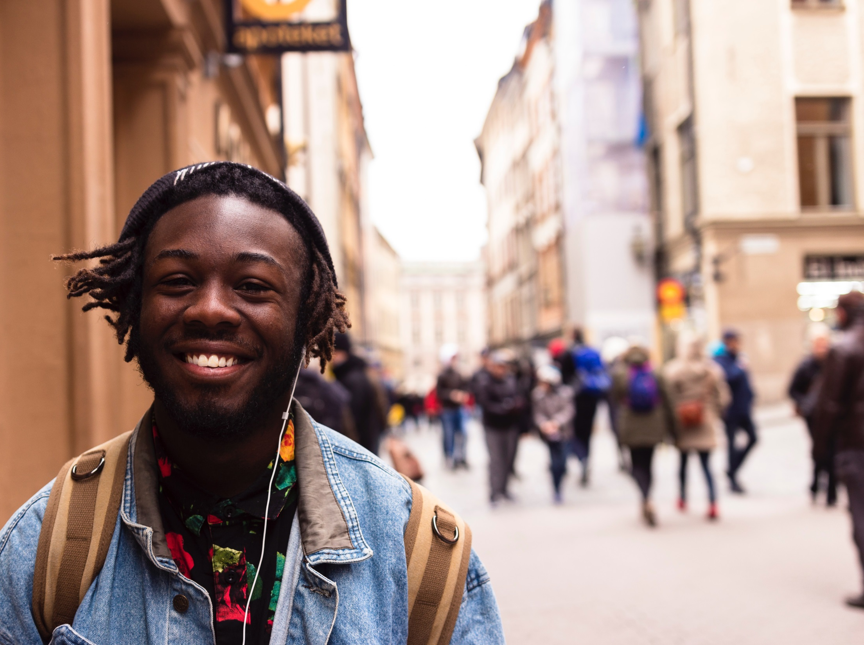
Christ has
no body now
but yours.
No hands, no feet on Earth, but yours…

Slide 3
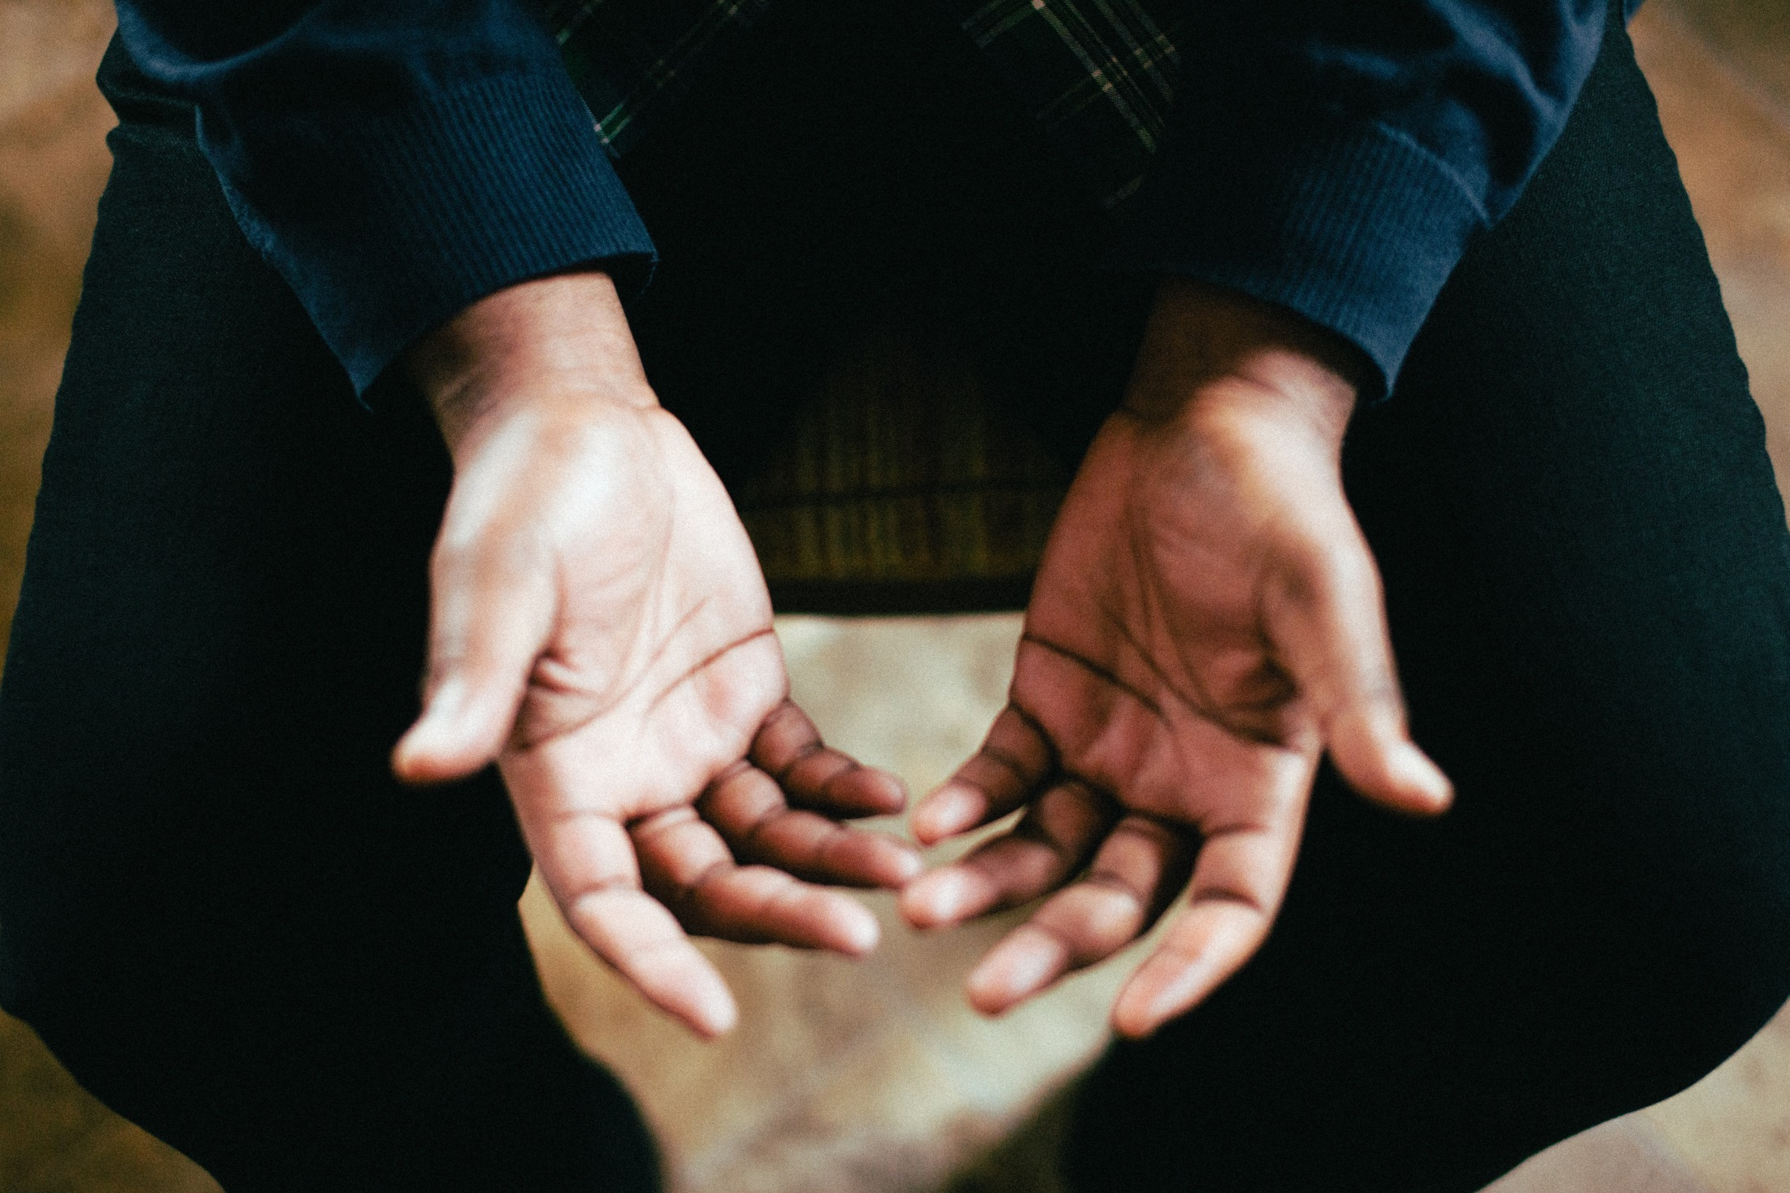
How are you going to be Christ’s hands to the world today?

Slide 4
Let us pray together…
Lord Jesus, through the experience of your caring love, help us to be compassionate for others.
Amen

