Slide 1
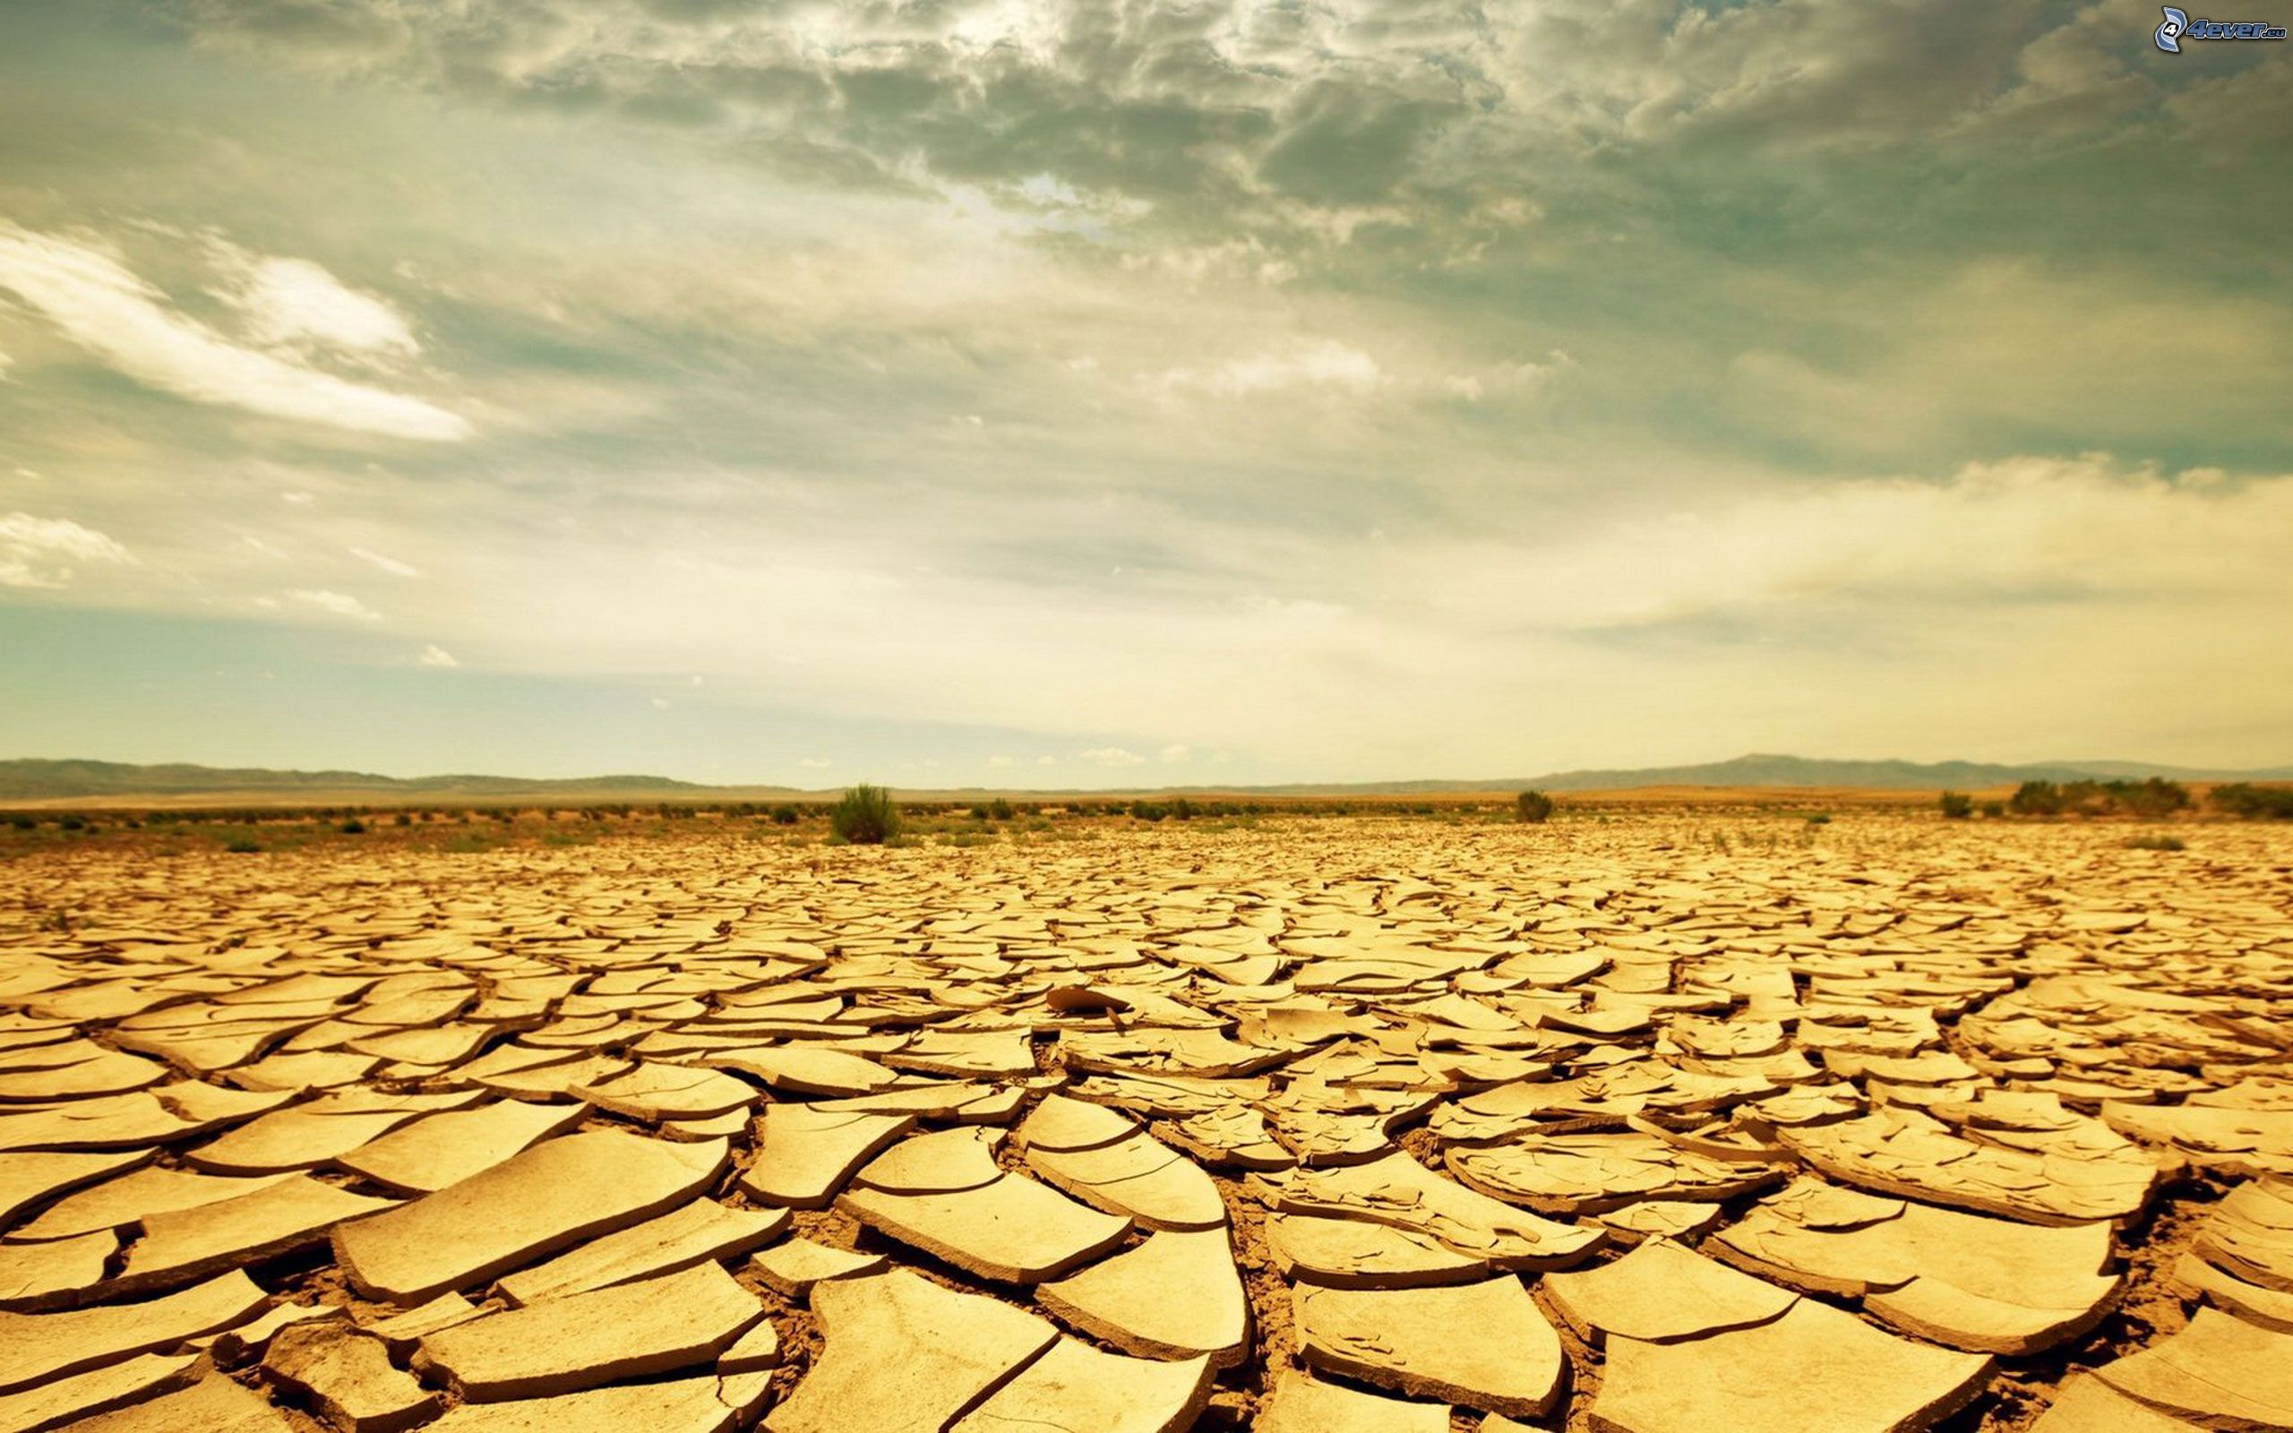
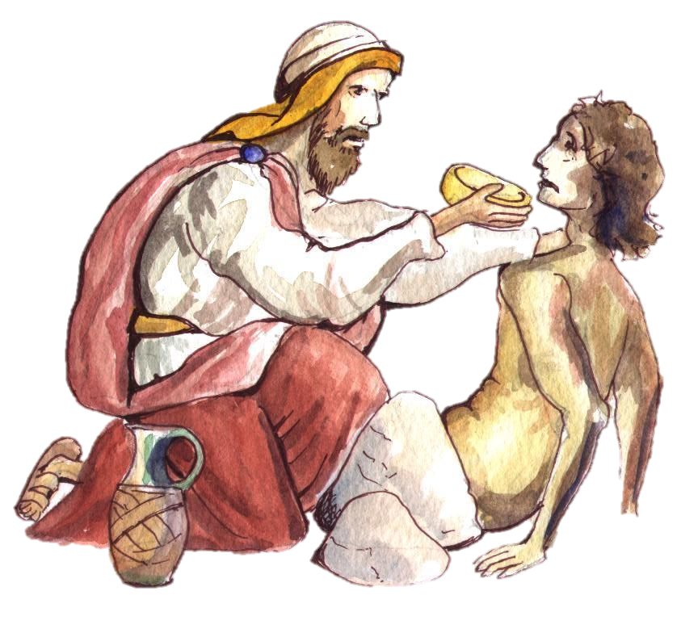
The Good Samaritan

Slide 2
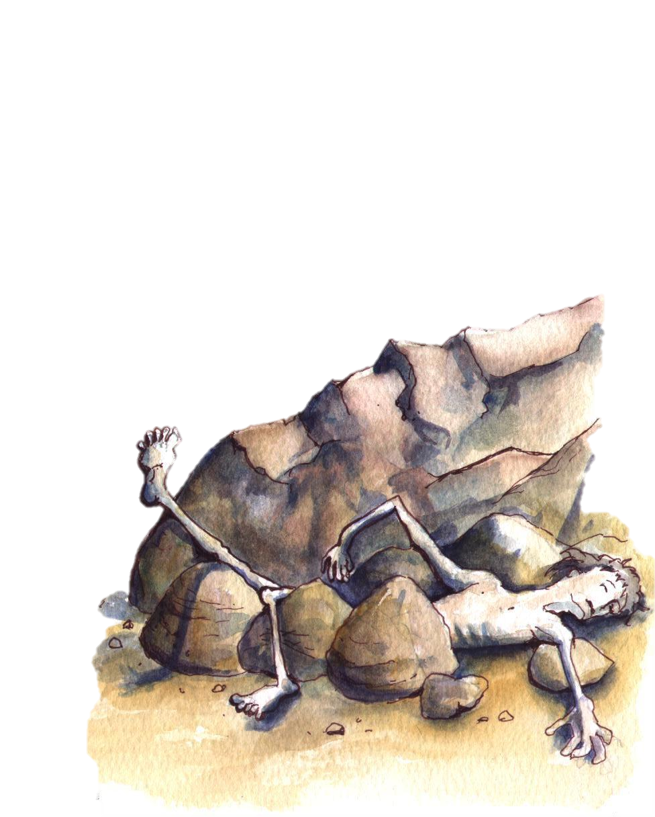
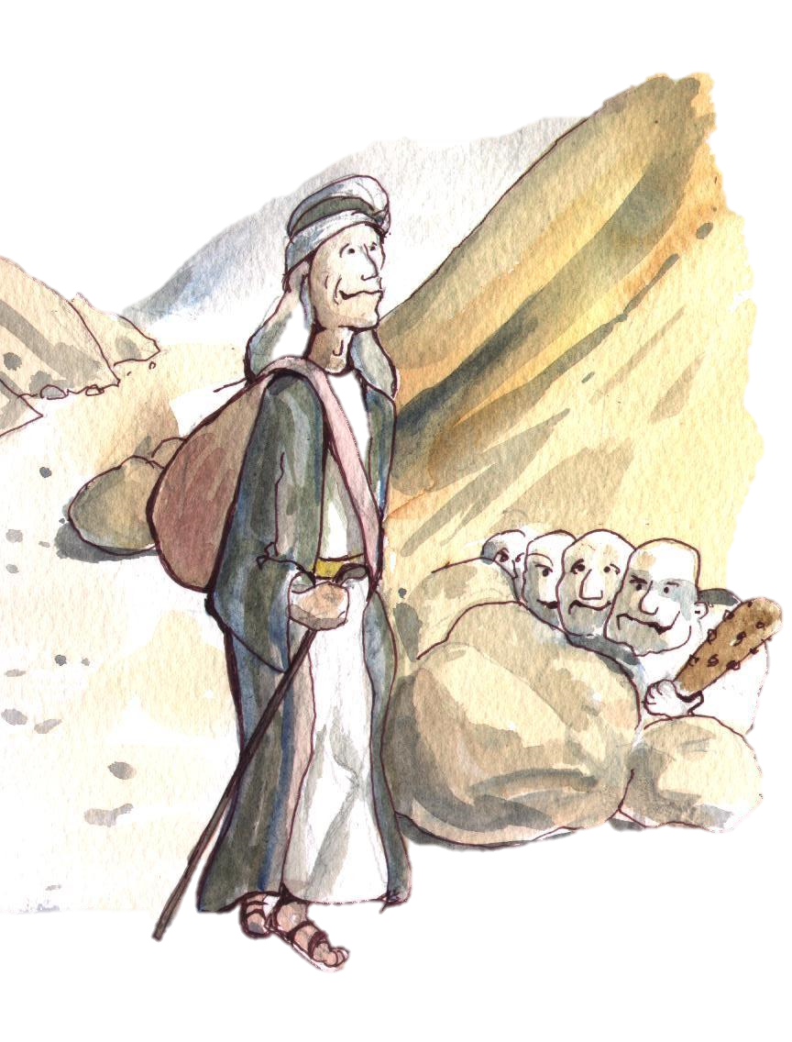
“A man was once on his way down from Jerusalem to Jericho and fell into the hands of bandits;
They stripped him, beat him and then made off, leaving him half dead…”

Slide 3
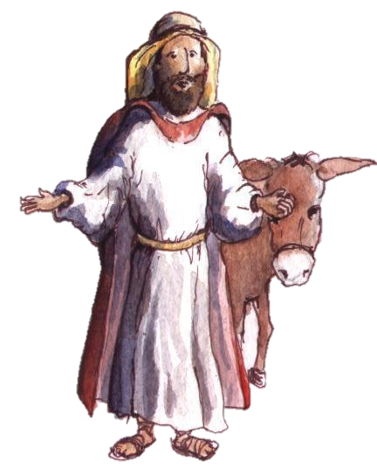
“…A Samaritan traveller who came on him was moved with compassion when he saw him…”

Slide 4
We have all had times in our life where we can find ourselves in the position of this man who fell into the hands of the bandits.

Slide 5
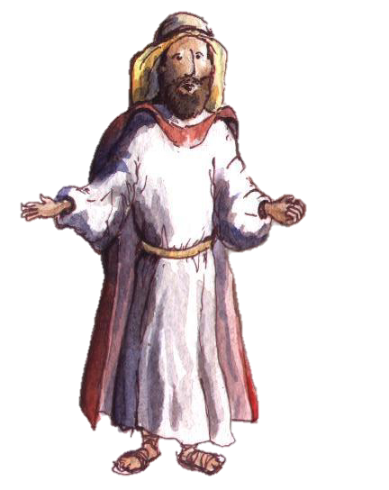
But when we walk our journey with Jesus he walks by our side every step of the way.
He will always be with us.

Slide 6
Lord Jesus, the Good Samaritan, thank you for your compassionate presence in our life.
Help us to open our hearts for you great love.
Amen

