Slide 1
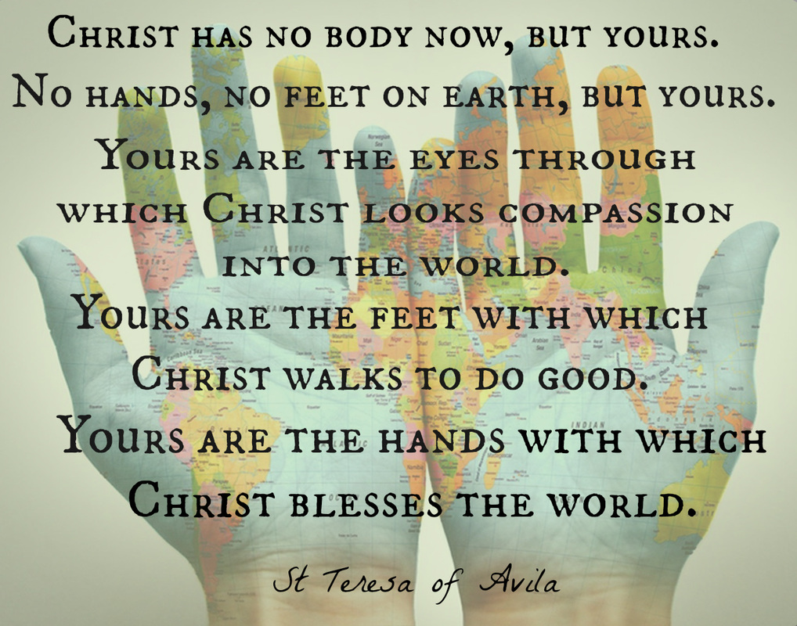

Slide 2
Yours are the feet with which Christ walks to do good.

Slide 3
Where is Christ leading you?
What good is He asking you to do in the world?

Slide 4
Let us pray together:
Lord Jesus, thank you for you unending love, which you lavish upon us at all times. Support to love our neighbours more than it is necessary. Amen

