Slide 1
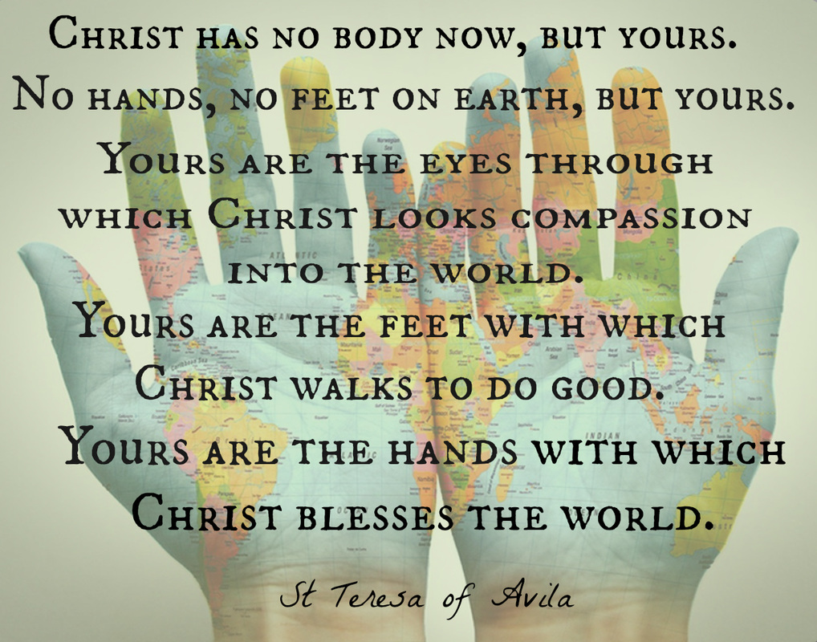

Slide 2
Yours are the eyes through which Christ looks compassion into the world.

Slide 4
Has there ever been a situation in your life where you have been quick to judge?
How can you have more compassion and patience today?

