Slide 1
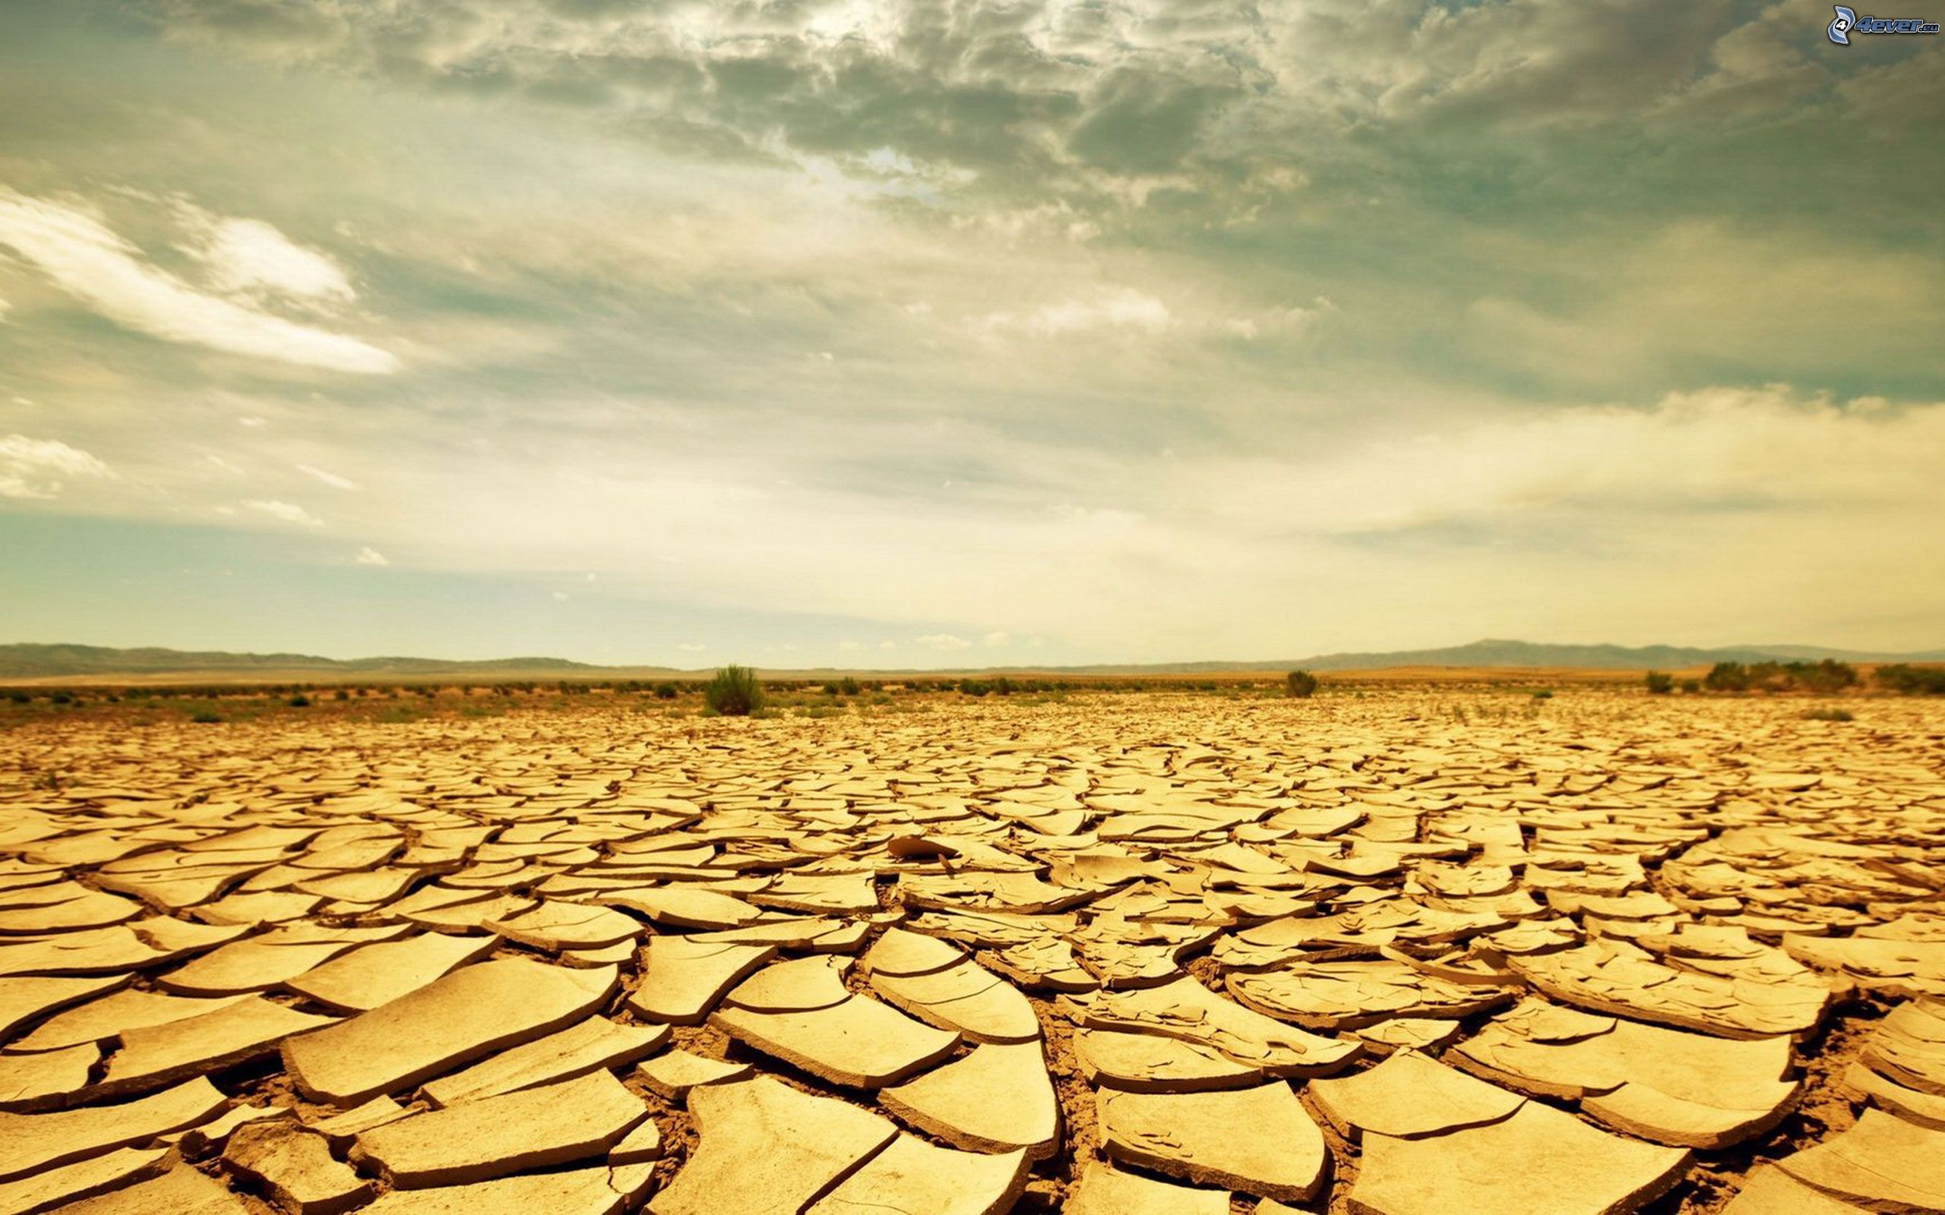
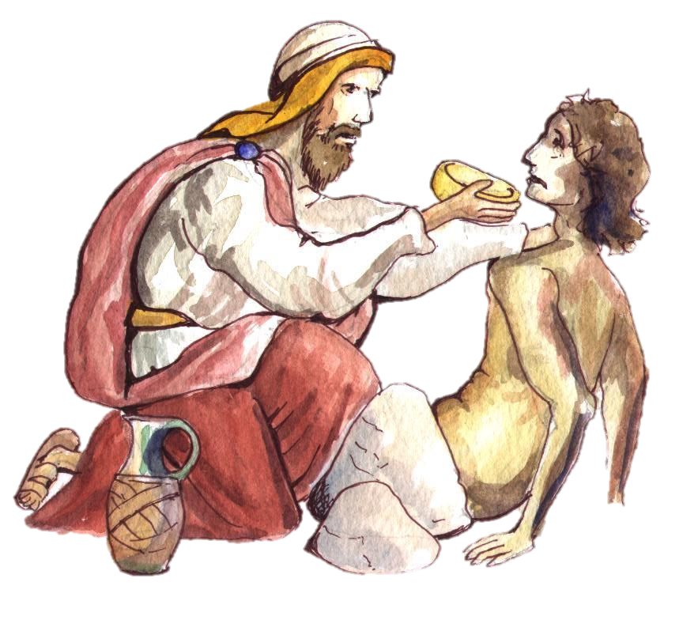
The Good Samaritan

Slide 2
Once we have experienced the compassion of Jesus, then we can be a good Samaritan for others.

Slide 3
We have all walked passed someone, but inside we all know the help that they need.

Slide 4
“We love because he first loved us”. (1 John 4:19)
Our answer is to love others.
“Anyone who loves God must also love their brother and sister”. (1 John 4:21)

Slide 5
Lord God, teach us how to love You in our brothers and sisters, so that we can share the love which we have received from You.
Through Christ our Lord.
Amen.

