Slide 1
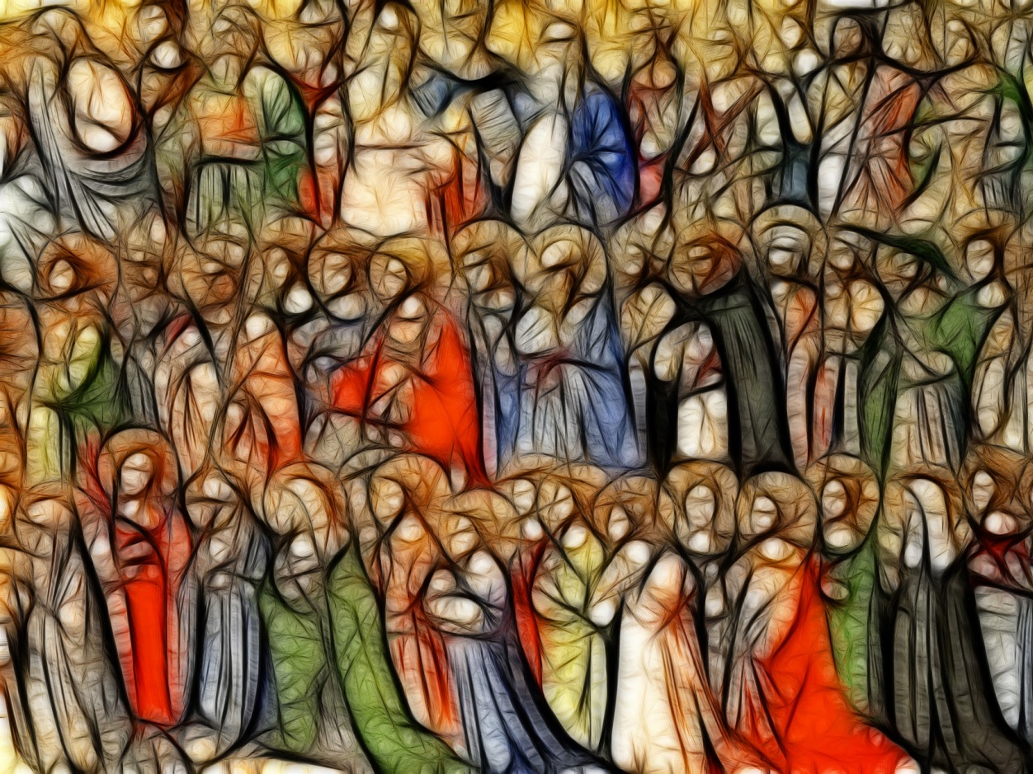
All Saints’

Slide 2
Therefore, since we are surrounded by such a great cloud of witnesses, we must get rid of every weight and the sin that clings so closely, and run with endurance the race set out for us, keeping our eyes fixed on Jesus, the pioneer and perfector of our faith.
(Hebrews 12:1-2)

Slide 3
‘Such a great cloud of witnesses’
The Saints are the heroes of faith. They are those who have gone before us and are now in Heaven.
Their lives can give us some insight into how to live for God.

Slide 4
On Friday the Catholic Church will celebrate the feast of All Saints.
But what is a Saint?

