Slide 1
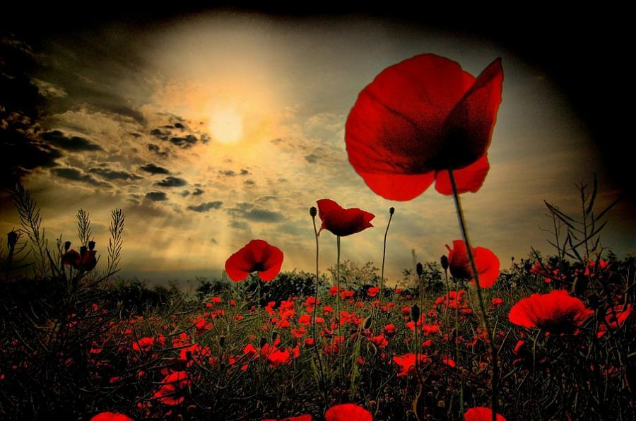
LEST WE FORGET

Slide 2
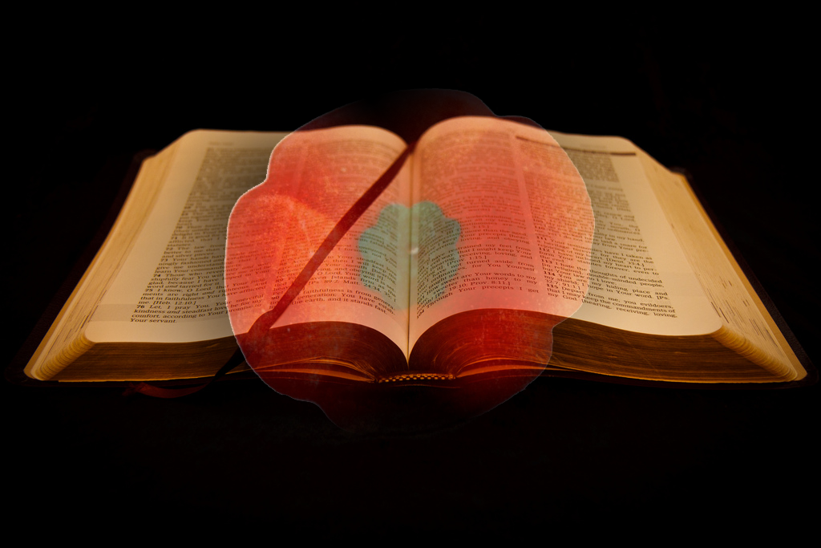
Love each other as I have loved you. Greater love has no one than this: to lay down one’s life for one’s friends. You are my friends if you do what I command.
John 15 13-14

Slide 3
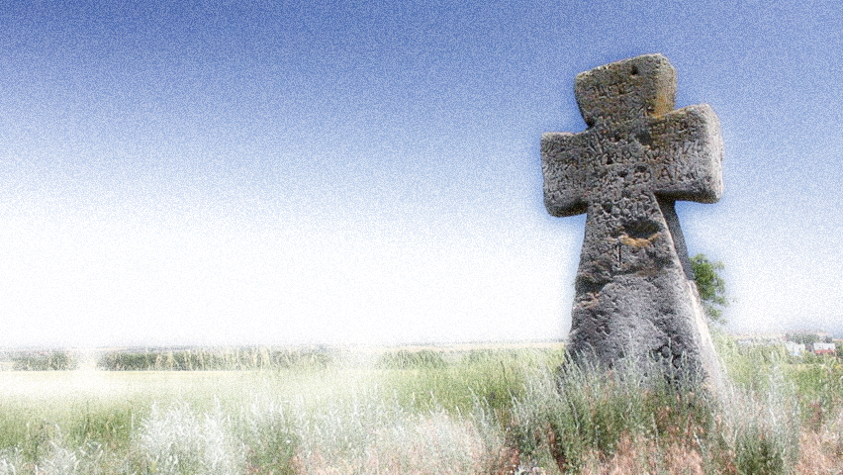
November is a month where we remember all those who we have lost.
However, November is also a time were we remember those who have given up their lives so that we might live.

Slide 4
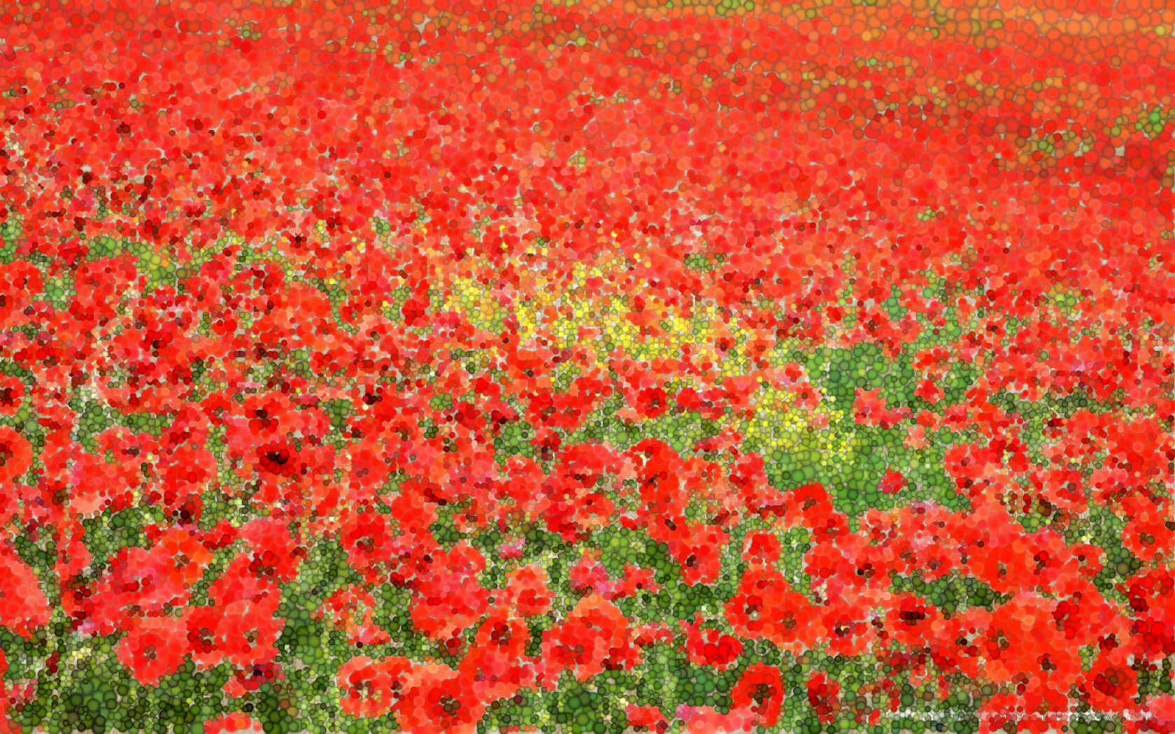
Almighty and eternal God, from whose love in Christ we cannot be parted, either by death or life: hear our prayers and thanksgivings for all whom we remember; fulfil in them the purpose of your love; and bring us all, with them, to your eternal joy;
We ask this through Jesus Christ our Lord.
Amen.

