Slide 1
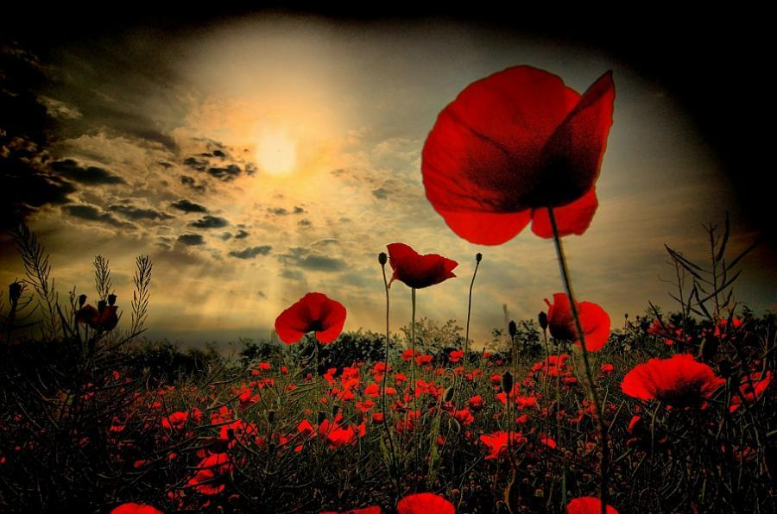
LEST WE FORGET

Slide 2
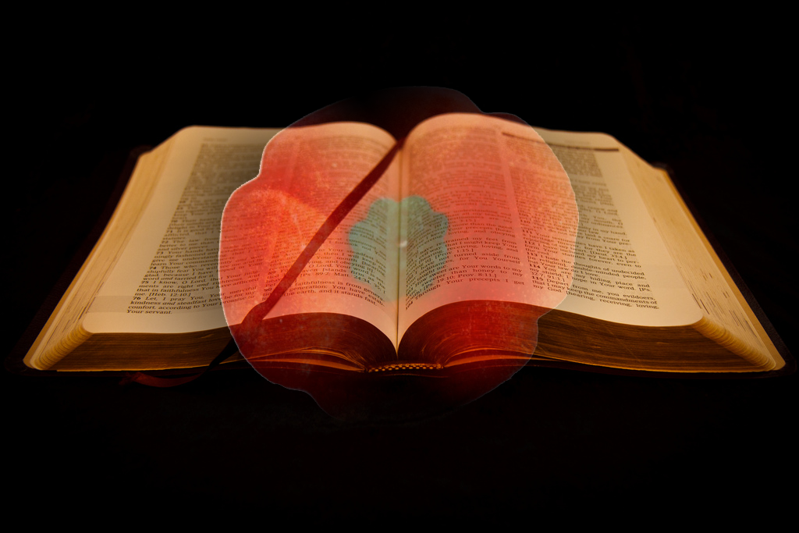
Love each other as I have loved you. Greater love has no one than this: to lay down one’s life for one’s friends. You are my friends if you do what I command.
John 15 13-14

Slide 3
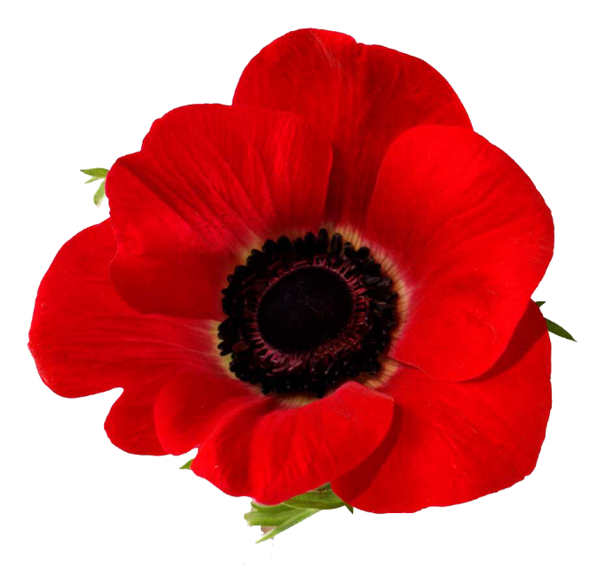
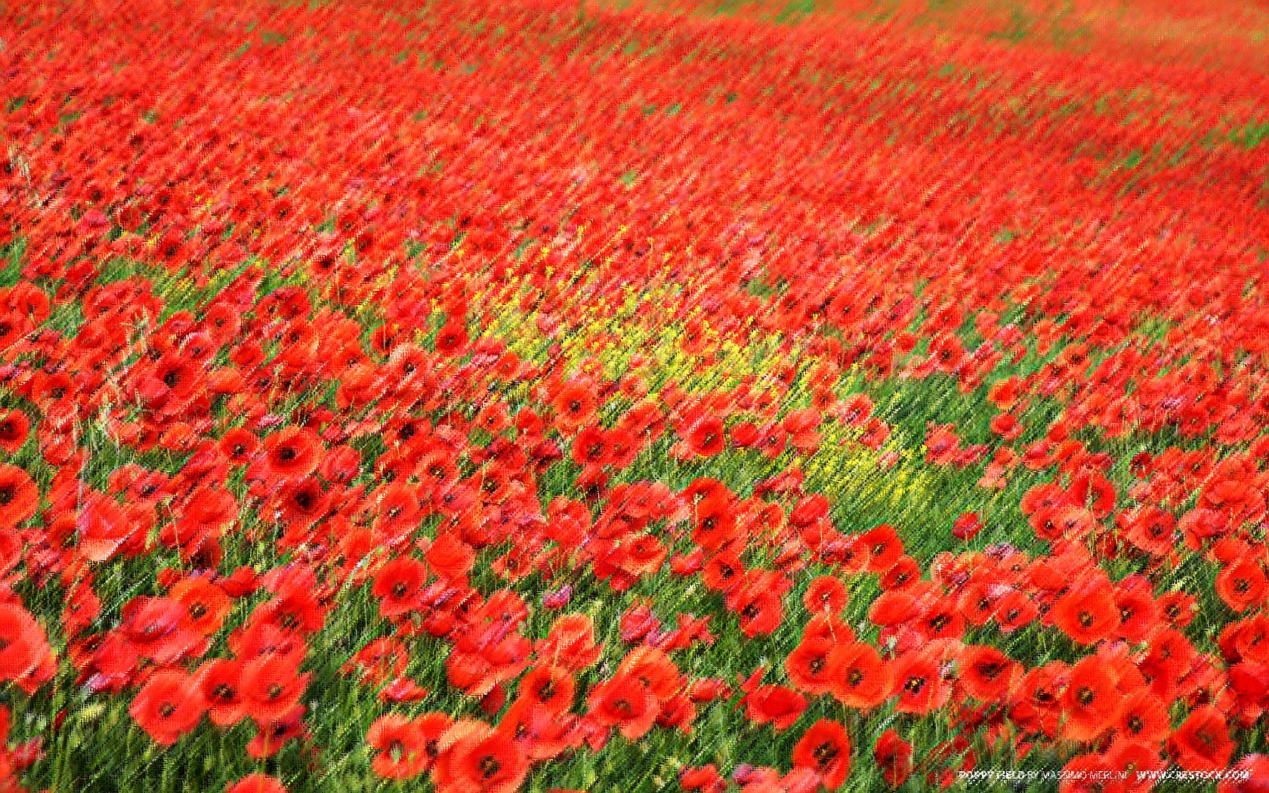
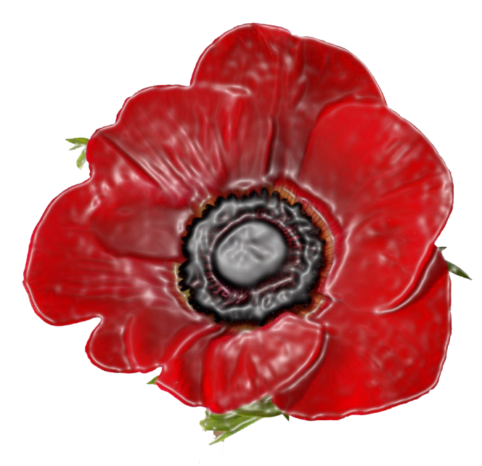
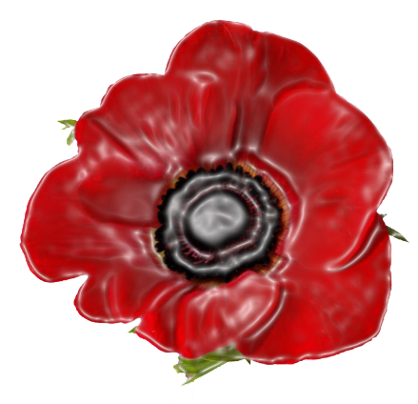
Why the POPPY?
The remembrance POPPY was inspired by the World War I poem "In Flanders Fields". Its opening lines refer to the many poppies that were the first flowers to grow in the churned-up earth of soldiers' graves in Flanders, a region of Belgium.
Why do we wear a POPPY?
Poppies are used to remember those who have given their lives in battle. They are the first flowers that grew on the battlefields after World War One ended.

Slide 4
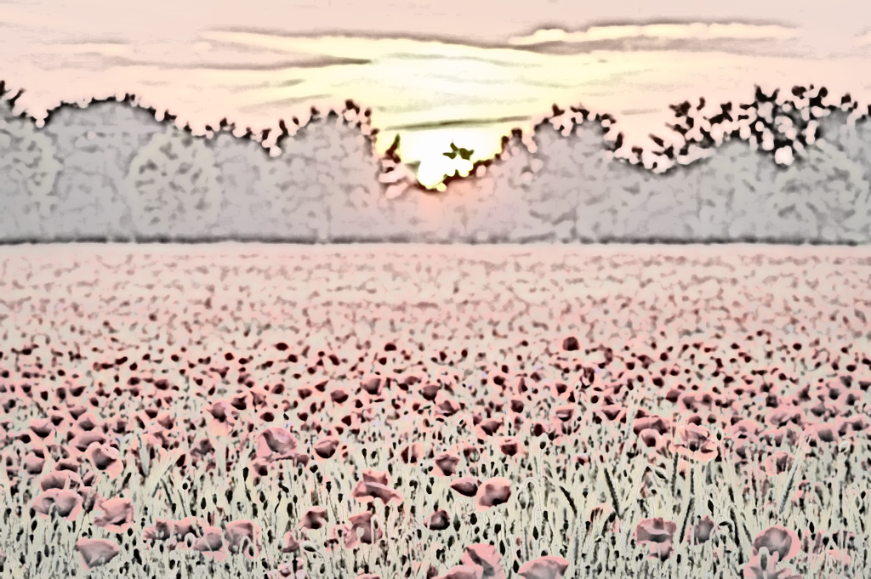
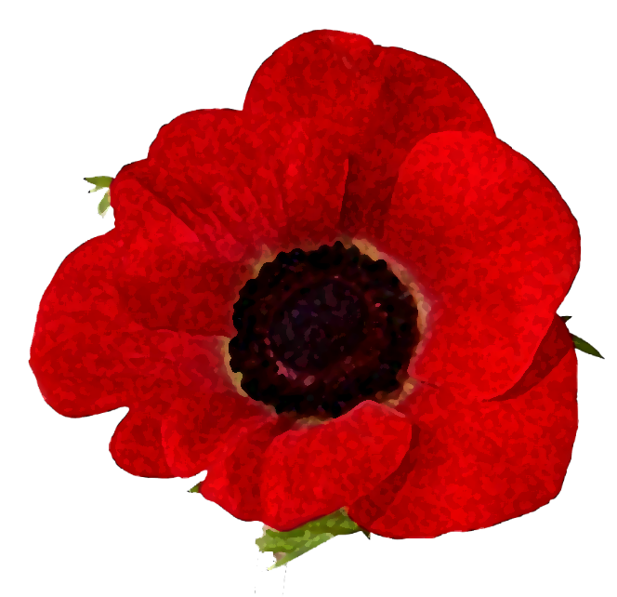
In Flanders fields the poppies blow
Between the crosses, row on row,
That mark our place; and in the sky
The larks, still bravely singing, fly
Scarce heard amid the guns below.
John McCrae

