Slide 1
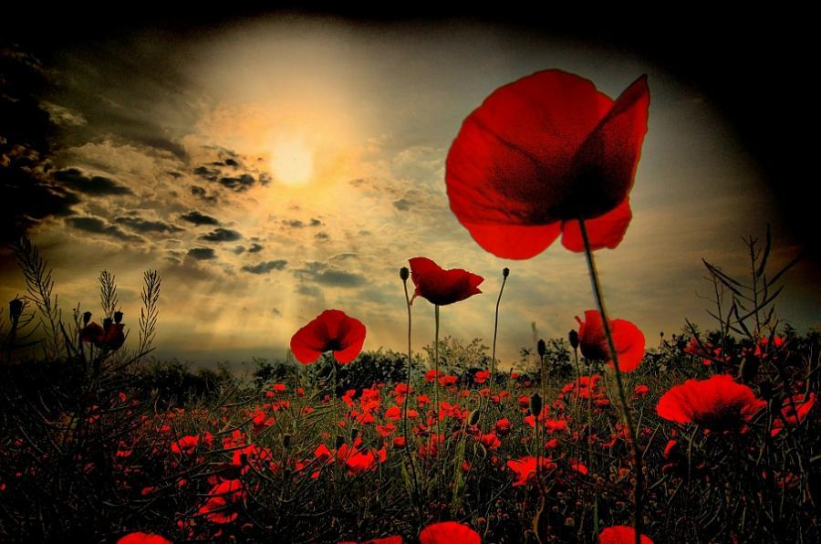
LEST WE FORGET

Slide 2
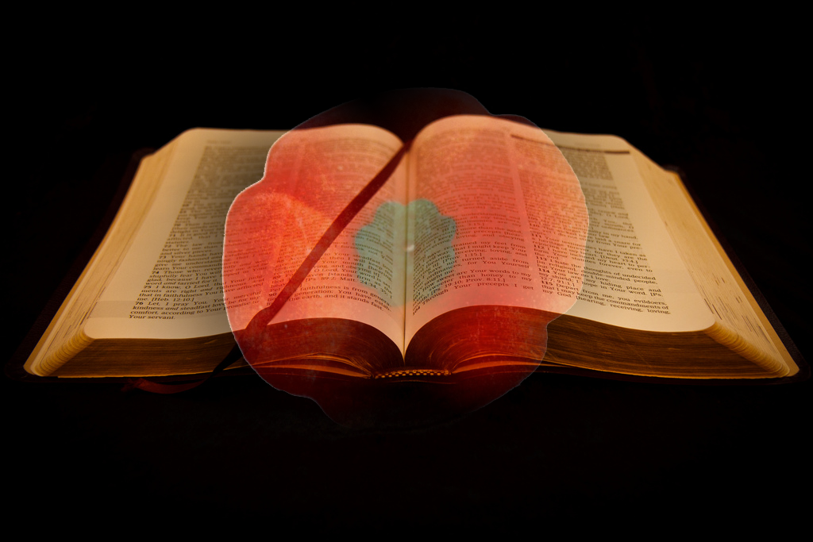
Love each other as I have loved you. Greater love has no one than this: to lay down one’s life for one’s friends. You are my friends if you do what I command.
John 15 13-14

Slide 3
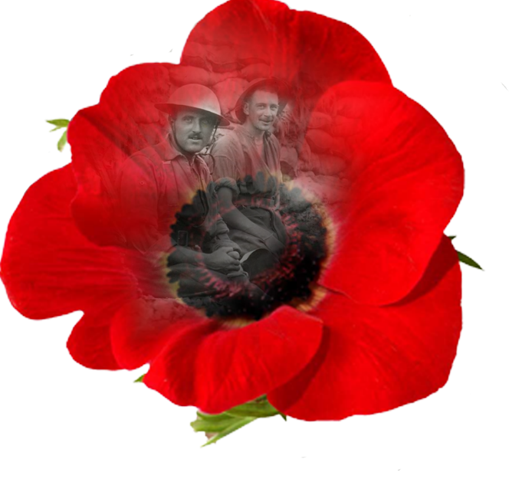
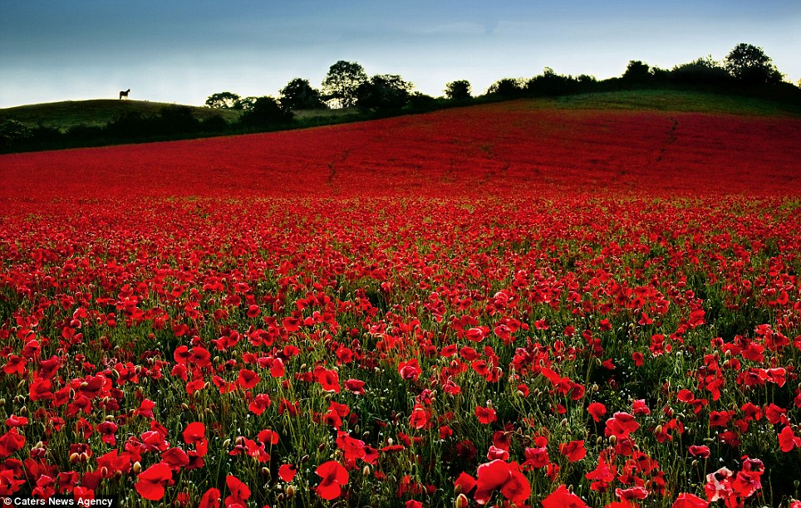
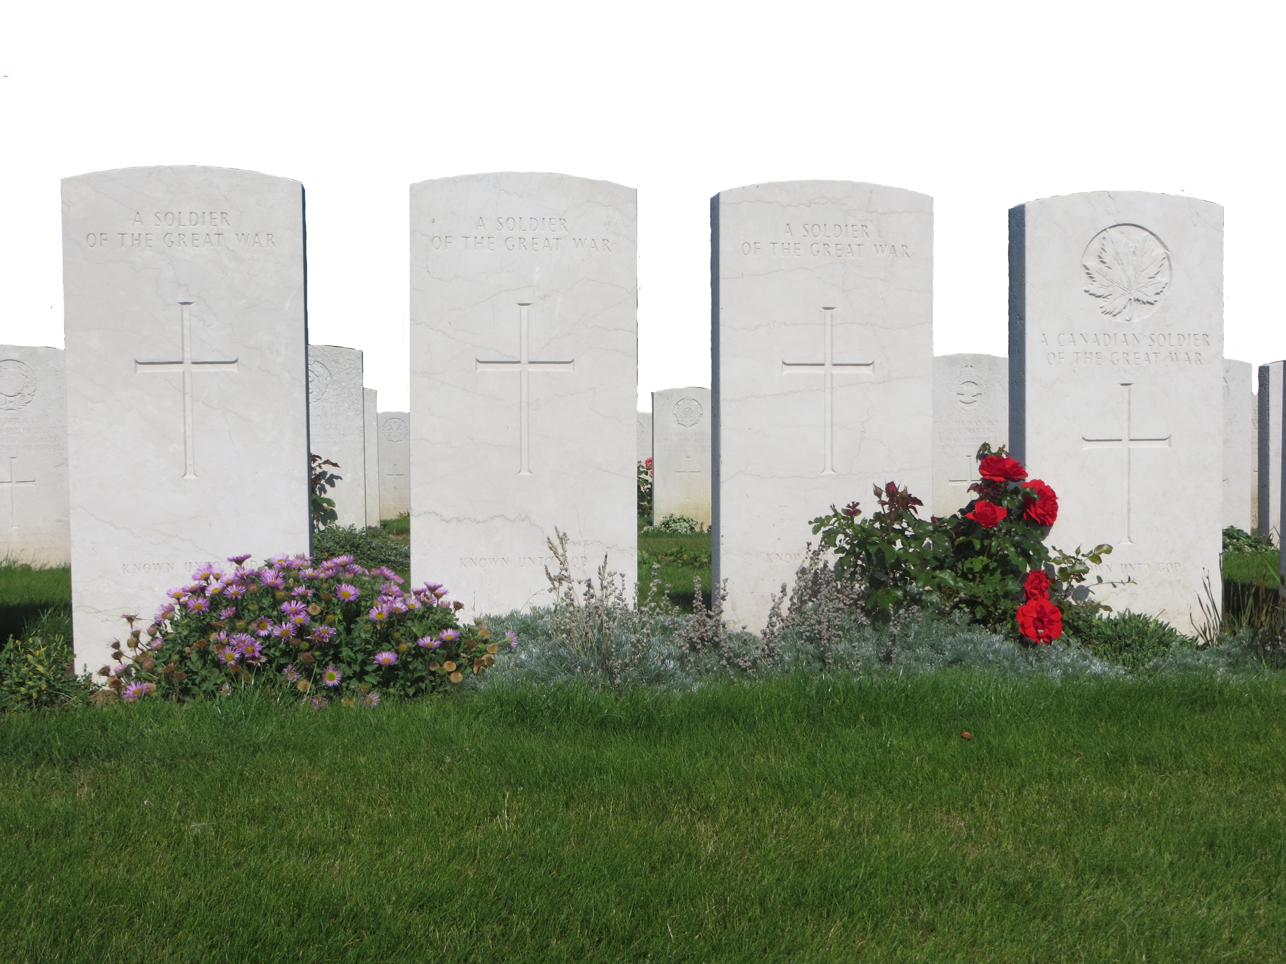
The Commonwealth War Graves Commission honours the 1.7 million men and women of the Commonwealth forces who died in the First and Second World Wars, and ensures they will never be forgotten.
Our work commemorates the war dead, from building and maintaining our cemeteries and memorials at 23,000 locations in more than 150 countries to preservation of our extensive records and archives.

Slide 4
Let us remember before God, and commend to his sure keeping, those who have died for their country in war and peace; those whom we knew, and those whose memory we treasure, and all who lived and died in the service of their country and mankind.

