Slide 1
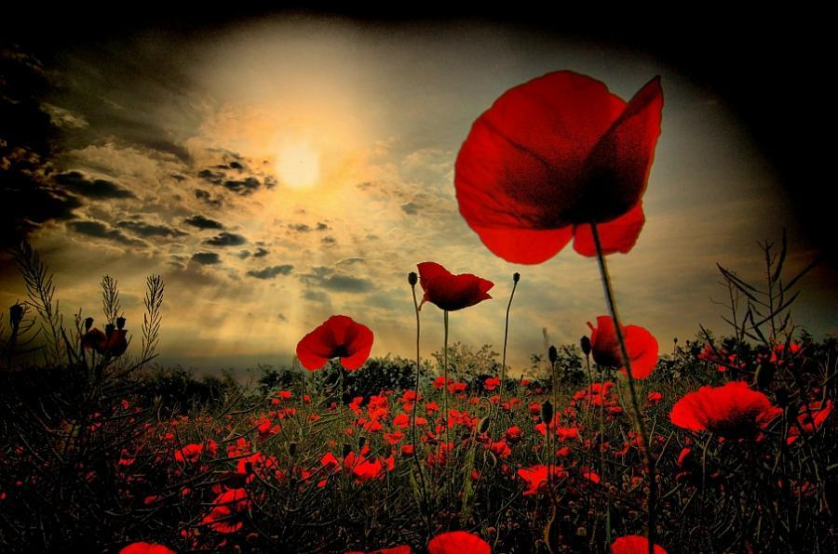
LEST WE FORGET

Slide 2
Love each other as I have loved you. Greater love has no one than this: to lay down one’s life for one’s friends. You are my friends if you do what I command.
John 15 13-14

Slide 3
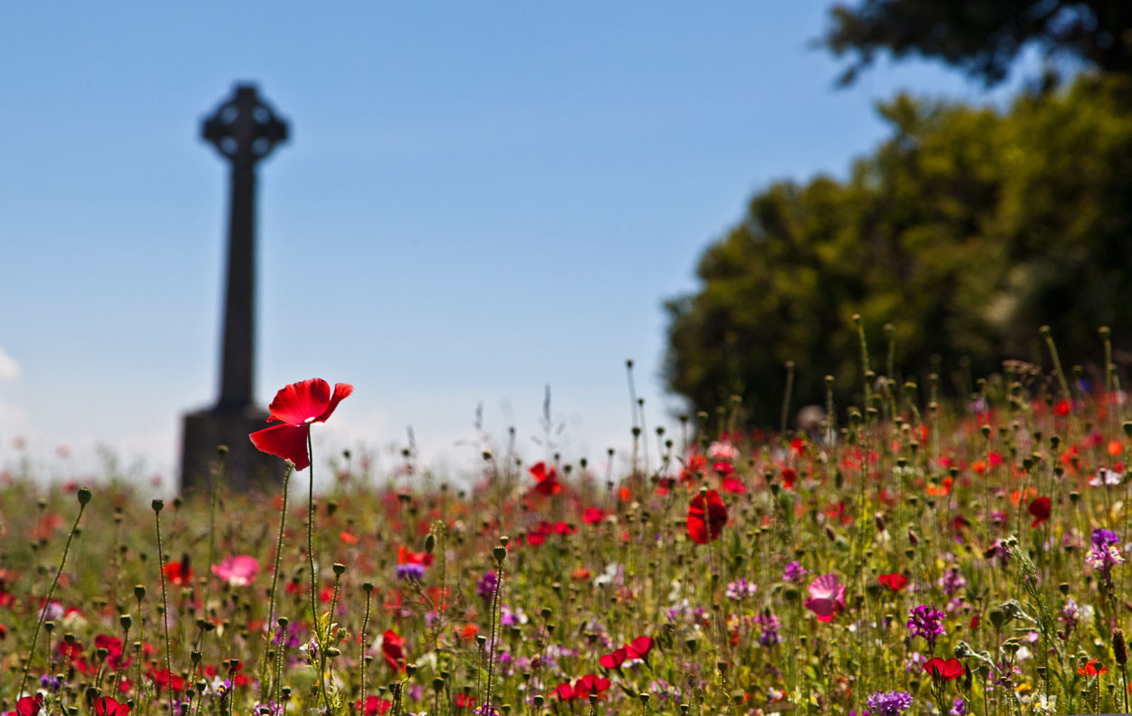
This Sunday memorials around the country will be adorned by poppies. A sea of red.
As we remember let us take a few moments to remember those who we know we have lost.

Slide 4
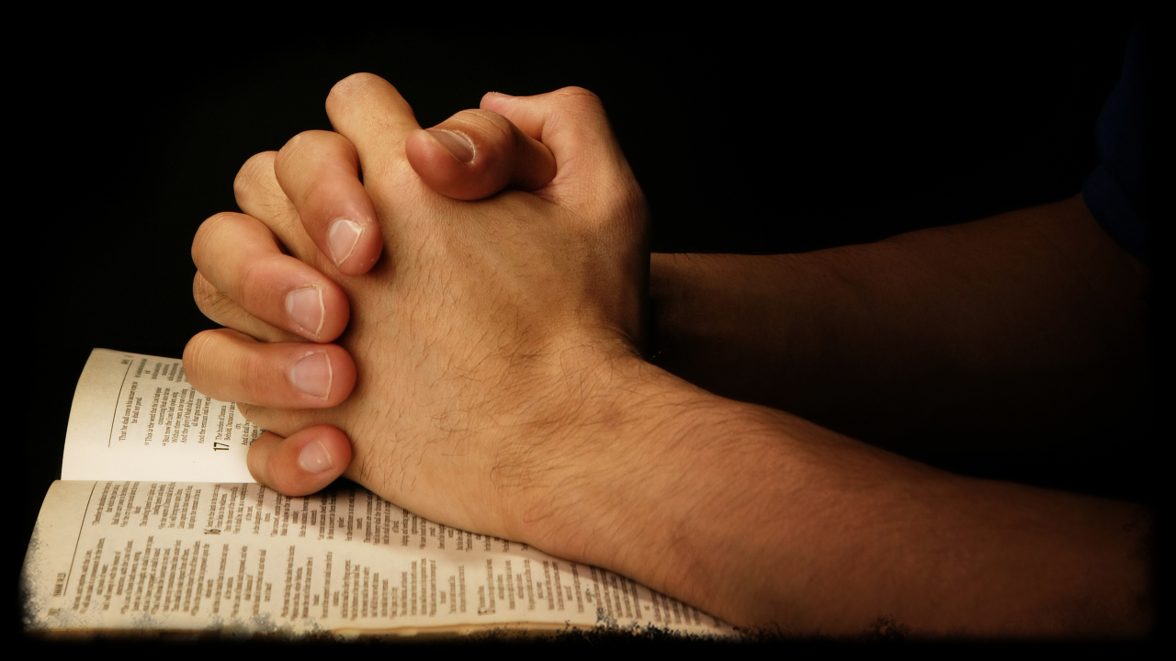
Lord God, you are attentive to the voice
of our pleading.
Let us find in your Son comfort in our sadness, certainty in our doubt, and courage to live
through difficult moments.
Make our faith strong through Christ our Lord.
Amen.

