Slide 1


Slide 2
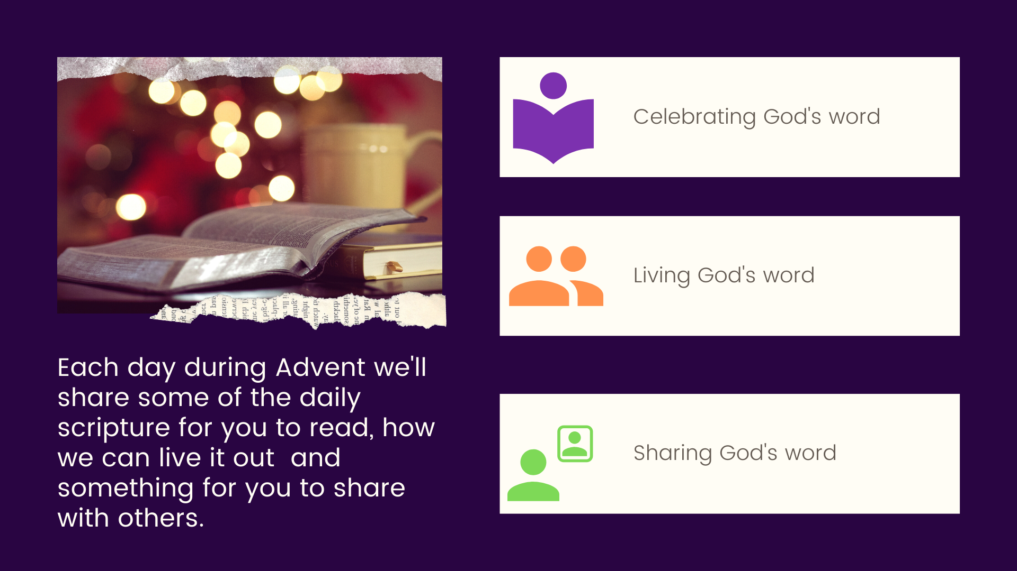

Slide 3

1
2
3
4
5
6
7
8
9
10
11
12
13
14
15
16
17
18
19
20
21
22
23
24
25

Slide 4





Sunday 1st December
The time has come for you to wake up from your sleep…The night is nearly over, day is almost here. Let us conduct ourselves as people who live in the light of day.
(Romans 13:11-13)
What does it mean to live in the light of day?
In what areas of you life to you need
to ‘wake up’ this Advent?
Let There Be Light by Hillsong Worship
https://youtu.be/9ZX4i3Z_ZyM
Back to calendar

Slide 5

Monday 2nd December
O house of Jacob,
come, let us walk
in the light of the Lord!
(Isaiah 2:5)
As we begin Advent, what do our footprints say about us? Are we walking towards Jesus at Christmas?
How can we make our steps deliberate and progressive?
Click here for today’s prayer.
Back to calendar

Slide 6
Monday 2nd December
He looked back at the footprints in the sand. He noticed that many times along the path of His life there was only one set of footprints. He also noticed that it happened at the very lowest and saddest times of His life.
The LORD replied, my precious, precious child, I Love you and I would never leave you! During your times of trial and suffering when you see only one set of footprints, it was then that I carried you.
Back to calendar

Slide 7

Tuesday 3rd December
“Blessed are the eyes that see what you see!” (Luke 10:23)
How have you seen the work of God in your life today?
How has He shown His love for you?
Start to write down all the ways God has shown His love to you. Share some of these with others.
Back to calendar

Slide 8

Wednesday 4th December
Then the Lord God will wipe away the tears from all faces.
(Isaiah 25:8)
What tears do we need the shed before meeting Jesus at Christmas?
What things do we need to offer to the Child Jesus in order to prepare ourselves for this Christmas season?
Run to the Father by Matt Maher
https://youtu.be/UeOtBiQw_B0
Back to calendar

Slide 9
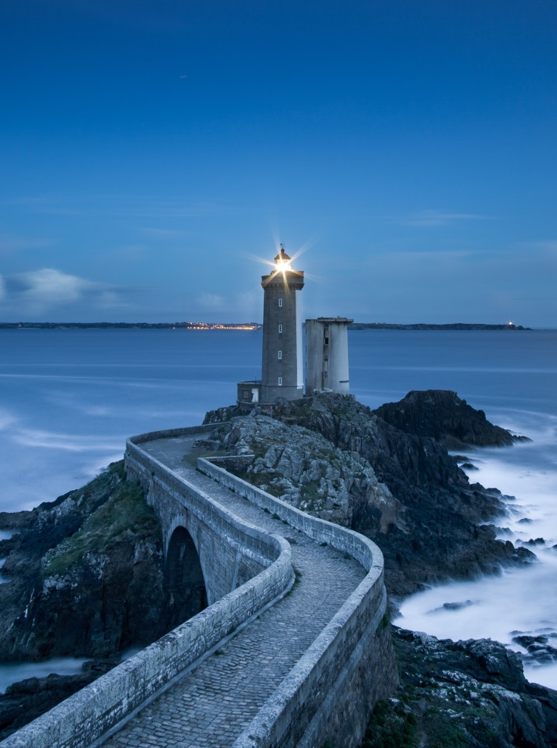
Thursday 5th December
The winds blew and beat on that house, but it did not fall, because it had been founded on rock.
(Matthew 7:25)
What is the foundation of your life?
How can you build a strong foundation on faith in God?
Build My Life by Housefires
https://youtu.be/QZW4_8_zCBE
Back to calendar

Slide 10
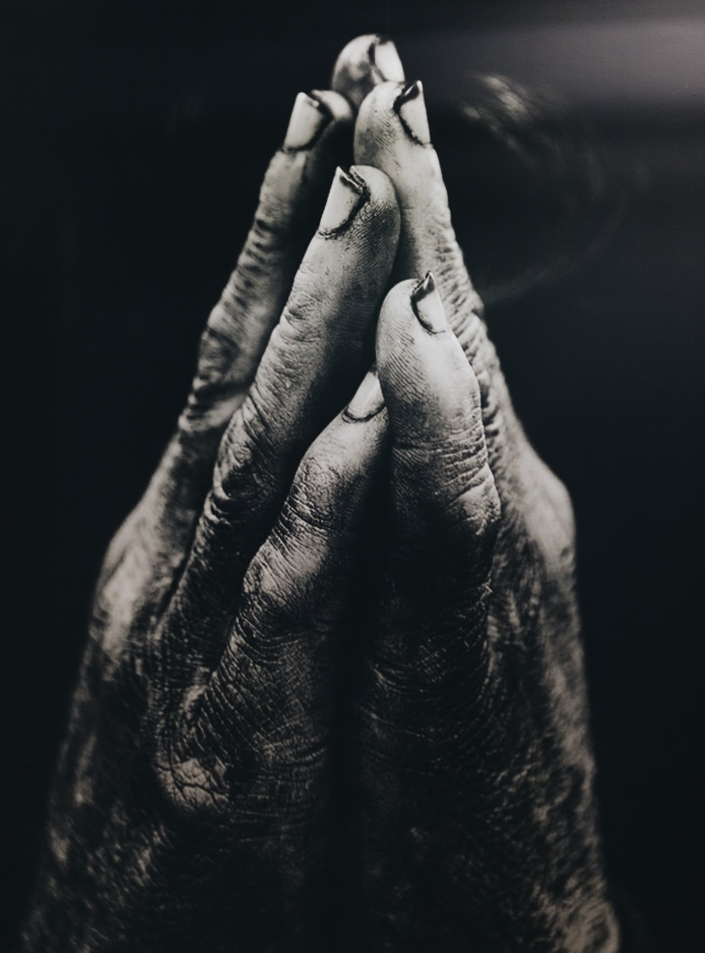
Friday 6th December
‘Have mercy on us, Son of David!’
(Matthew 9:27)
Our faith is what carries us, how will we walk in faith this advent?
How will we deepen our love of our Lord as we prepare for the coming of his son?
He Came
https://youtu.be/u65m__-LLfs
Back to calendar

Slide 11

Saturday 7th December
As you go, proclaim the good news, “The kingdom of heaven has come near.” (Matthew 10:7)
Jesus gives this mission to us too, to share the Good News with everyone. Do our lives lead others to Jesus?
“If anyone comes to me, I want to lead them to Him.” (St Teresa Benedicta of the Cross)
Back to calendar

Slide 12

Sunday 8th December
“The voice of one crying out in the wilderness: ‘Prepare the way of the Lord, make his paths straight.’”
(Matthew 3:3)
John the Baptist called out for people to prepare for Jesus.
How can you be a voice in the wilderness of life for others?
Ask one person this week how they are preparing for Christmas, other than Christmas shopping!
Back to calendar

Slide 13
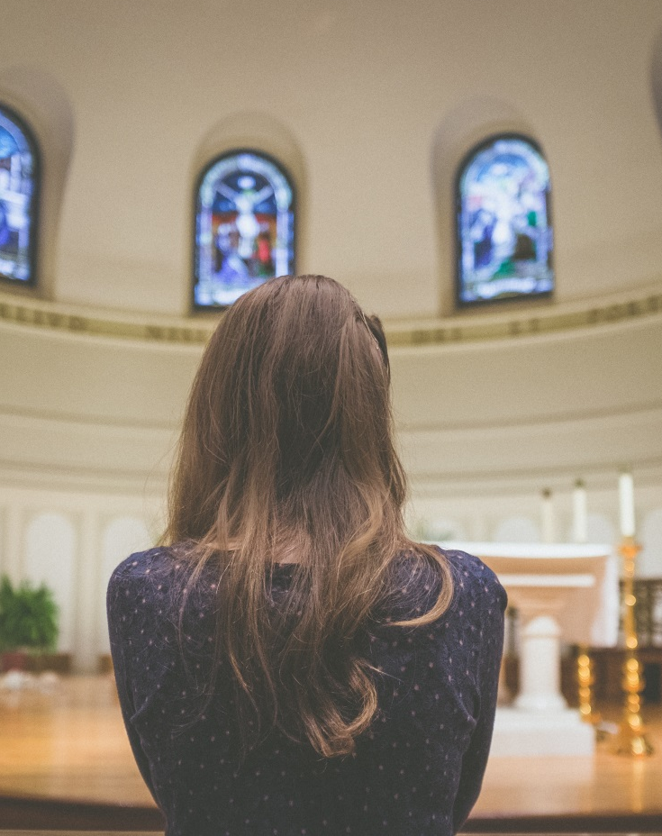
Monday 9th December
How lovely is your dwelling place,
O Lord of hosts!
(Psalm 84:1)
Where is God’s dwelling place? God dwells in each one of us, in the people that we meet, in all those we encounter.
God is particularly present with us in His body in the Eucharist. Call in to a Church this week and spend some time with Him or spend a few moments in prayer at home.
Back to calendar

Slide 14

Tuesday 10th December
So it is not the will of your Father in heaven that one of these little ones should be lost. (Matthew 18:14)
It is Gods will that he finds every sheep that has wandered, Advent is a great time for us to refocus on our relationship with God.
How will we keep ourselves from wandering this advent?
Click here for today’s prayer.
Back to calendar

Slide 15
Tuesday 10th December
As streets fill with shoppers,
bright lights and tempting offers,
Christmas songs and children’s laughter,
You lead us along a different path,
to a desert and a hope-filled voice,
a call to repentance,
a call to service,
a call to immerse ourselves
in living water that will never run dry,
a call to prepare a way in our own lives
for the Saviour of the world to enter in,
to know the touch of tender mercy
and rest in your forgiving love.
Back to calendar

Slide 16

Wednesday 11th December
“Come to me, all of you who are tired from carrying heavy loads, and I will give you rest.”
(Matthew 11:28)
What are the heavy loads you are carrying?
How can you allow Jesus to help you carry them?
Lay It Down by Will Reagan
https://youtu.be/RNacm6zR8eU
Back to calendar

Slide 17

Thursday 12th December
Happy are the people to whom such blessings fall; happy are the people whose God is the Lord.
(Psalm 144:15)
Advent is a time to be happy, expectant, waiting for great Joy.
How can we share my happiness with those around us today?
Happiness is Sharing
https://youtu.be/0LzYAwBGzD8
Back to calendar

Slide 18

Friday 13th December
All your creatures, Lord, will praise you,
and all your people will give you thanks.
(Psalm 145:10)
Have you ever taken a walk outside and marvelled at creation?
Take time this Advent to go outside and appreciate what God has made for us.
So Will I by Hillsong Worship
https://youtu.be/C2U7ffUM5Ec
Back to calendar

Slide 19

Saturday 14th December
But I tell you that Elijah has already come and people did not recognise him, but treated him just as they pleased. In the same way they will also mistreat the Son of Man. (Matthew 17:12)
Advent is a time where we prepare ourselves, what can we do in this season of Advent, to make sure we don’t miss the true meaning of this season?
Advent is Waiting
https://youtu.be/WcravEG2ATE
Back to calendar

Slide 20

Sunday 15th December
Rejoice in the Lord always: Again I say to you, rejoice. Indeed, the Lord is near! (Philippians 4:4)
Today is known as Gaudete Sunday, the word comes from the Latin for 'rejoice' in today's entrance antiphon. The rose colour reminds us of the call to live joyfully as we prepare for the great feast of Christmas!
How can your faith be a beacon of joy for all to see?
Back to calendar

Slide 21
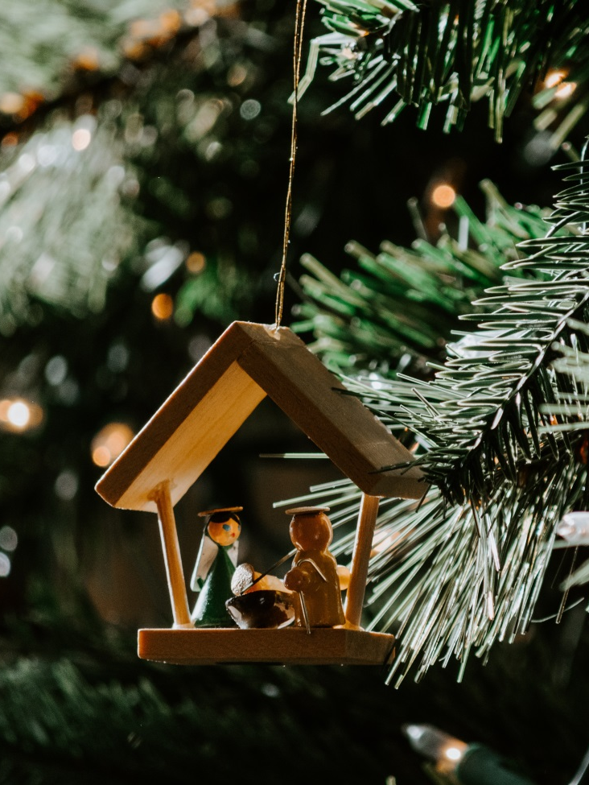
Monday 16th December
Who shall ascend the hill of the Lord?
And who shall stand in his holy place?
Those who have clean hands and pure hearts. (Psalm 24:3-4)
How can I put the “Christ” back in to Christmas?
True Meaning of Christmas
https://youtu.be/3brQyu4nKsc
Back to calendar

Slide 22

Tuesday 17th December
My mouth is filled with your praise,
and with your glory all day long.
(Psalm 71:8)
Today, try to be aware of the words that you use and the things you talk about. Can we use our voices to build people up rather than tearing others down?
Try to say something encouraging to 5 different people today. Use your words for good!
Back to calendar

Slide 23
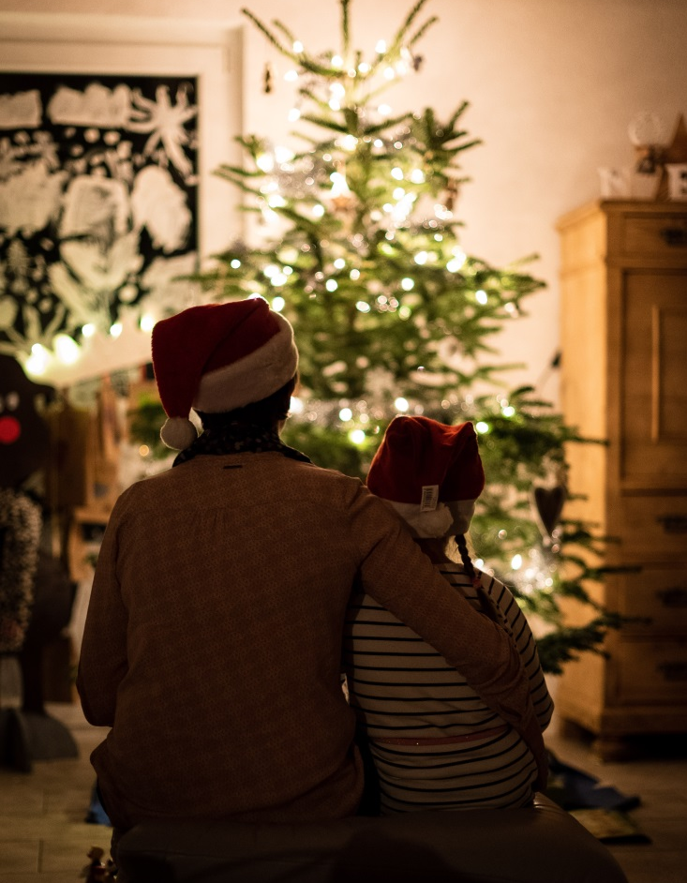
Wednesday 18th December
In you, O Lord, I take refuge.
(Psalm 71:1)
Some people find this time of year especially difficult. Today let’s take a minute to entrust everyone who struggles at this time of year into the loving arms of God.
Click here for today’s prayer.
Back to calendar

Slide 24
Wednesday 18th December
Jesus, Emmanuel
God with us.
enter into each place,
each home,
each hospital room,
each homeless shelter,
each hotel,
each cell,
each place of business
let them know they are not alone.
Back to calendar

Slide 25

Thursday 19th December
The angel said to him, "Do not be afraid, Zechari'ah, for your prayer is heard, and your wife Elizabeth will bear you a son, and you shall call his name John.
(Luke 1:13)
God hears all our prayers. Sometimes it might feel as though we don’t get an answer but we know that God is listening and loves us.
Make time for 5 minutes of prayer today. Need help to start? Try reading this blog:
https://lifeteen.com/blog/prayer-starter-kit-10-things-help-pray-today/
Back to calendar

Slide 26
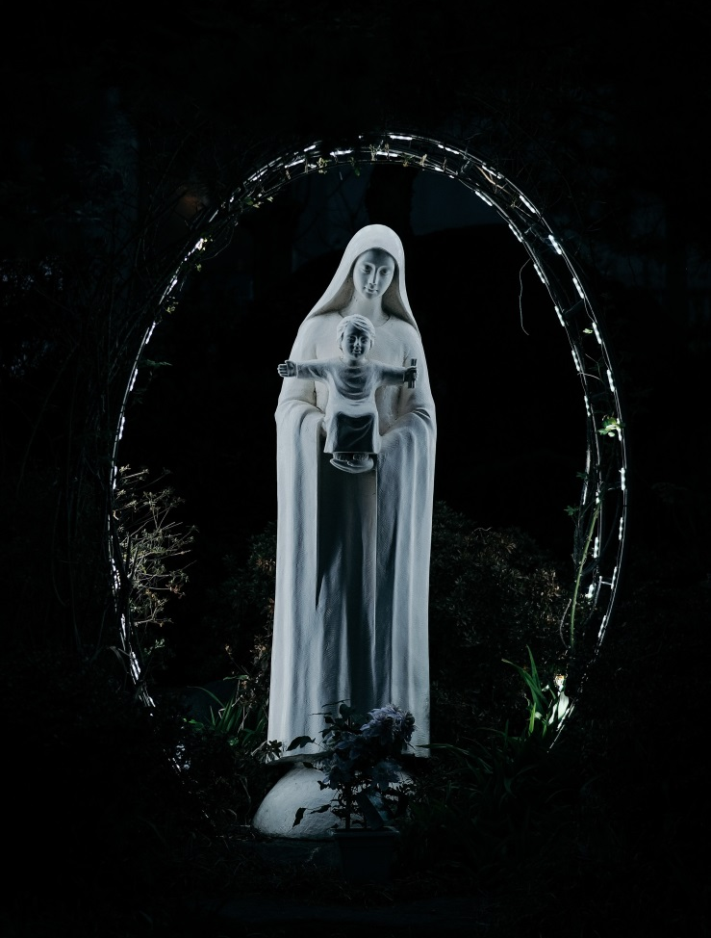
Friday 20th December
“I am the Lord's servant,” said Mary; “may it happen to me as you have said.”
(Luke 1:38)
Mary trusted God. How can we become more trusting in this world we live in?
Gabriel’s Message by Matt Maher
https://youtu.be/GHWtWIcSN3U
Back to calendar

Slide 27
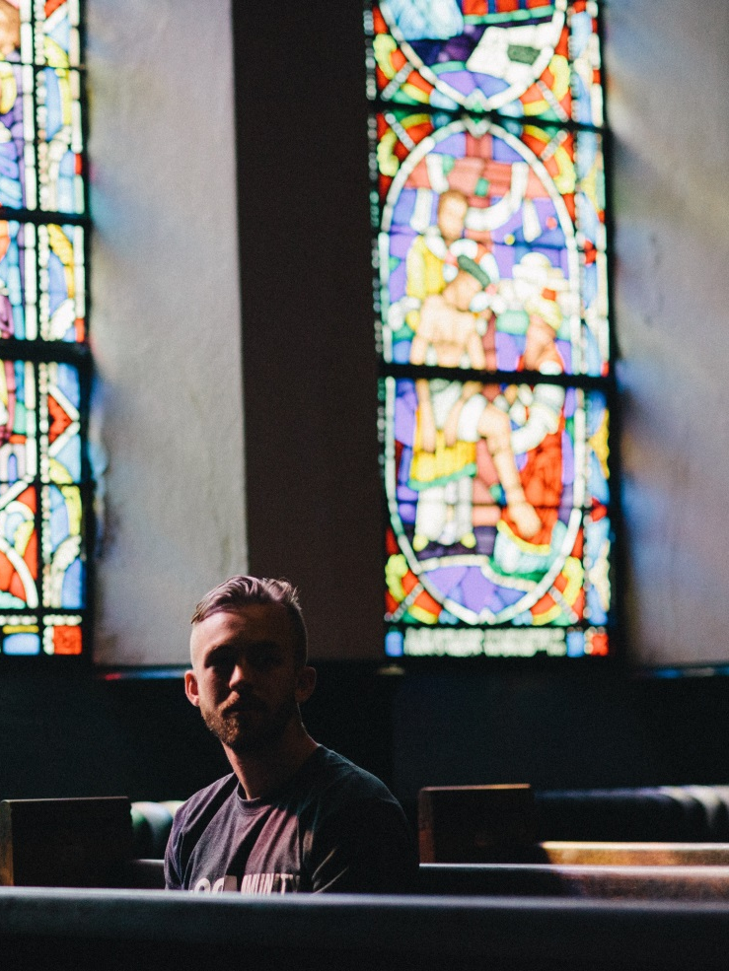
Saturday 21st December
How happy you are to believe that the Lord's message to you will come true!
(Luke 1:45)
Sometimes it can feel as though we are waiting a long time for God. We are called to trust that He can make everything work just as He planned.
When it seems as though you are waiting for God, say the prayer of St Faustina: ‘Jesus, I trust in you.’
Back to calendar

Slide 28
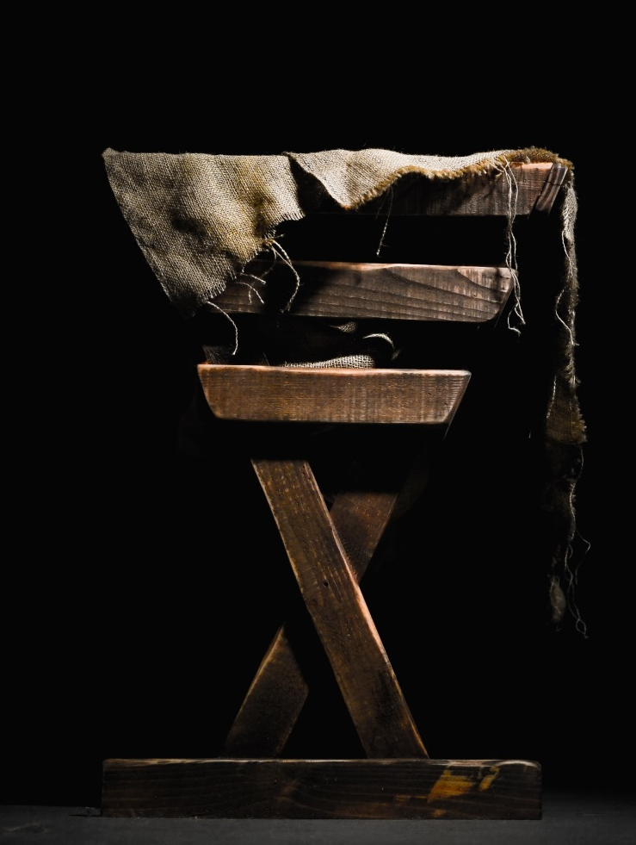
Sunday 22nd December
All this took place to fulfil what the Lord had spoken by the prophet. (Matthew 1:22)
Jesus’ life was foretold long before His birth. God’s people had waited many years for the Messiah. Are we ready to receive Jesus too?
One Solitary Life
https://youtu.be/iPZpE7PLWJY
Back to calendar

Slide 29

Monday 23rd December
See, I am sending my messenger to prepare the way before me.
(Malachi 3:1)
God sent prophets and messengers to prepare the way for Jesus. How can we share God’s message and help those around us to welcome Jesus?
Each of you has to be God’s microphone. Each of you has to be a messenger, a prophet. (St Oscar Romero)
Back to calendar

Slide 30

Tuesday 24th December
To give light to those who sit in darkness and in the shadow of death, to guide our feet into the way of peace.
(Luke 1:79)
Jesus is our light, he leads the way. How can we be people of light?
Glory (Let there be peace) by Matt Maher
https://youtu.be/QW4c6DcxgGc
Back to calendar

Slide 31
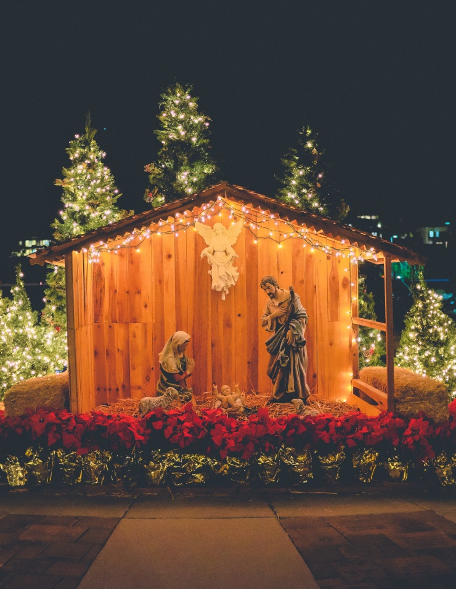
Wednesday 25th December
This very day in David's town your Saviour was born—Christ the Lord!
(Luke 2:11)
Christmas day is all about the birth of Jesus! Amidst the presents, dinner and games, take a moment to be thankful and think about how Jesus is ‘present’ in our lives.
Away in a Manger (Forever Amen)
https://youtu.be/sO8LHWabziM
Back to calendar

