Slide 1
The Season of Lent
This is the confidence we have in approaching God: that if we ask anything according to His will, He hears us. 1 John 5:14

Slide 2
Lent is spring cleaning for the soul
Then you will call on me and come and pray to me, and I will listen to you. Jeremiah 29:12

Slide 3
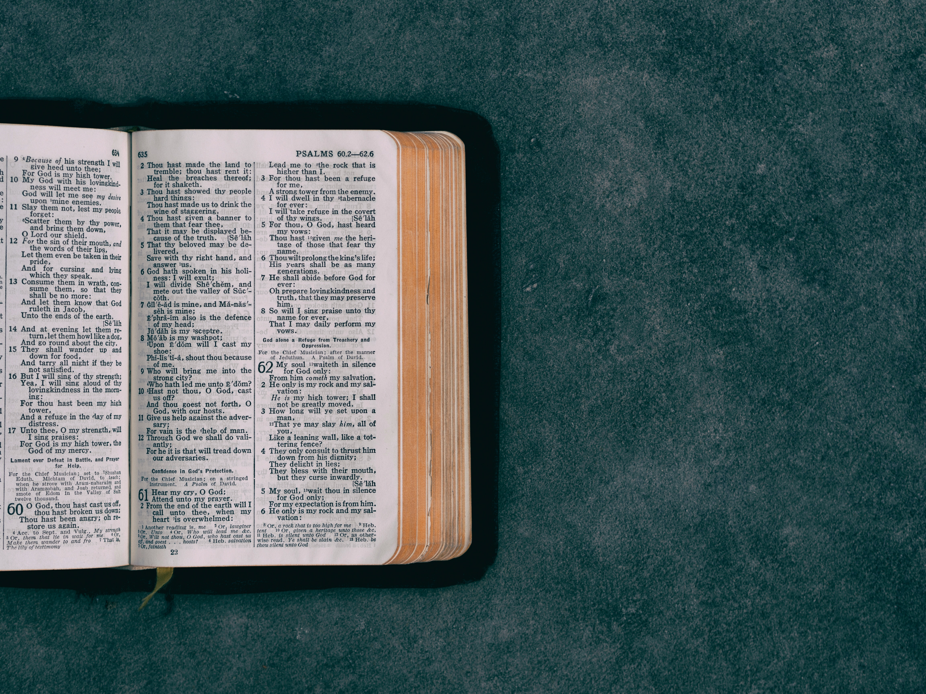
As Jesus was walking along, he saw a man named Matthew sitting at his tax collector’s booth. “Follow me and be my disciple,” Jesus said to him. So Matthew got up and followed him.
Later, Matthew invited Jesus and his disciples to his home as dinner guests, along with many tax collectors and other disreputable sinners. But when the Pharisees saw this, they asked his disciples, “Why does your teacher eat with such scum?
When Jesus heard this, he said, “Healthy people don’t need a doctor—sick people do.” Then he added, “Now go and learn the meaning of this Scripture: ‘I want you to show mercy, not offer sacrifices. ’For I have come to call not those who think they are righteous, but those who know they are sinners.”
Then you will call on me and come and pray to me, and I will listen to you. Jeremiah 29:12

Slide 4
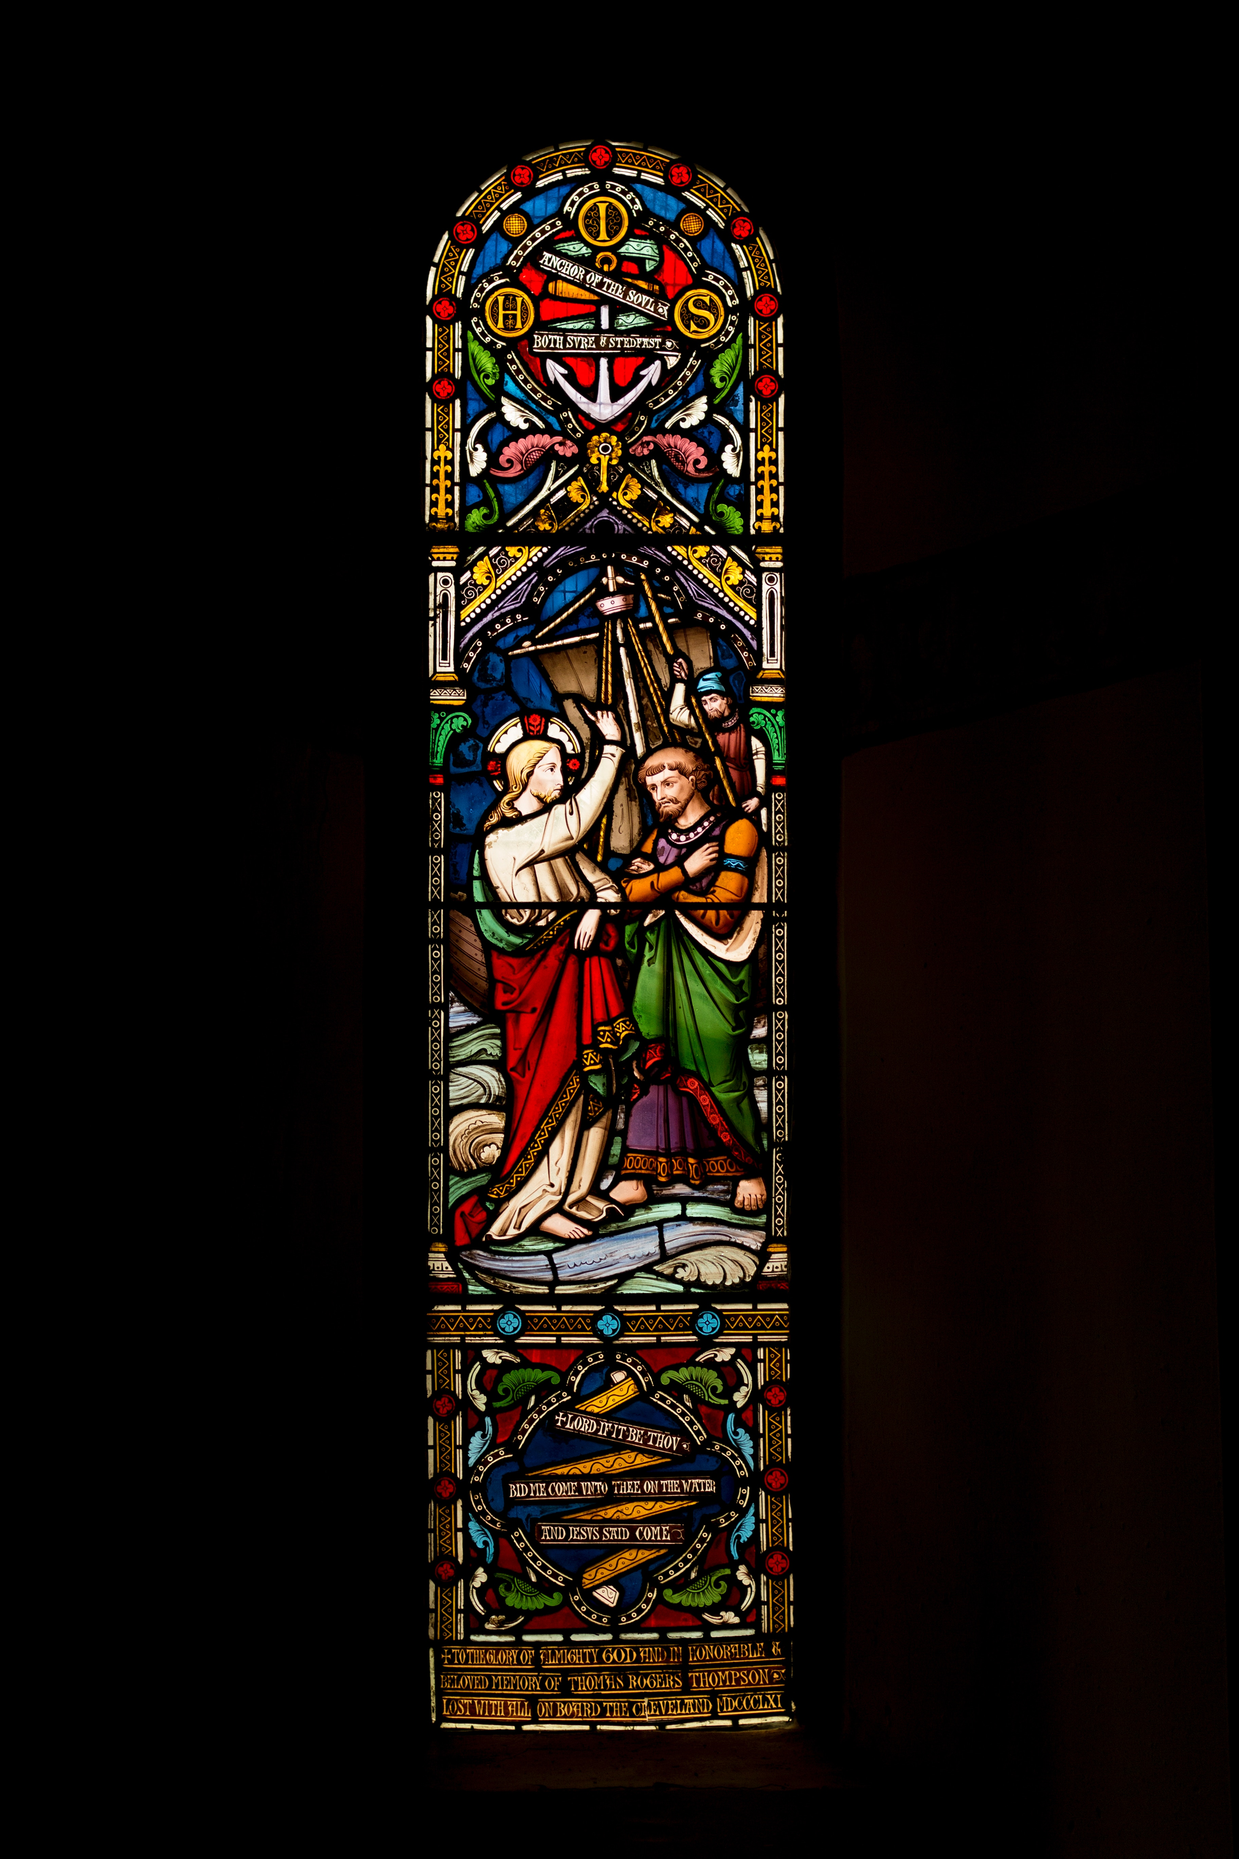
WHERE CAN WE MEET JESUS?
Scripture
Prayer
In others
In the Sacraments
Mass and Reconciliation
"The Lord, your God, is in your midst, a mighty savior, who will rejoice over you with gladness, and renew you in his love. Zephaniah 3:17

Slide 5
Then you will call on me and come and pray to me, and I will listen to you. Jeremiah 29:12

Slide 17
Bidding prayers
For when we are sick of feeling alone, Lord help us to remember You are always with us. Let us always know Your comfort and peace.
Lord in Your mercy
Hear our prayer
Then you will call on me and come and pray to me, and I will listen to you. Jeremiah 29:12

Slide 18
Bidding prayers
For when we are sick of being selfish, Lord change our hearts so they are more like Your Sacred Heart. Guide us to always think of other people first, rather than ourselves. Inspire us to be counter cultural in loving our neighbour, and our enemies.
Lord in Your mercy
Hear our prayer
Then you will call on me and come and pray to me, and I will listen to you. Jeremiah 29:12

Slide 19
Bidding prayers
For when we are sick of turning away from God, Lord lead us back to You. Fill us with a sense of Your glory and majesty so we can always have our eyes fixed on You.
Lord in Your mercy
Hear our prayer
Then you will call on me and come and pray to me, and I will listen to you. Jeremiah 29:12

Slide 20
Bidding prayers
For when we are sick of being afraid, Lord send us Your strength. Give us courage to stand up for what is right, particularly for the rights of those who are most vulnerable, the sick, the poor, the unborn and elderly.
Lord in Your mercy
Hear our prayer
Then you will call on me and come and pray to me, and I will listen to you. Jeremiah 29:12

Slide 21
Bidding prayers
We lift up all of our prayers to our Mother Mary, to pray for us as we say
Hail Mary, full of grace
The Lord is with thee.
Blessed are thou among women and blessed is the fruit of thy womb Jesus. Holy Mary Mother of God, pray for us sinners now and at the hour of our death Amen.
Then you will call on me and come and pray to me, and I will listen to you. Jeremiah 29:12

Slide 22
The Season of Lent
This is the confidence we have in approaching God: that if we ask anything according to His will, He hears us. 1 John 5:14

