Slide 1

Dare to be Saints!
“You shall be holy; for I the Lord your God am holy”(Lev 19:2)

Slide 2
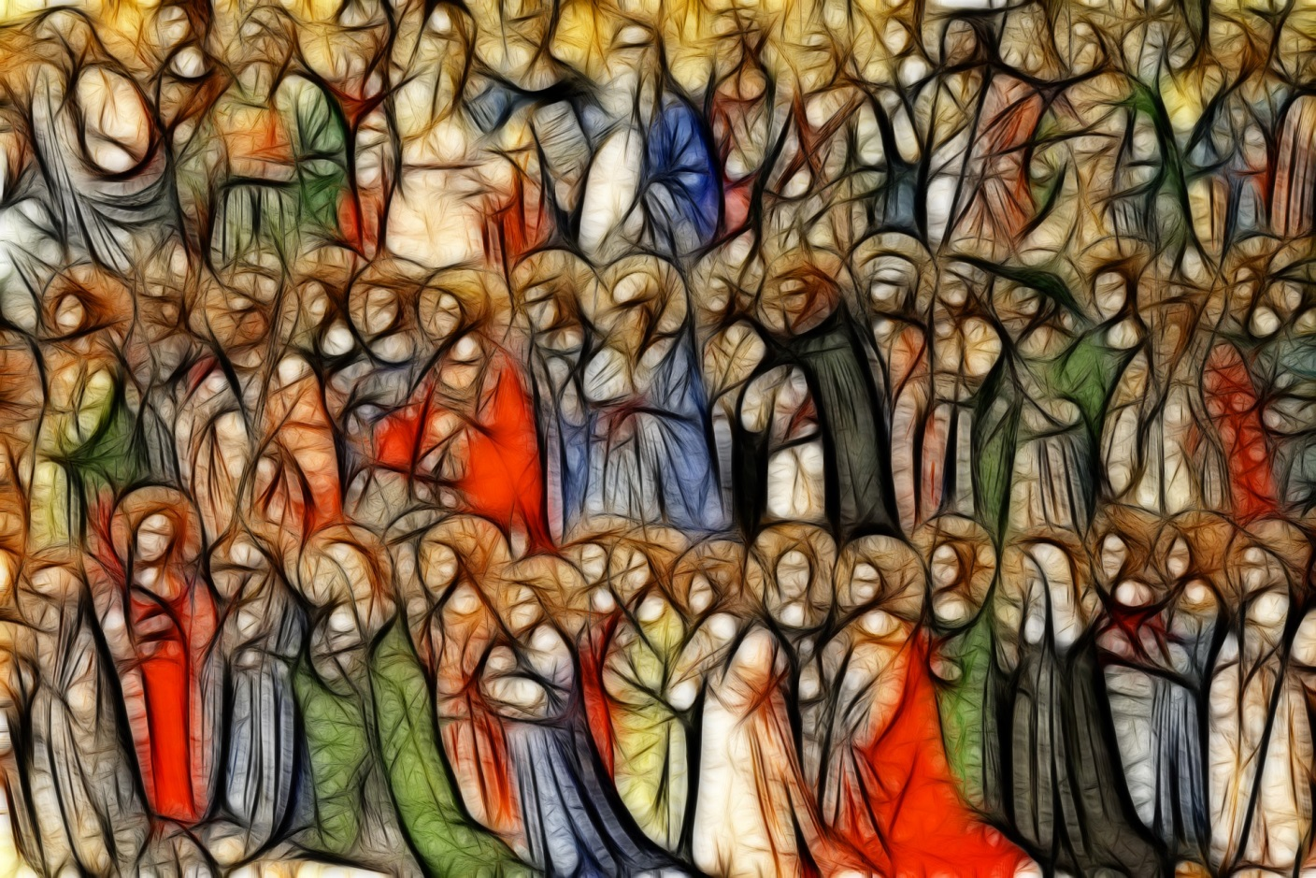
What is a Saint?
“You shall be holy; for I the Lord your God am holy”(Lev 19:2)

Slide 3
What is a Saint?
saint
seɪnt,s(ə)nt/
Noun
a person acknowledged as holy or virtuous and regarded in Christian faith as being in heaven after death.
Verb
1. formally recognize as a saint; canonize.
“You shall be holy; for I the Lord your God am holy”(Lev 19:2)

Slide 4
“Universal Call To Holiness”
The Church tells us:
“Everyone [in the Church] whether belonging to the hierarchy, or being cared for by it, is called to holiness, according to the saying of the Apostle [St. Paul]: ‘For this is the will of God, your sanctification’.”
This means we are all called to holiness, we are all called to be saints!
We are called to lead lives that inspire others.
“You shall be holy; for I the Lord your God am holy”(Lev 19:2)

Slide 5
The Scriptures tell us that God cares about our holiness: “Be perfect as your heavenly Father is perfect” (Matthew 5:48)
“But, I could never be ‘perfect…”
Holiness is not about perfection. It may seem that we could never live up to the lives of the great Saints we hear about in the Church but they had real struggles and obstacles to overcome in their love of God and of neighbour.
“You shall be holy; for I the Lord your God am holy”(Lev 19:2)

Slide 6
How can I answer the call to holiness?
Pope St John Paul II once told young people
“Dear young people of every continent, do not be afraid to be the saints of the new millennium!
Be contemplative, love prayer; be coherent with your faith and generous in the service of your brothers and sisters, be active members of the Church and builders of peace.
To succeed in this demanding project of life, continue to listen to His Word, draw strength from the Sacraments, especially the Eucharist and Penance.
The Lord wants you to be intrepid apostles of his Gospel and builders of a new humanity.”
“You shall be holy; for I the Lord your God am holy”(Lev 19:2)

Slide 7
Will I be a Saint of today?
Holiness is all about the choices we make in life:
Will I choose to love God and love my neighbour?
Will I follow where God leads me?
Will I reach out to those around me?
Will I accept who God has created me to be?
Will I share my God-given gifts and talents?
“You shall be holy; for I the Lord your God am holy”(Lev 19:2)

Slide 8
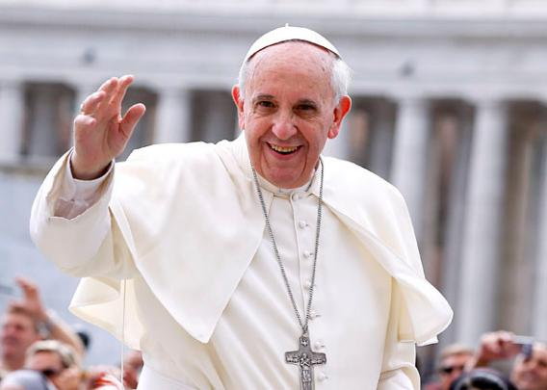
What choice will you make today?
“Remain steadfast in the journey of faith, with firm hope in the Lord. This is the secret of our journey! He gives us the courage to swim against the tide.” Pope Francis
“You shall be holy; for I the Lord your God am holy”(Lev 19:2)

Slide 9
Breathe in me, O Holy Spirit,
that my thoughts may all be holy.
Act in me, O Holy Spirit,
that my work, too, may be holy.
Draw my heart, O Holy Spirit,
that I love only what is holy.
Strengthen me, O Holy Spirit,
to defend all that is holy.
Guard me so, O Holy Spirit,
that I may always be holy.
Amen.
“You shall be holy; for I the Lord your God am holy”(Lev 19:2)

