Slide 2
^{Prayer}
^{(Matthew 6:5-15)}
“And when you pray, do not be like the hypocrites, for they love to pray standing in the synagogues and on the street corners to be seen by others. Truly I tell you, they have received their reward in full. But when you pray, go into your room, close the door and pray to your Father, who is unseen. Then your Father, who sees what is done in secret, will reward you. And when you pray, do not keep on babbling like pagans, for they think they will be heard because of their many words. Do not be like them, for your Father knows what you need before you ask him.
“This, then, is how you should pray:
“‘Our Father in heaven, hallowed be your name, your kingdom come, your will be done, on earth as it is in heaven. Give us today our daily bread. And forgive us our debts, as we also have forgiven our debtors.
And lead us not into temptation, but deliver us from the evil one.’
For if you forgive other people when they sin against you, your heavenly Father will also forgive you. But if you do not forgive others their sins, your Father will not forgive your sins.

Slide 3
^{Fasting}
^{(Matthew 6:16-18)}
“When you fast, do not look sombre as the hypocrites do, for they disfigure their faces to show others they are fasting. Truly I tell you, they have received their reward in full.
But when you fast, put oil on your head and wash your face, so that it will not be obvious to others that you are fasting, but only to your Father, who is unseen; and your Father, who sees what is done in secret, will reward you.

Slide 4
^{Giving}
^{(Matthew 6:1-4)}
“Be careful not to practice your righteousness in front of others to be seen by them. If you do, you will have no reward from your Father in heaven.
“So when you give to the needy, do not announce it with trumpets, as the hypocrites do in the synagogues and on the streets, to be honoured by others. Truly I tell you, they have received their reward in full. But when you give to the needy, do not let your left hand know what your right hand is doing, so that your giving may be in secret.
Then your Father, who sees what is done in secret, will reward you.

Slide 5
Here are some compliments not based on appearance:
You’re a good listener
You’re a really great friend.
I appreciate it when you…
You always make me smile
You’re a strong person
You’re so much fun to be around
I can always count on you
You’re good at making people feel welcome
It makes people happy to be around you
You’re a very resilient person

Slide 6
Some ideas for your letter…
Catch them up on your life
Reminisce about happy times you have spent together
Ask some questions to get to know them better
Suggest some plans for the next time you have together
Tell them what you appreciate about them

Slide 9
Things you could do with your journey instead…
Chat to someone
Make a to-do list
for your day
Read a book
Pray
(especially for the intentions of those around you)
Pray the rosary
Doodle, colour
or sketch
Look out the window and appreciate the surroundings
Write in a journal
Simply sit and think
Complete a crossword/sudoku
Read a newspaper or magazine

Slide 10
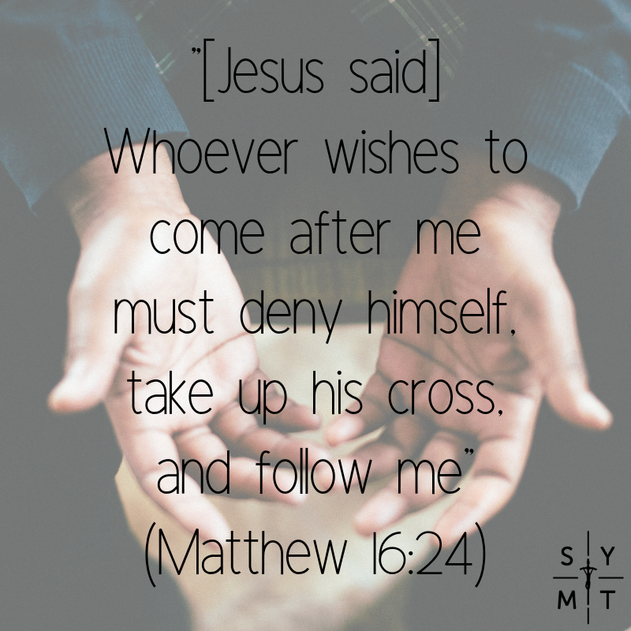
What does this look like in practice?
Each time you face a difficult situation at home or work, pray,
“Lord, I offer this to you for the sake of [insert name].”
Each time you suffer a small cut, or perhaps a sore throat, bear it willingly and say,
“Lord, I offer this sacrifice to you for [insert name].”
(Brandon Voght
https://www.wordonfire.org/resources/blog/how-to-offer-up-your-suffering-like-st-john-vianney/5236/)

Slide 11
Instead you could…
Cook a meal and
eat together
Play a game together
(Dust off Monopoly!)
Watch a film together, at home or at the cinema
Pray a rosary together
Invite family friends round to the house
Go for a walk or a bike ride
Talk about your days with each other
Make a family scrapbook
Get some jobs done
Plan the next family birthday
Make a meal plan for the week

Slide 12
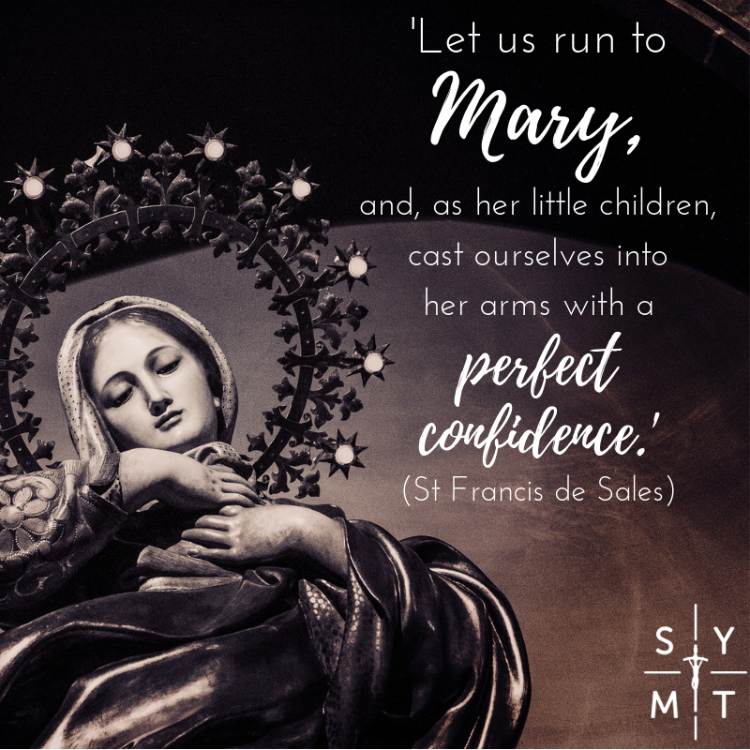

Slide 13
Read a blog about Catholic Simplicity here

Slide 15
Matthew 4:1-11
The Temptation of Jesus
Then Jesus was led up by the Spirit into the wilderness to be tempted by the devil. He fasted forty days and forty nights, and afterwards he was famished. The tempter came and said to him, “If you are the Son of God, command these stones to become loaves of bread.” But he answered, “It is written,
‘One does not live by bread alone, but by every word that comes from the mouth of God.’”
Then the devil took him to the holy city and placed him on the pinnacle of the temple, saying to him, “If you are the Son of God, throw yourself down; for it is written,
‘He will command his angels concerning you,’ and ‘On their hands they will bear you up, so that you will not dash your foot against a stone.’”
Jesus said to him, “Again it is written, ‘Do not put the Lord your God to the test.’”
Again, the devil took him to a very high mountain and showed him all the kingdoms of the world and their splendour; and he said to him, “All these I will give you, if you will fall down and worship me.” Jesus said to him, “Away with you, Satan! for it is written,
‘Worship the Lord your God, and serve only him.’”
Then the devil left him, and suddenly angels came and waited on him.

Slide 16
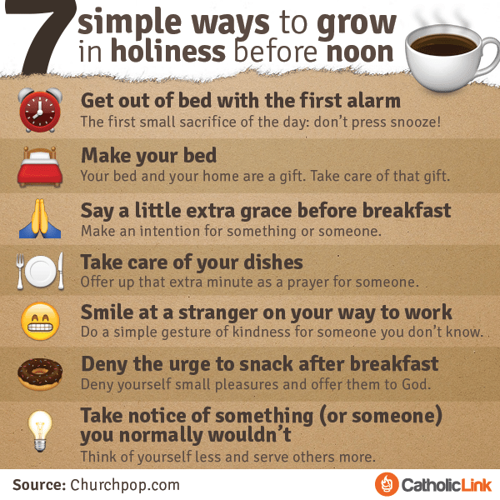

Slide 18
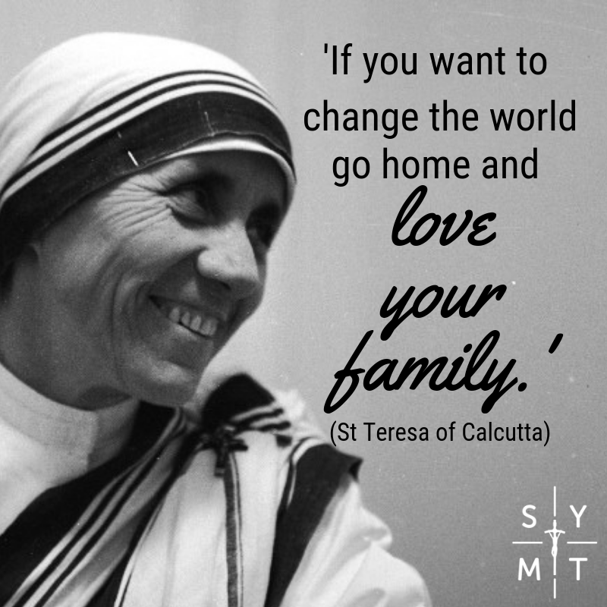
Read a blog on loving your family here

Slide 19
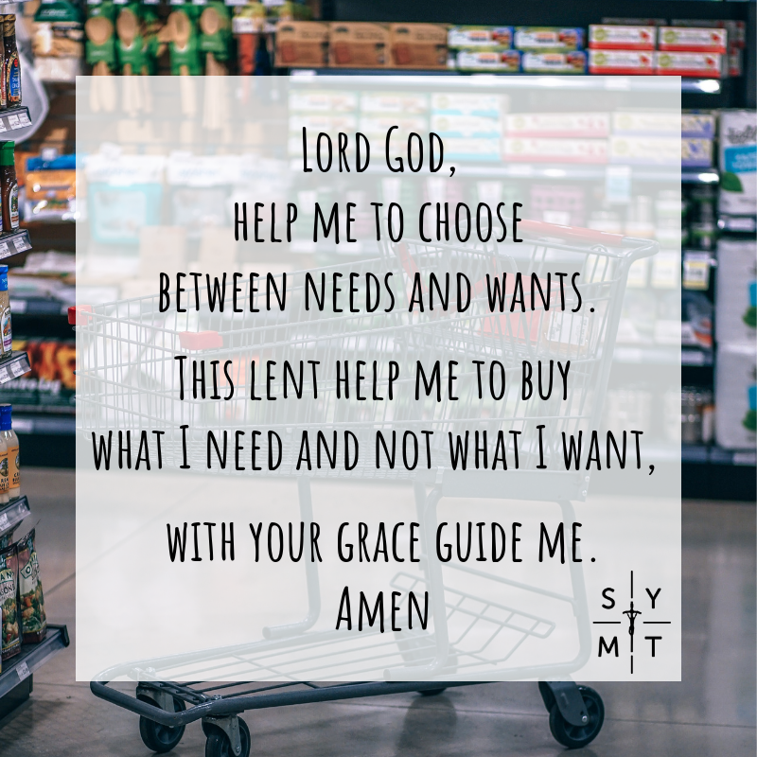
What are the essential things in life?
Water
Shelter
Food
How much do you buy in
a week that you don’t
really need?

Slide 21
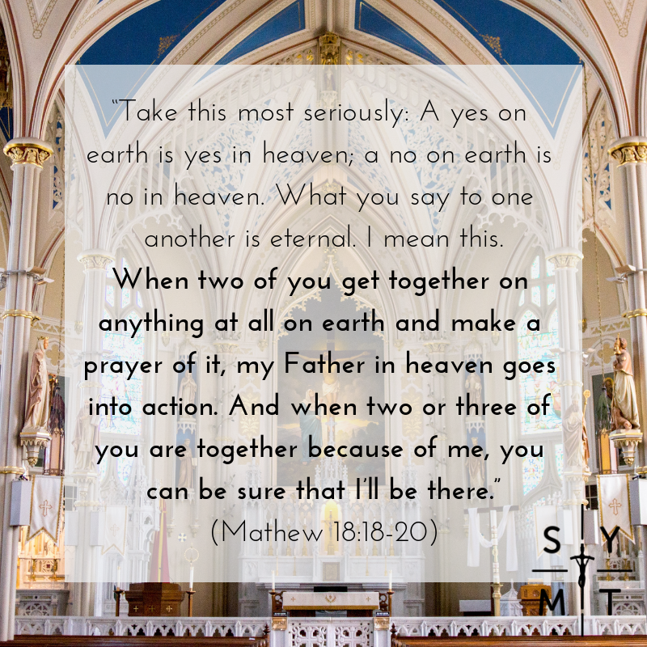

Slide 22
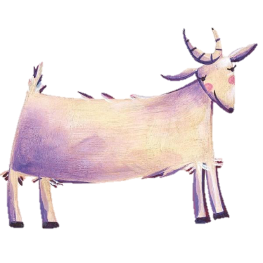
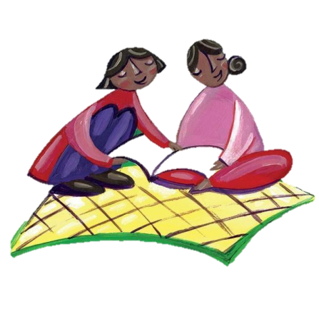
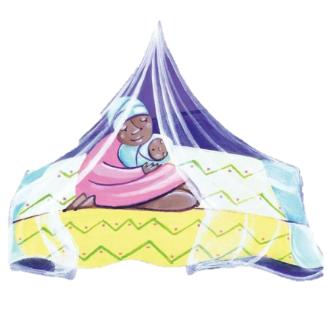
CAFOD World Gifts
https://worldgifts.cafod.org.uk/
A goat provide a family with up to 12 pints of milk a week – which they can drink or sell – it also produces free fertiliser which they can use to help grow crops.
£28.00
Reading can open up so many doors: education, work, pleasure and self-improvement. This fabulous, life-changing charity gift can pay for children's literacy classes.
£10
This charity gift provides a happy queen bee for a hive. The queen brings more bees to the hive, and more bees mean more delicious honey to eat and sell!
£4.00
This charity gift is a real life-saver! This simple, treated mosquito net can keep families and babies safe from deadly diseases.
£7.00
Many children in developing countries cannot go to school, so are unable to reach their true potential. This brilliant charity gift includes a uniform, stationery and a school bag; everyday items that will give a child the gifts of education and opportunity.
£25.00
You can make a difference, even a little difference.
The little difference you make will make a HUGE difference to someone’s life.
This lent change someone’s life.

Slide 23
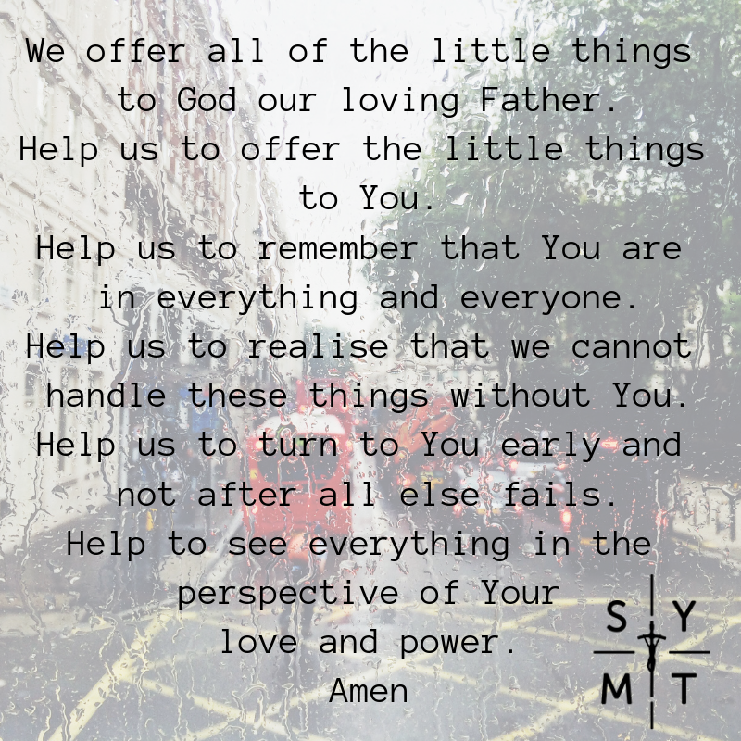

Slide 24
Seven benefits to benefits to leaving social media alone…
Social media leads you to focus on others more than yourself.
Social media presents us with a distorted version of reality.
Social media causes your happiness to be too dependent on others.
Social media doesn't allow you to interact with friends in a substantial way.
Social media can distract you from the moment.
Social media tends to make your life too public.
Social media can make it harder to move forward with your life.

Slide 25
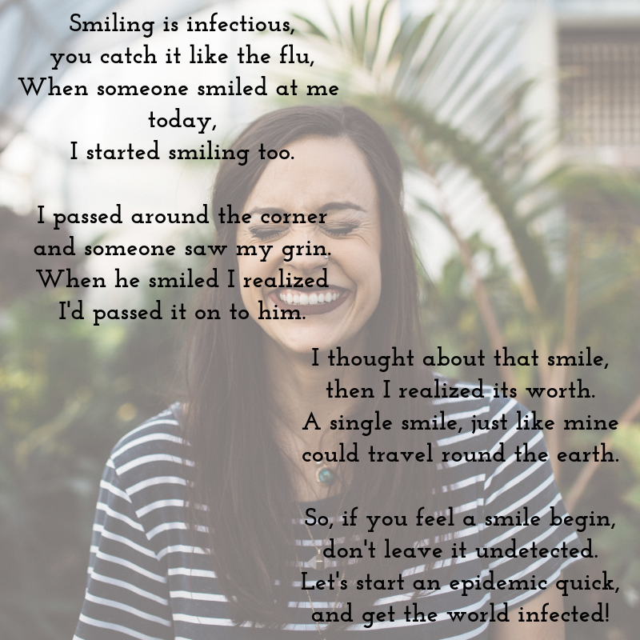

Slide 26
Books you might enjoy…
The Screwtape Letters
by CS Lewis
The Hobbit
by JRR Tolkein
YOUCAT: Youth Catechism of the Catholic Church
To Kill A Mockingbird
by Harper Lee
The Bible!
The Book Thief
by Marcus Zusak
Follow
By Katie Prejean McGrady

Slide 27
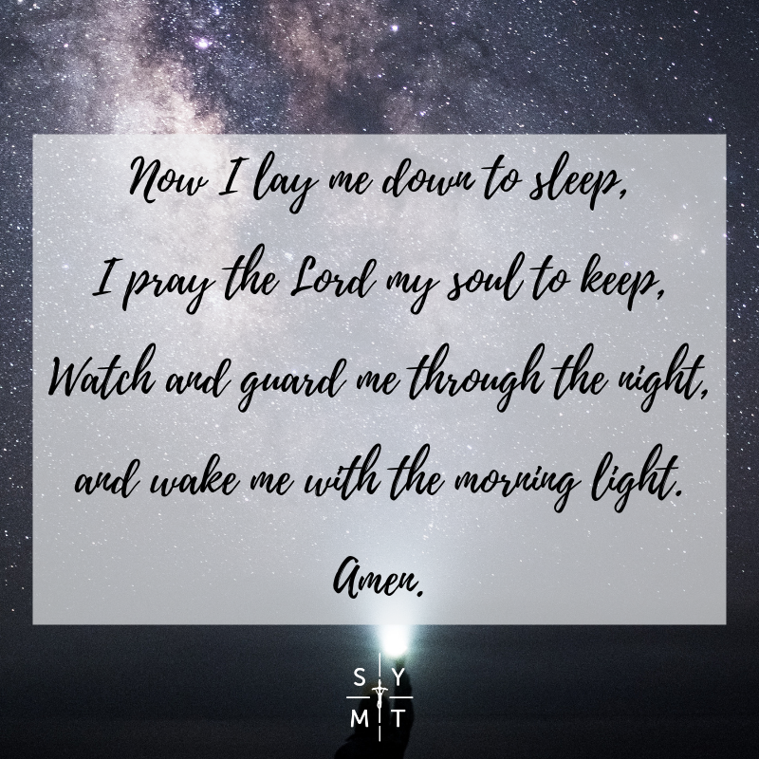
10 benefits to a good night’s sleep…
Sleep helps reduce stress
Sleep can improve your
memory
Sleep can lower your blood
pressure
Sleep helps your body to
fight back
Sleep can help you
maintain your weight
Sleep puts you in a better
mood
Sleep could reduce your
chances of diabetes
Sleep helps keep your heart healthy
Sleep can be a painkiller
Sleep can make you smarter

Slide 28
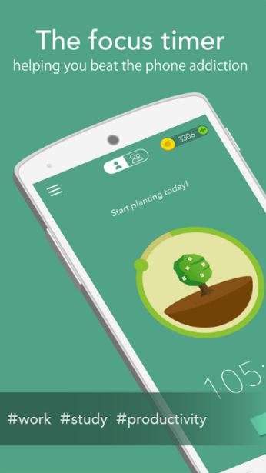
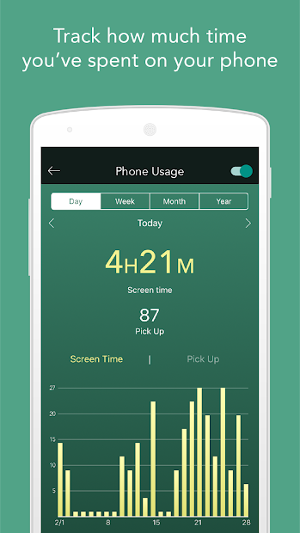
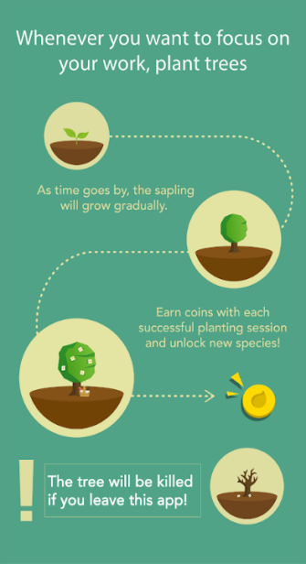
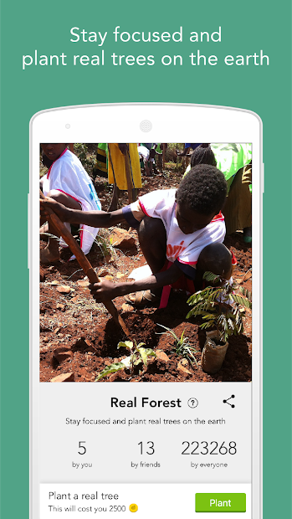
Why not try the “Forest: Stay focused” app – available for both android and apple. Plant a tree and see it grown by not using your phone.
This lent let’s take some time to sit back from our phones and try and connect more with Jesus.

Slide 29
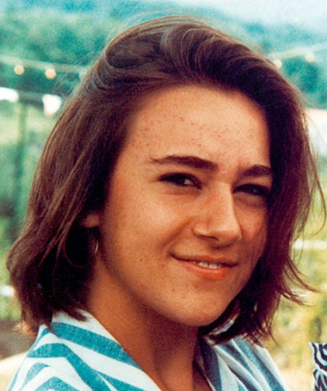
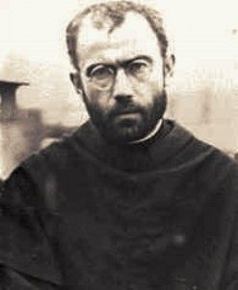
Blessed Chiara Luce Badano
Chiara was born in Italy in 1971. She was popular, went to Church regularly with her family and love to spend time with her friends, who she tried to share the Gospel with. At age 17 she was diagnosed with bone cancer, and although it was hard to accept, she knew she could use her suffering to lead others to Jesus.
Chiara would say ‘For you Jesus; if you want it, I want it too.’
She died in October 1990 but her life continues to inspire people around the world.
Learn more about her here: https://lifeteen.com/blog/fame-fortune-faith/
St Maximilian Kolbe
St Maximilian Kolbe was born in Poland in 1894 and from a young age had a strong devotion to Our Lady.
As a young man he joined the Franciscans and trained to be a priest with them. As a priest he founded an association to share the love of Our Lady and build up the Kingdom of God; this took him as far as Japan in his missionary efforts!
During the Nazi invasion of Poland, St Maximilian and his fellow friars cared for over 5000 Jewish refugees. In 1941 he was arrested and later taken to Auschwitz. Even in the concentration camp St Maximilian continued to minister to those around him, offering them counsel, sharing his food and eventually giving his life.
When a prisoner attempted to escape, St Maximilian offered his own life in exchange for this man’s, who had a wife and children. After 10 days of isolation where he prayed and sang hymns with others, he was given a lethal injection.
For more stories of the saints have a look at this website here

Slide 30
Heavenly Father we pray that You would raise up an army of willing volunteers to be called to go and enter into Your service and to go wherever You choose to lead them.
Lord, we ask for Your special protection to surround all those who answer this call - that they will not be exploited.
Provide for the needs of all those who volunteer, and we pray that You lead and guide them in all things.
Amen

