Slide 1
Journey with...
During lent we are invited to
journey with Jesus.
We do this through prayer, fasting
and almsgiving.
Use this moment to pause, read and connect with Jesus.
Choose a prayer to say and repeat it on your daily journey.

Slide 2
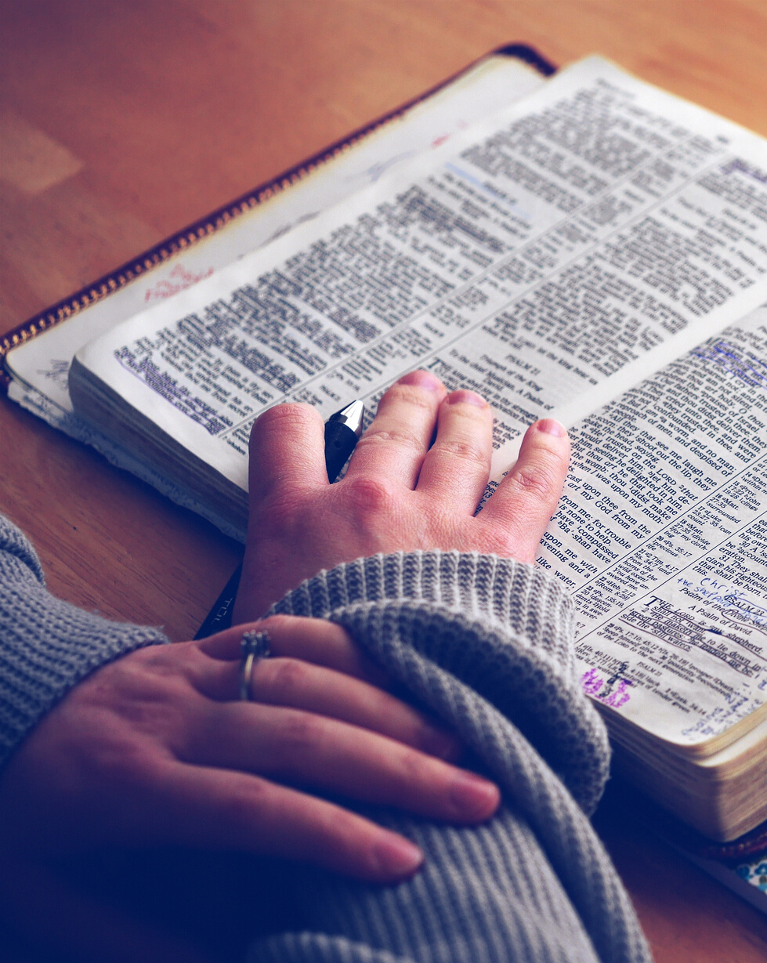
Journey with
prayer
The LORD is near to all who call on him, to all who call on him in truth.
(Psalm 145:18)

Slide 3
Journey with
prayer
Do not be anxious about anything,
but in every situation, by prayer and petition, with thanksgiving, present your requests to God.
(philippians 4:6)

Slide 4
Journey with
prayer
This is the confidence we have in approaching God: that if we ask anything according to his will,
he hears us.
(1 John 5:14)

Slide 5
Journey with
prayer
Look to the LORD
and his strength;
seek his face always.
(1 chronicles 16:11)

Slide 6
Journey with
prayer
I call on you, my God, for you will answer me; turn your ear to me
and hear my prayer.
(psalm 17:6)

