Slide 1
When the Eucharist is being celebrated, the sanctuary is filled with countless angels who adore the divine victim sacrificed on the altar.
St. John Chrysostom

Slide 2
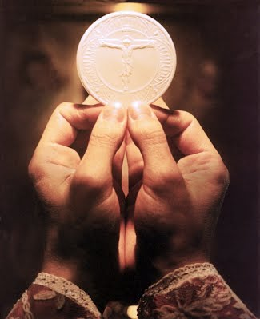
The angels surround and help the priest when he is celebrating Mass.
St. Augustine

Slide 3
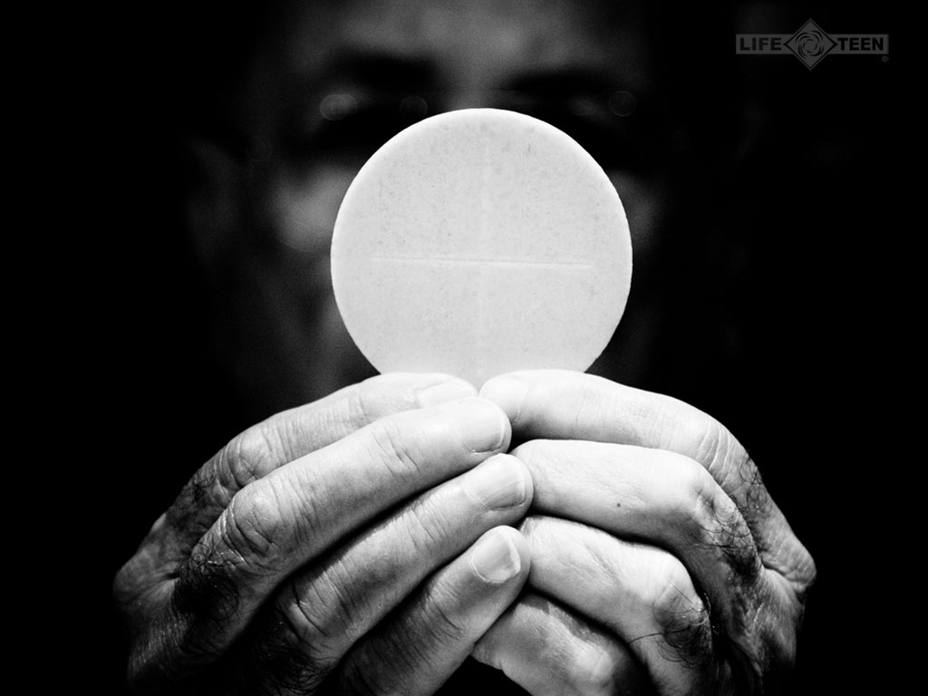
If we really understood the Mass, we would die of joy.
Saint Jean Vianney

Slide 4
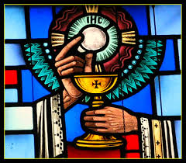
The celebration of Holy Mass is as valuable as the death of Jesus on the cross.
Saint Thomas Aquinas

Slide 5
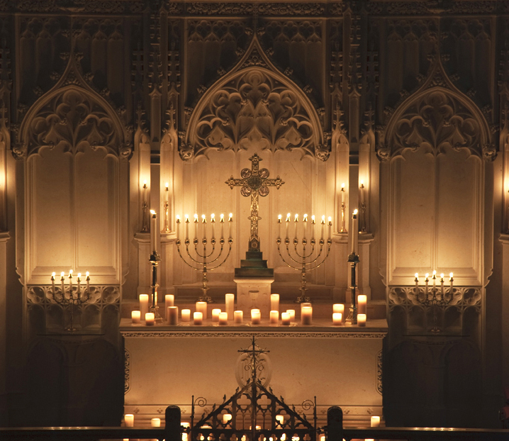
The Mass is the most perfect form of prayer!
Pope Paul VI

Slide 6
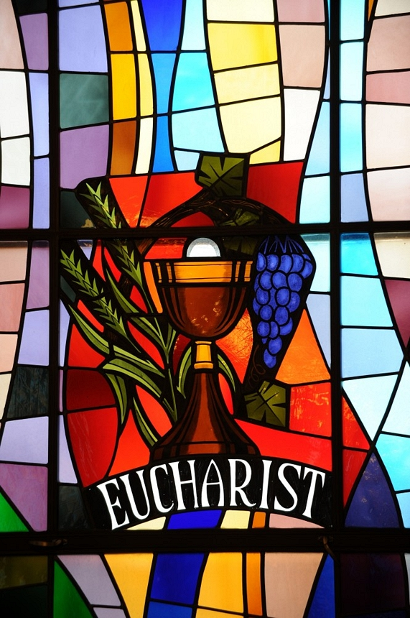
There is nothing so great as the Eucharist
If God had something more precious, He would have given it to us.
Saint Jean Vianney

Slide 7
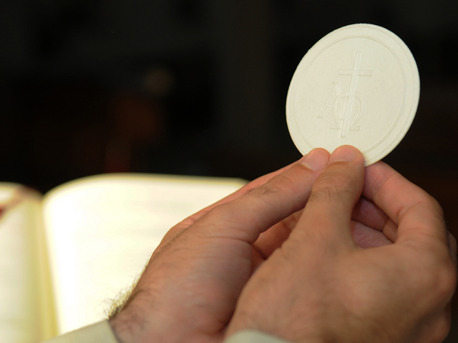
"It would be easier for the world to survive without the sun than to do without Holy Mass."
St. Padre Pio

Slide 8
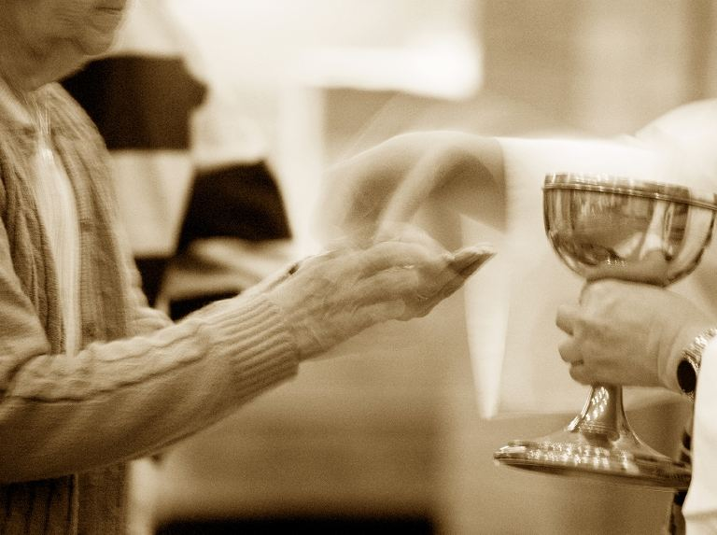
The heavens open and multitudes of angels come to assist in the Holy Sacrifice of the Mass."
Saint Gregory

Slide 9
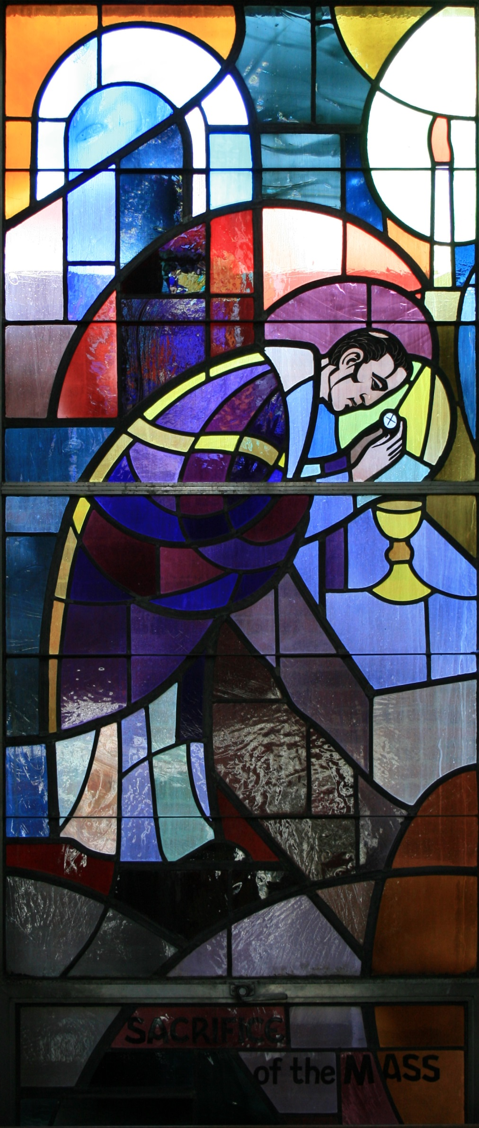
Be the apostle of the divine Eucharist, like a flame which enlightens and warms, like the Angel of His heart who will go to proclaim Him to those who don’t know Him and will encourage those who love Him and are suffering."
Saint Peter Julian Eymard

Slide 10
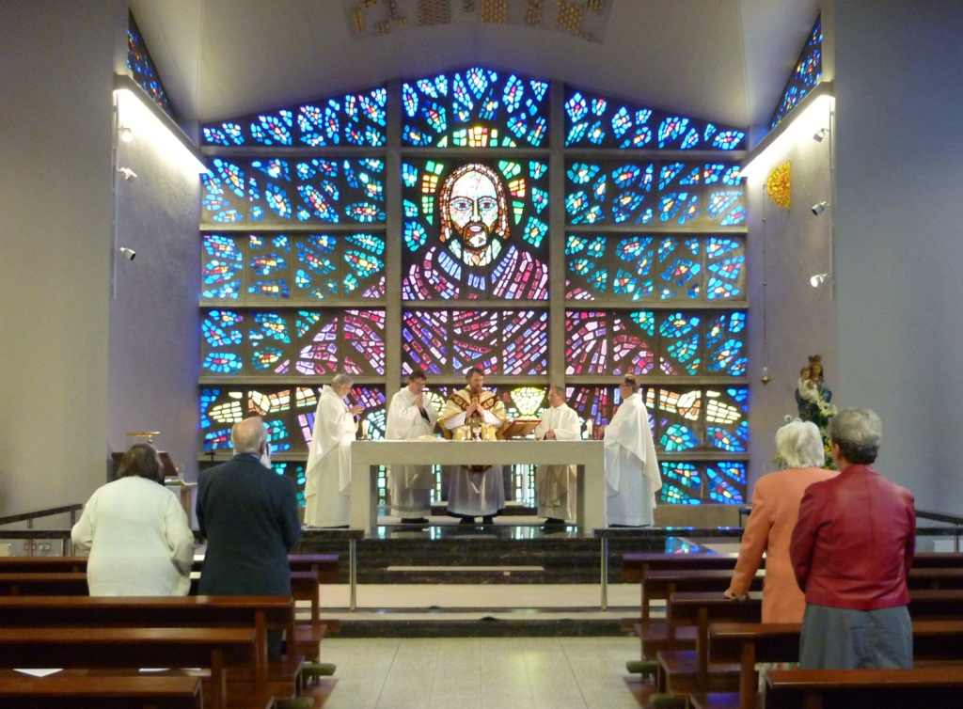
There is no prayer or good work so great, so pleasing to God, so useful to us as the Mass."
St. Lawrence Justinian

