Slide 1



Shrewsbury Youth Mission Team
Faith in Action Award
Group Reflection Activity
Jesus Heals

Slide 2
FAITH IN ACTION PRAYER
God Our Father, We thank you for the gift of your love which you give to every person in the world. We thank you that because of your love, we are never alone and should never feel afraid.
We thank you for the gift of faith which allows is to know you, one God, three persons. We thank you that because of that faith, the whole of our lives are directed to living for other people.
Through your son, Jesus Christ, our friend and brother, you show us how to love.
Give us the strength we need to live lives of love and faith, so that the world might come to know your son more and more through our actions and words as we seek to live lives which help to build your kingdom here on earth.
We ask this through Christ our Lord. Amen.

Slide 3
The Good News
Matthew 8:1-4
1) Jesus came down from the hill, and a large crowd followed him. Then a man sick with leprosy came to him. The man bowed down before Jesus and said, “Lord, you have the power to heal me if you want.” Jesus touched the man. He said, “I want to heal you. Be healed!” Immediately the man was healed from his leprosy. Then Jesus said to him, “Don’t tell anyone about what happened. But go and let the priest look at you. And offer the gift that Moses commanded for people who are made well. This will show everyone that you are healed.”

Slide 4
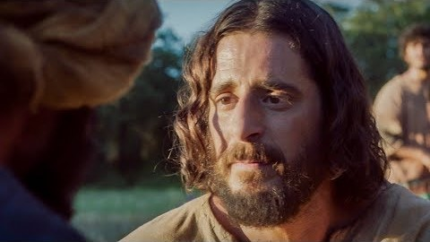
The Good News
Jesus heals a man with leprosy
Discuss in pairs: Why do you think Jesus healed people?

Slide 5
The Good News
Acts of the Apostles 3:1-9
2) Peter and John approached the Temple, and a man lame from birth was being carried in. When he saw Peter and John about to enter, he asked them for some money. Peter and John looked at him intently, and Peter said, “Look at us!” The lame man looked at them eagerly, expecting some money. But Peter said, “I don’t have any silver or gold for you. But I’ll give you what I have. In the name of Jesus Christ the Nazarene, get up and walk!”
Then Peter took the lame man by the right hand and helped him up. And as he did, the man’s feet and ankles were instantly healed and strengthened. He jumped up, stood on his feet, and began to walk! Then, walking, leaping, and praising God, he went into the Temple with them.
Discuss in pairs: How could your words be healing to others?

Slide 6
The Good News
Matthew 9:1-12
3) And just then some people were carrying a paralysed man lying on a bed. When Jesus saw their faith, he said to the paralytic, “Take heart, son; your sins are forgiven.” Then some of the scribes said to themselves, “This man is blaspheming.” But Jesus, perceiving their thoughts, said, “Why do you think evil in your hearts? For which is easier, to say, ‘Your sins are forgiven,’ or to say, ‘Stand up and walk’? But so that you may know that the Son of Man has authority on earth to forgive sins”—he then said to the paralytic—“Stand up, take your bed and go to your home.” And he stood up and went to his home. When the crowds saw it, they were filled with awe, and they glorified God.

Slide 7
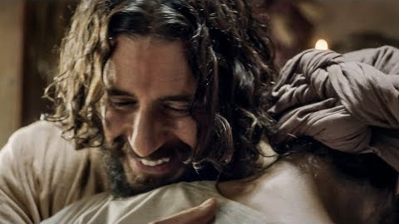
The Good News
Jesus heals a paralysed man
Discuss in pairs: Who would you bring for healing to Jesus and why?

Slide 8


Scrapbook/Journal Scripture Activity
Choose one to do in your scrapbook:
1) Rewrite one of the scripture stories from the perspective of the person being healed. Imagine that person's thoughts and feelings as they are healed by Jesus when you re-write the story.
2) Draw in detail the main scene from one of the healing stories. You are welcome to use dialogue as well.
You will be given a copy of the healing stories to choose from

Slide 9
The Church Story
Catechism of the Catholic Church, paragraphs 1503 & 1504
Christ's compassion toward the sick and his many healings of every kind are a glorious sign that "God has visited his people" and that the kingdom of God is close at hand.
Jesus has the power not only to heal but to also forgive sins; he has come to heal the whole man, soul and body; he is the physician the sick have need of.
His compassion toward all who suffer goes so far that he identifies himself with them: ‘I was sick and you visited me’.
Often Jesus asks the sick to believe. The sick try to touch him, ‘for power came forth from him and healed them all’. And so in the sacraments, Christ continues to ‘touch’ us in order to heal us.
Discuss in pairs what you have learned so far

Slide 10
Personal Story
Think about the content of this session so far. Answer the following in your scrapbook/journal:
1) What have you learned in this session?
2) Think about your Faith In Action journey so far. What have you learned about yourself?
3) Write about how you can bring healing through your words and actions with at least 3 people in your life.
Name these 3 people and be specific about what you could say or do to help each person.

Slide 11
Prayer Activity
A page with a heart will be given to you. On the heart write:
On one side, list the names of the people in your life who need healing, either physically or emotionally
On the other side, write a prayer to Jesus about those you have listed.
You are welcome to decorate it if you wish
You are the only one who will see this, and you will be able to keep it
to use for your own private prayer

Slide 12
CLOSING PRAYER
Lord, we have so much in this life to worry and think about, so many things to be anxious, so many things to doubt. But you call us to live by faith, to place our trust in you, and live according to your will. This isn't always easy, Lord. If it was, then everyone would do it. But the extra effort
is certainly worth it.
Because by saying that we believe in you, not only are we given access to your Kingdom, but by realising your presence in our lives, we are suddenly aware of guidance, love and an inner peace that has always been offered to us, but until now, we had not even been aware of.
So now, as you call us to have faith in you, we know that what you ask of us is a great deal, but we also know that what you have given in return is far greater. And for this Lord, we are forever thankful. Amen. (prayer by Ray Jackson)

