Slide 1
Shrewsbury Youth Mission Team
Faith in Action Award
Reflection Point
The Beatitudes

Slide 2
FAITH IN ACTION PRAYER
God Our Father, we thank you for the gift of your love which you give to every person in the world. We thank you that because of your love, we are never alone and should never feel afraid.
We thank you for the gift of faith which allows is to know you, one God, three persons. We thank you that because of that faith, the whole of our lives are directed to living for other people. Through your son, Jesus Christ, our friend and brother, you show us how to love.
Give us the strength we need to live lives of love and faith, so that the world might come to know your son more and more through our actions and words as we seek to live lives which help to build your kingdom here on earth. We ask this through Christ our Lord. Amen.

Slide 3
The Good News
Matthew 5:1-11
When Jesus saw the crowds, he went up the mountain; and after he sat down, his disciples came to him.
Then he began to speak, and taught them, saying:
Blessed are the poor in spirit, for theirs is the kingdom of heaven.
Blessed are those who mourn, for they will be comforted.
Blessed are the meek, for they will inherit the earth.
Blessed are those who hunger and thirst for righteousness, for they will be filled.
Blessed are the merciful, for they will receive mercy.
Blessed are the pure in heart, for they will see God.
Blessed are the peacemakers, for they will be called children of God.
Blessed are those who are persecuted for righteousness’ sake, for theirs is the kingdom of heaven.
Blessed are you when people revile you and persecute you and utter all kinds of evil against you falsely on my account.
Rejoice and be glad, for your reward is great in heaven, for in the same way they persecuted the prophets who were before you.

Slide 4
The Good News
Matthew 5:1-11

Slide 5
Discussion questions
1 What makes you happy?
2 What does it mean to be happy?
3 Which Beatitude stands out to you? Why?

Slide 6
The Church Story
Catechism of the Catholic Church (CCC) paragraph 1723
The Beatitudes invite us to purify our hearts of bad instincts and to seek the love of God above all else.
It teaches us that true happiness is not found in riches or well-being,
in human fame or power,
or in any human achievement such as science, technology and art,
or indeed in any person or thing,
but in God alone,
the source of every good and of all love.

Slide 7
Discussion Questions
So Church teaching says this will not bring true happiness:
Being rich, famous or powerful
(although there is nothing wrong with being these things)
1 Do you agree? Why or why not?
The Church also says that true happiness is found only in God alone who is the source of goodness and love.
2 Do you agree? Why or why not?

Slide 8
Personal Story
Using your journal/scrapbook:
For each of the following slides, please write the question and your response to each one

Slide 9
The Beatitudes: You can make a difference
Blessed are the poor in spirit =
those who:
are not full of themselves
want to be filled with good things from God
for theirs is the kingdom of heaven
What good thing from God could you use now to be a better person?

Slide 10
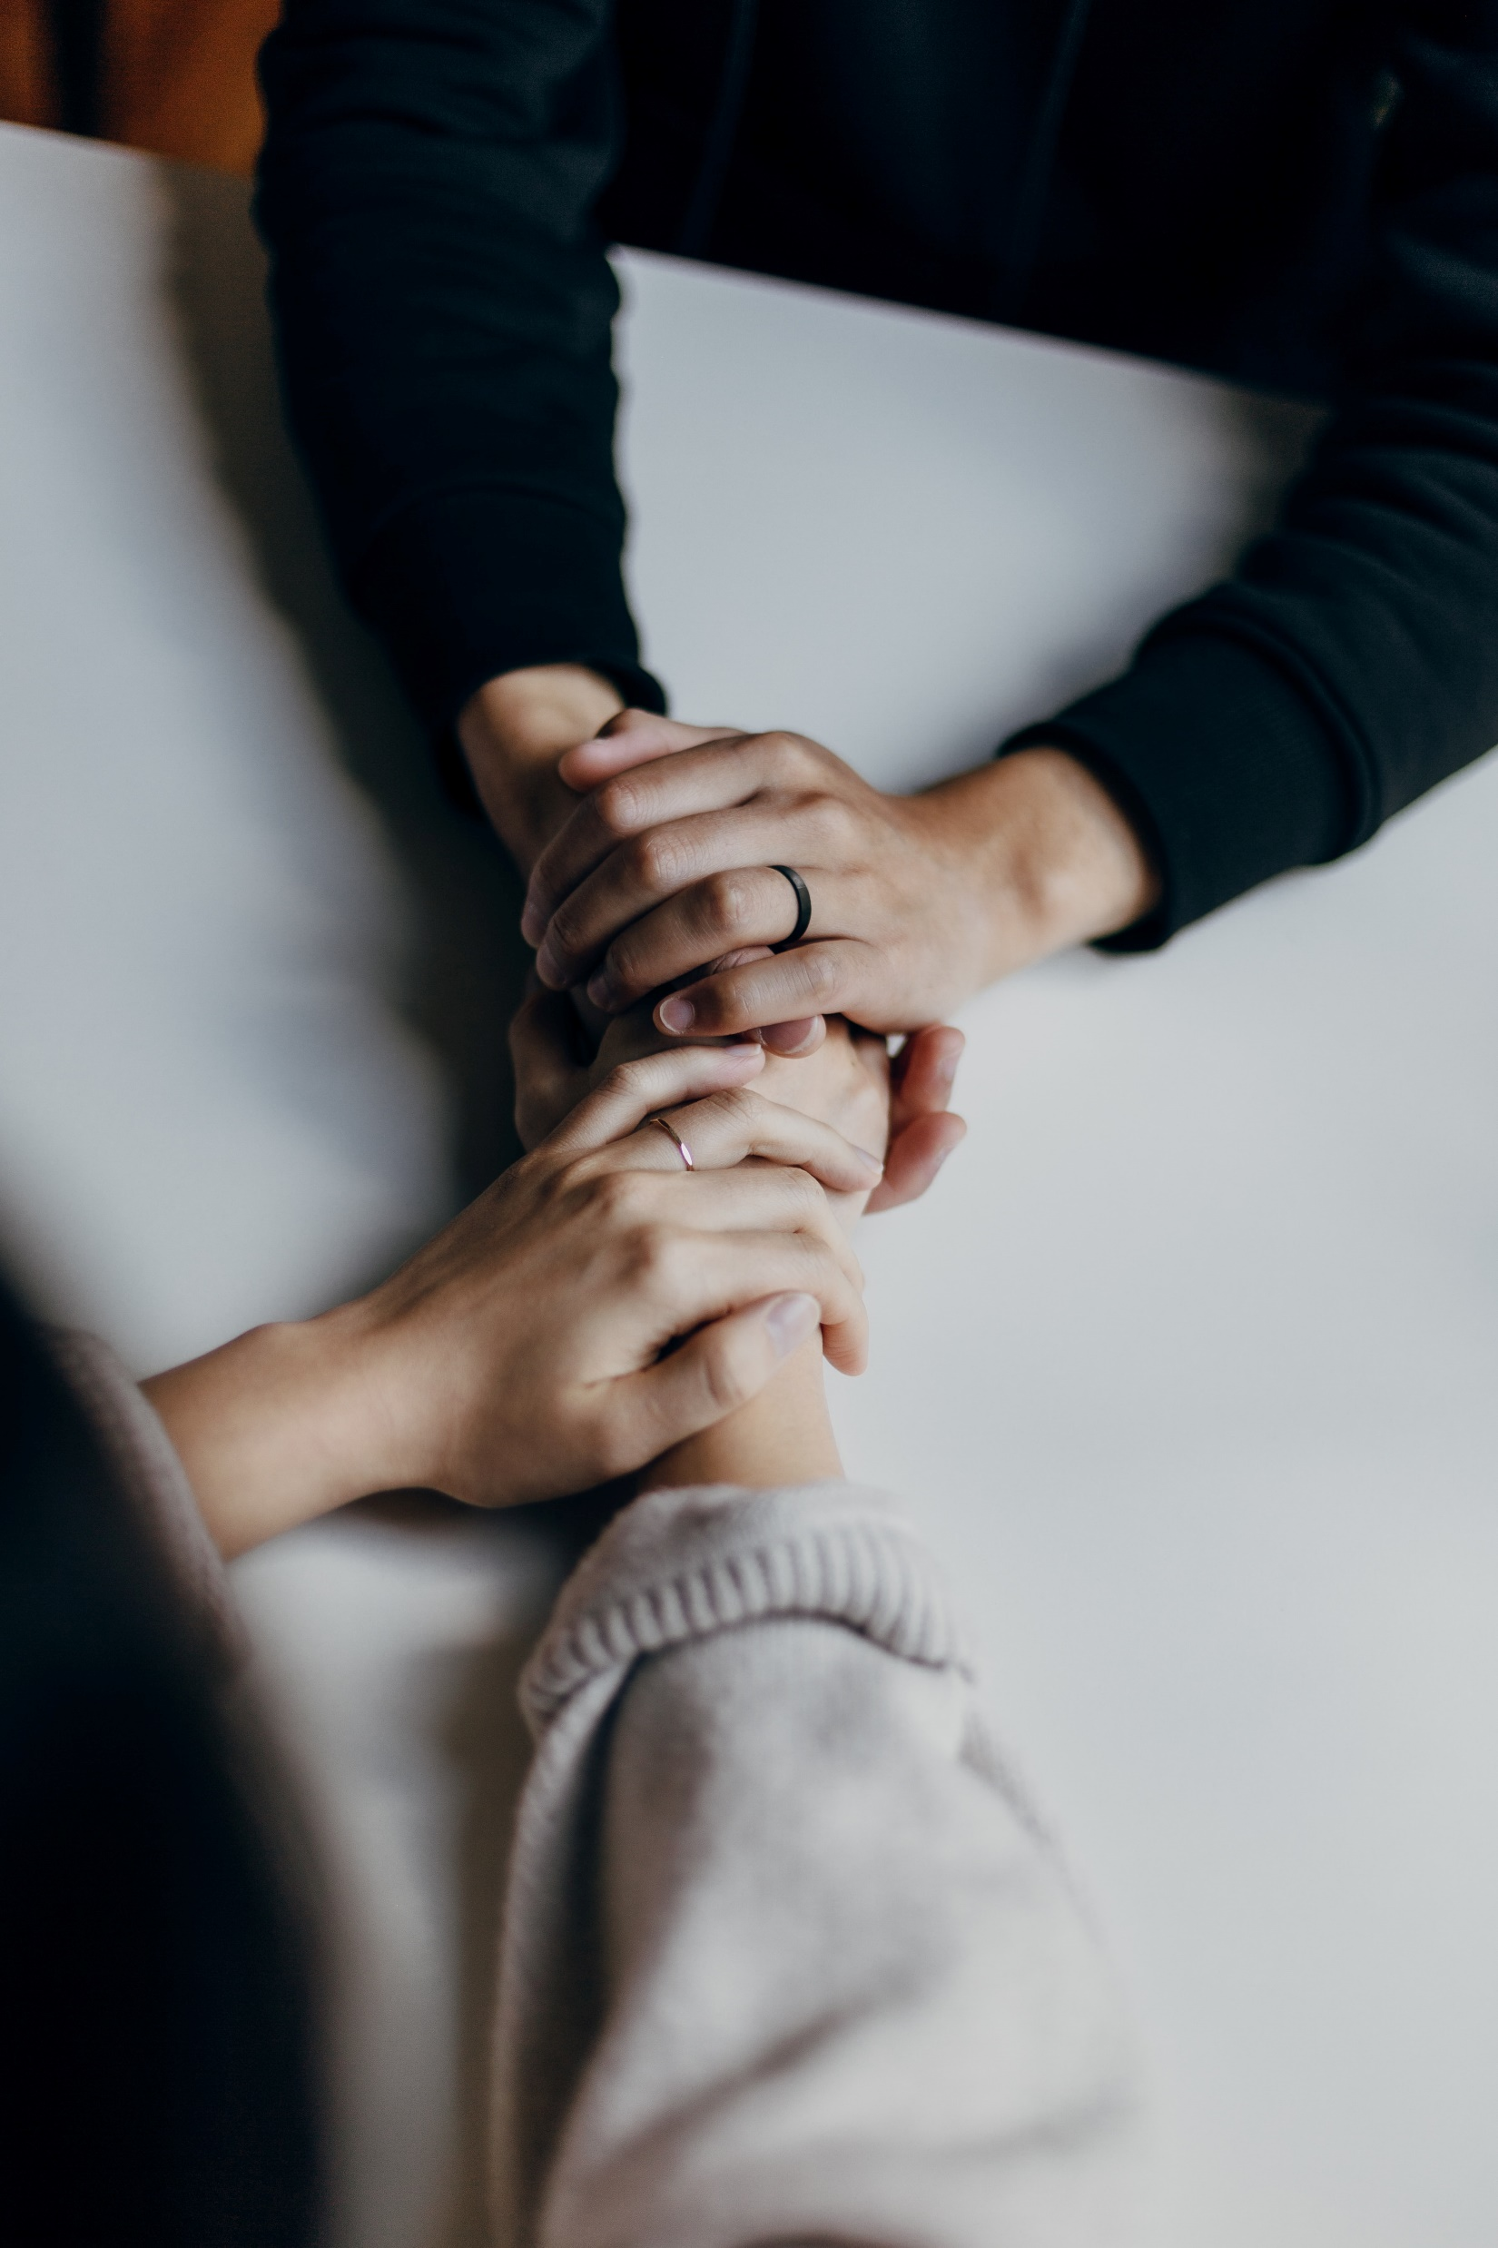
Blessed are those who mourn =
those who
have little hope
are sad because of a loss
for they will be comforted
Describe a time when you comforted someone.

Slide 11
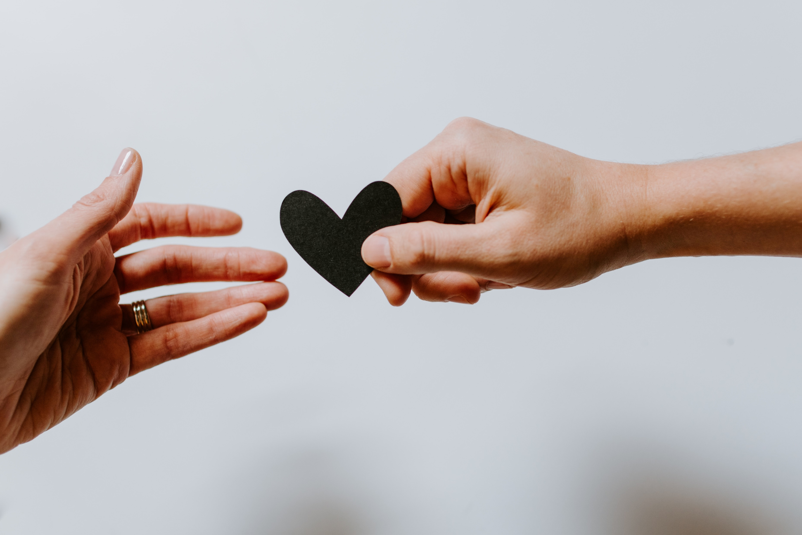
Blessed are the meek =
those who are
kind
gentle
patient
for they will inherit the earth
Describe a time when you were kind, gentle or patient with someone.

Slide 12
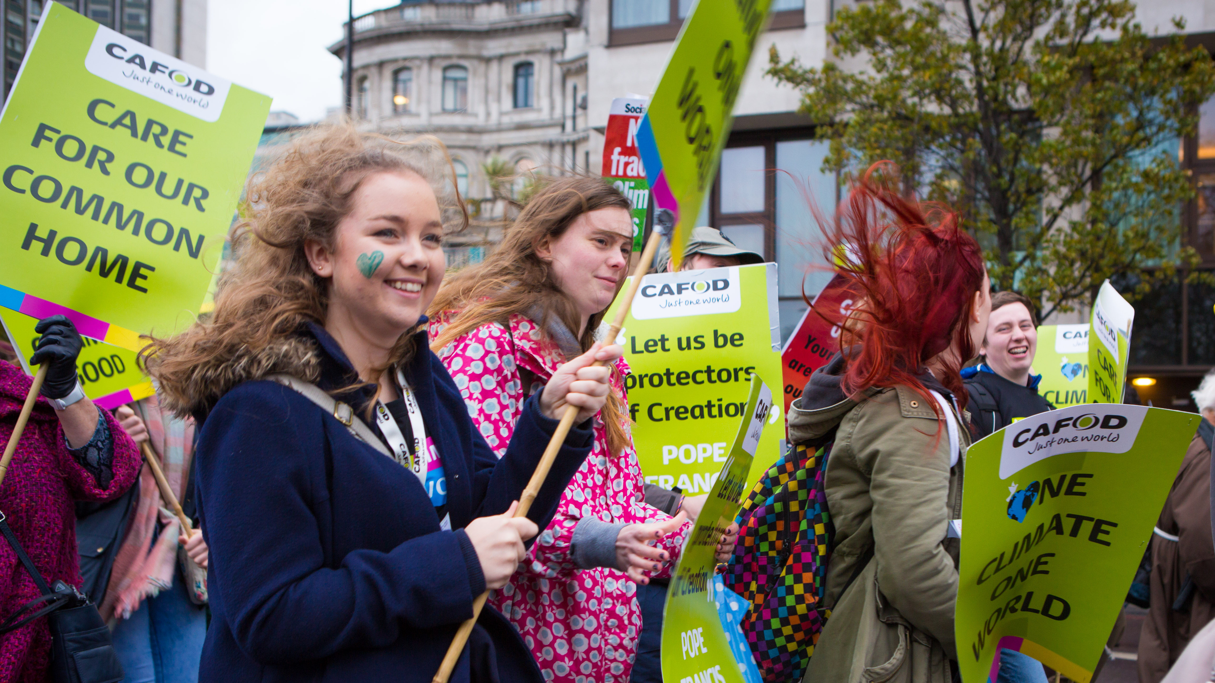
Blessed are those who hunger and thirst for righteousness =
those who want
fairness for everyone
wrong situations to be made right
for they will be filled
How can you help a wrong situation be made right?

Slide 13
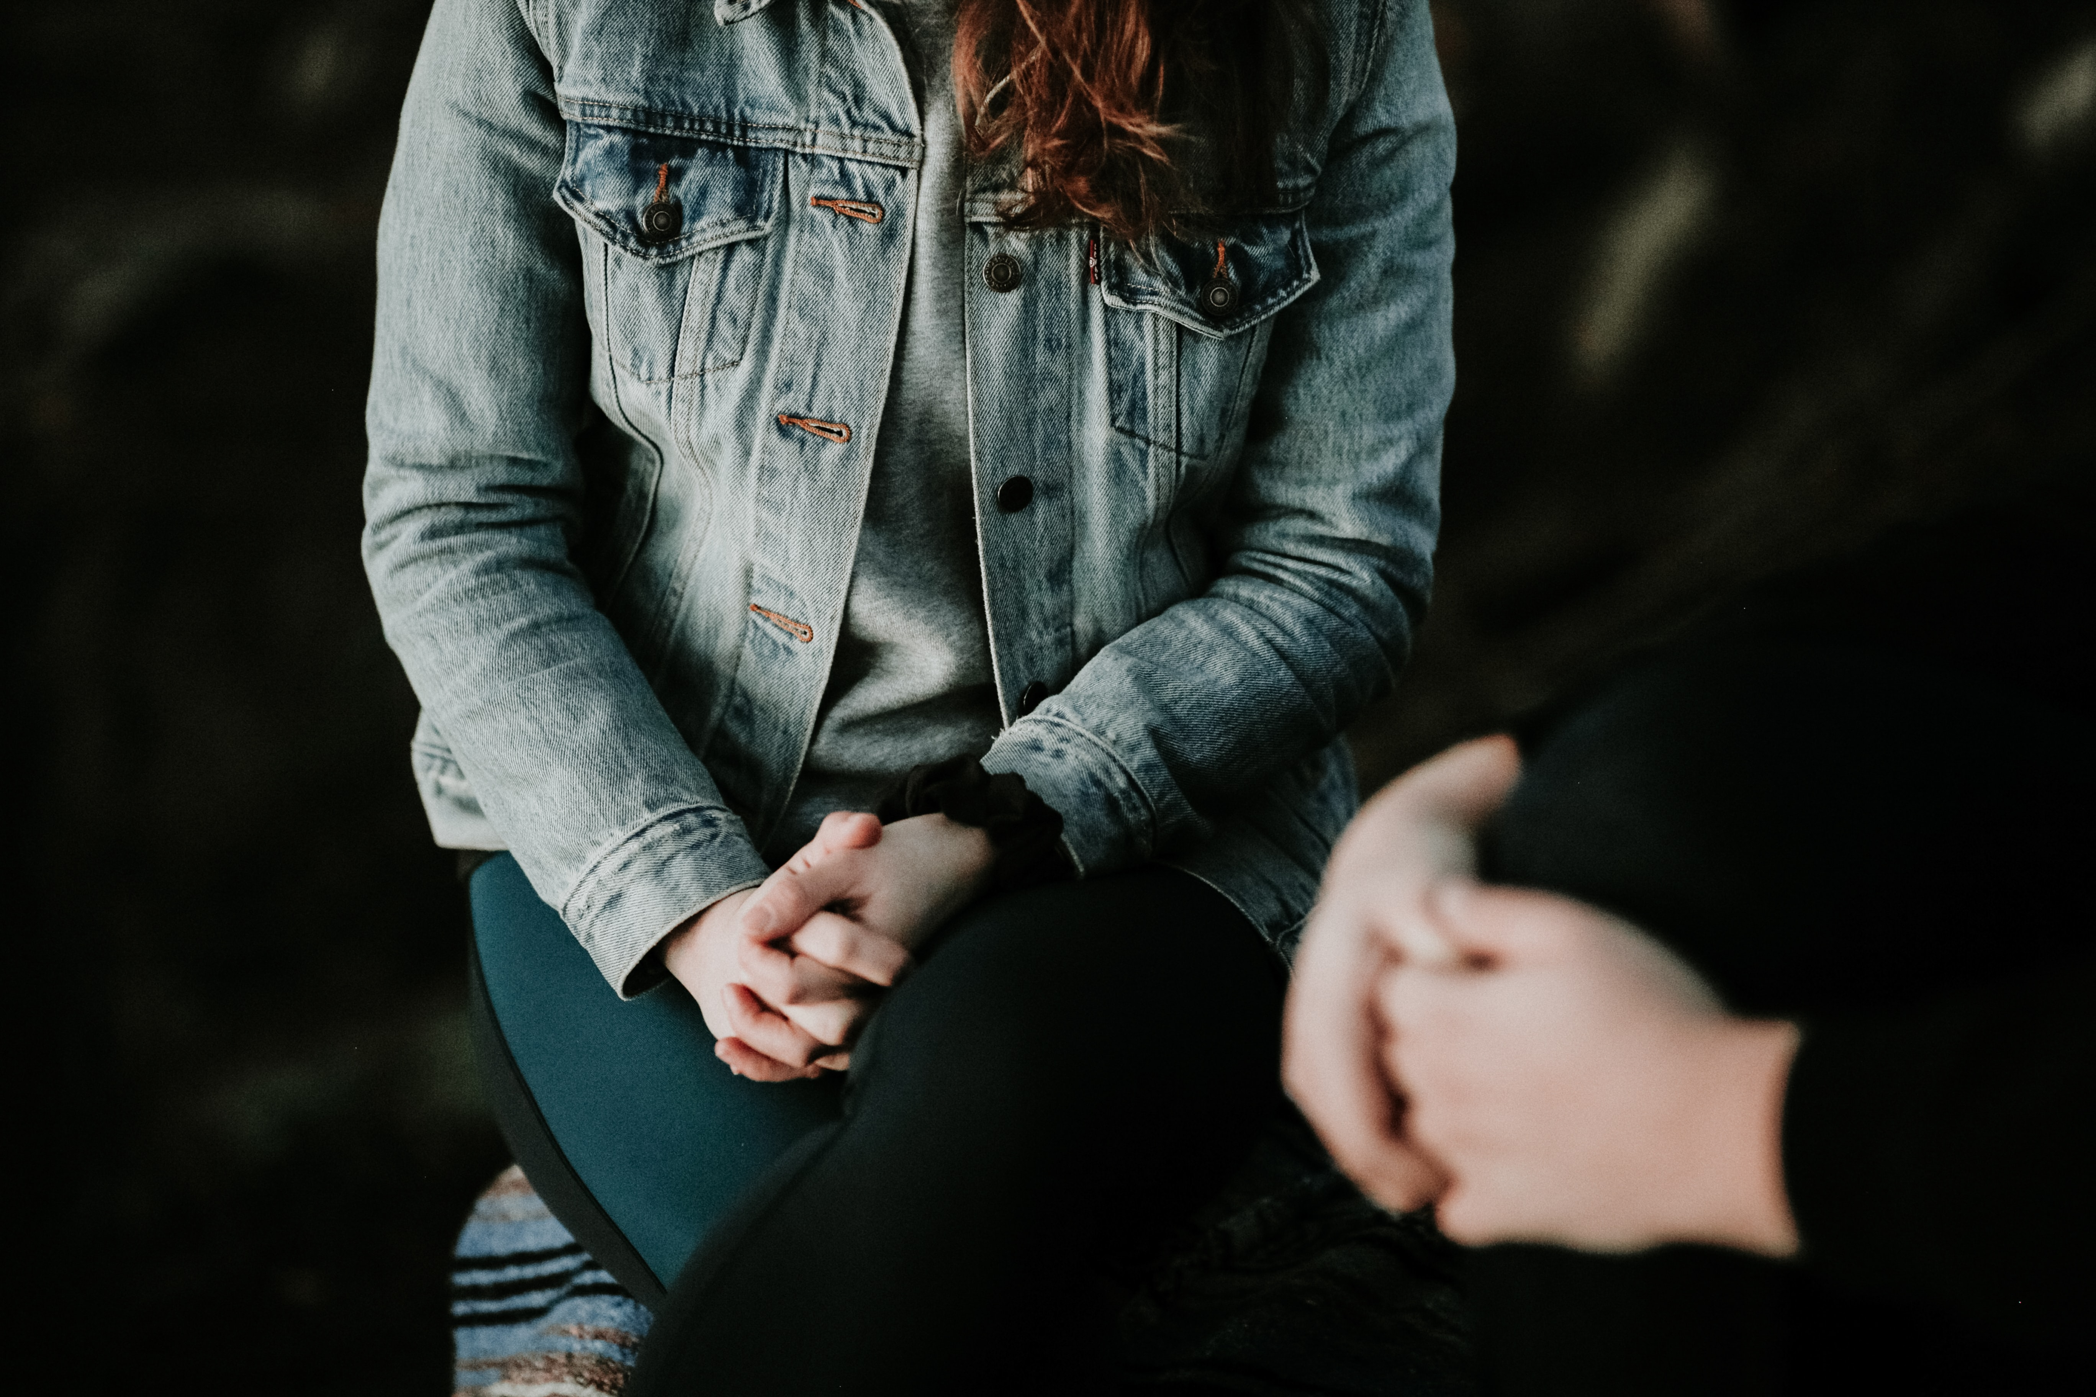
Blessed are the merciful =
those who
give second chances
offer forgiveness
for they will be shown mercy
Describe a time when you gave someone a second chance.

Slide 14
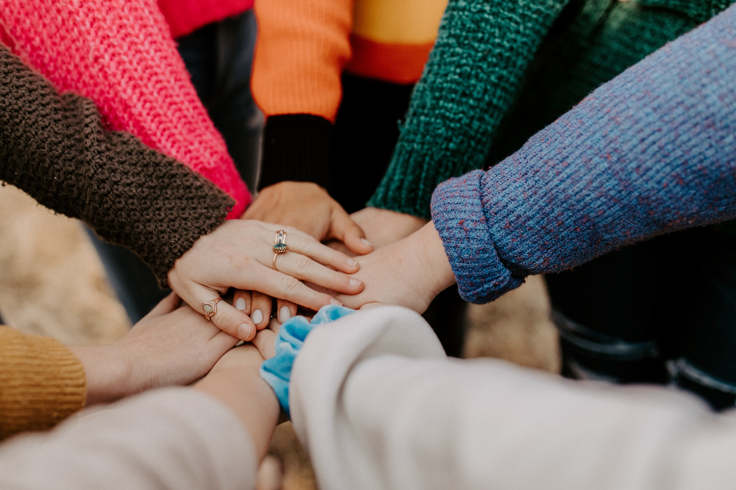
Blessed are the pure in heart =
those who
do not judge
look for the best in others
for they will see God
Think of someone you may have judged. How could you keep from judging them now?

Slide 15
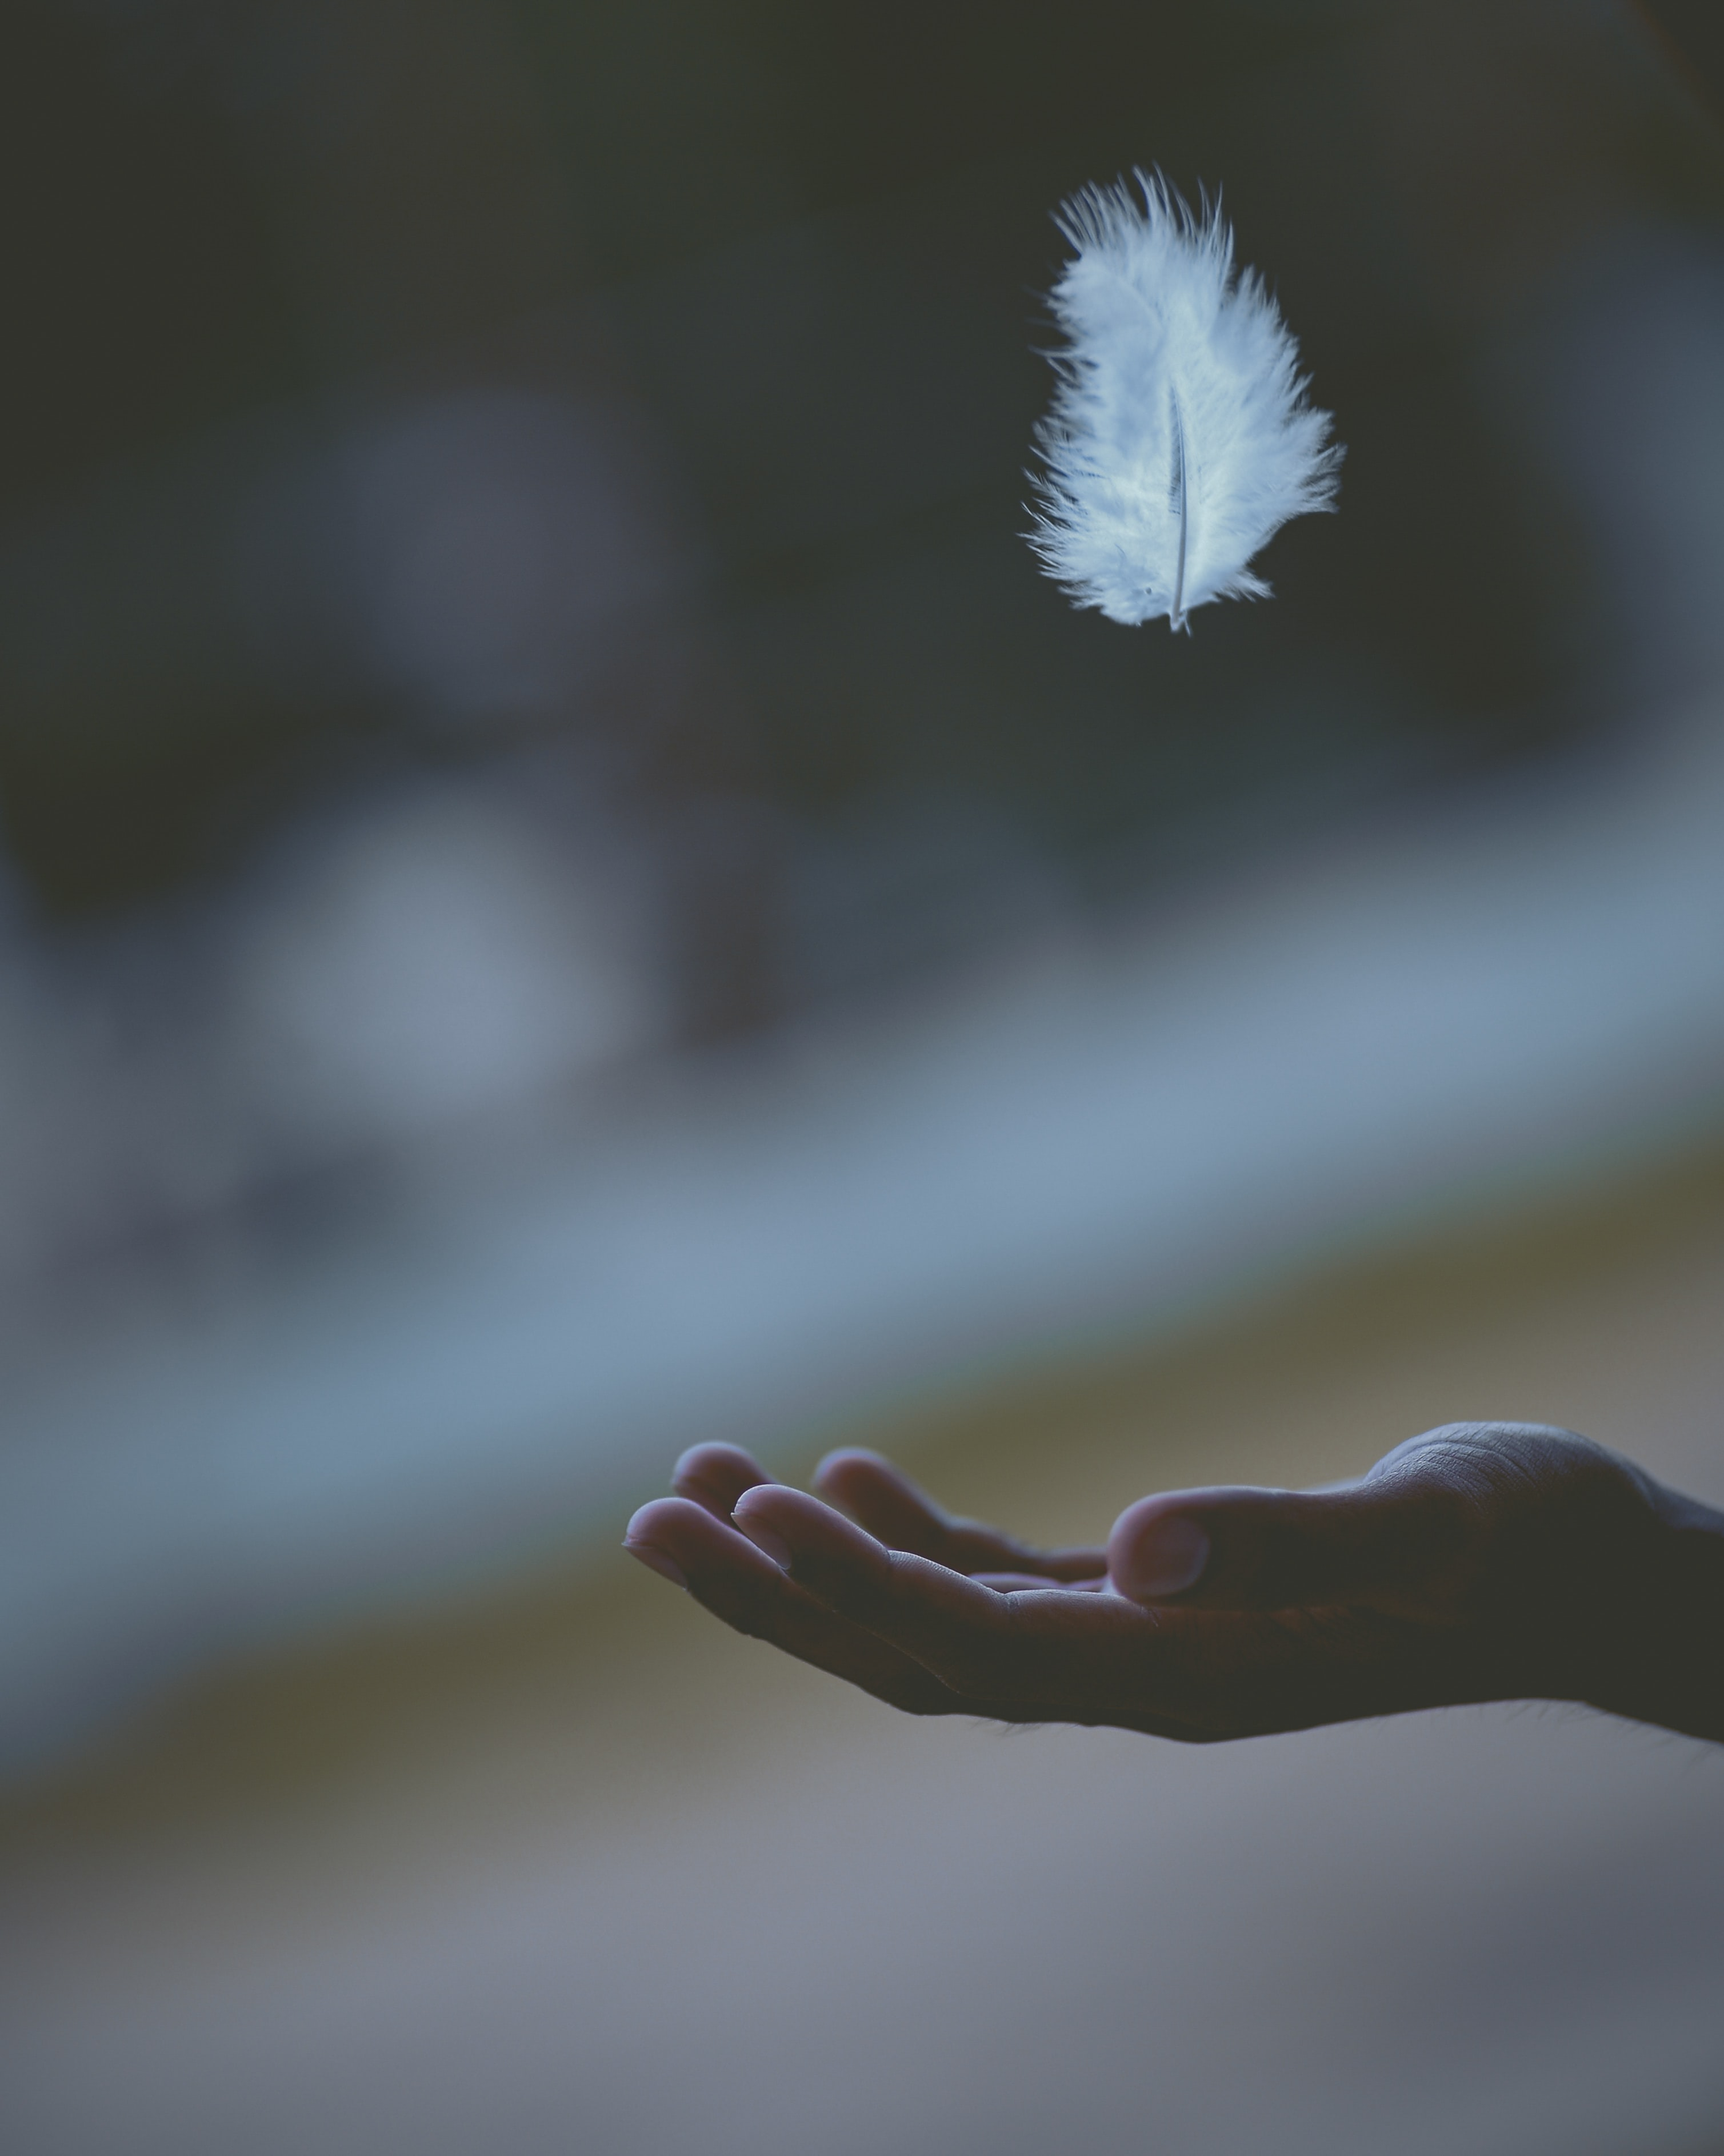
Blessed are the peacemakers =
those who
say no to violence
help enemies become friends
for they will be called children of God
Describe a way you could bring peace to your school or at home.

Slide 16
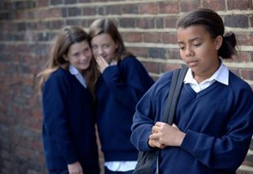
Blessed are those who are persecuted because of righteousness =
those who
suffer for doing what is right
for theirs is the kingdom of heaven
Describe a time you may have suffered for doing something right.

Slide 17
Faith in Action Closing Liturgy
Before our final prayer: slow your breathing and reflect

Slide 18
FAITH IN ACTION CLOSING PRAYER
All: Jesus is the light of the world and He wants to shine His light through us and our love for each other.
Reader 1: Blessed are the poor in spirit, for theirs is the kingdom of heaven. We pray for those who still do not recognise that they need God. All: Jesus, help us to depend on you.
Reader 2: Blessed are those who mourn, for they will be comforted. We pray for all those who have died and for everyone who misses them. All: Jesus, help us to show your love to others.
Reader 3: Blessed are the meek, for they will inherit the earth. We pray for all those who serve God rather than themselves or the world. All: Jesus, help us to keep you as our number one priority.
Reader 4: Blessed are those who hunger and thirst for righteousness, for they will be filled. We pray for anyone who is in need of healing. All: Jesus, help us to heal the hurts in our lives.
Reader 5: Blessed are the merciful, for they will receive mercy. We pray for all those who are in need of forgiveness.
All: Jesus, help us to follow your example of mercy and offer forgiveness to others.
Reader 6: Blessed are the pure in heart, for they will see God. We pray for those whose hearts need to in the right place.
All: Jesus, help us to have the right motivation in doing good.
Reader 7: Blessed are the peacemakers, for they will be called children of God. We pray for those who stand up for what is right. All: Jesus, help us to be people of peace, love and justice.
Reader 8: Blessed are those who are persecuted for righteousness’ sake, for theirs is the kingdom of heaven. We pray for all persecuted Christians around the world. All: Jesus, help us to be grateful for our freedom.

