Slide 1
Something
to say
National Youth Sunday and the Youth Synod in Rome

Slide 2
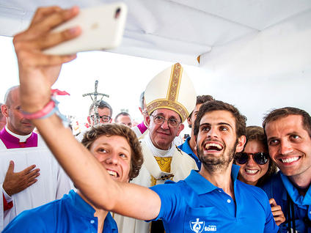
"The Church wishes to listen to your voice, your sensitivities and your faith; even your doubts and your criticism. Make your voice heard, let it resonate in communities and let it be heard by your shepherds of souls."

Slide 3
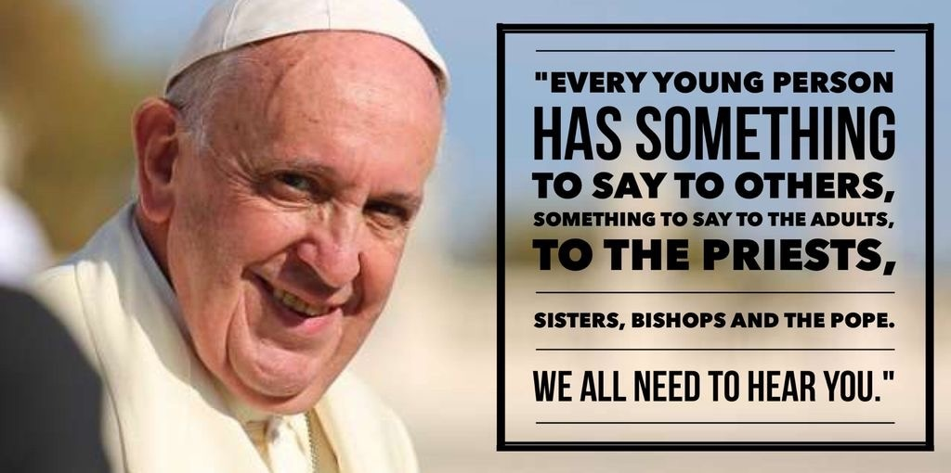

Slide 4
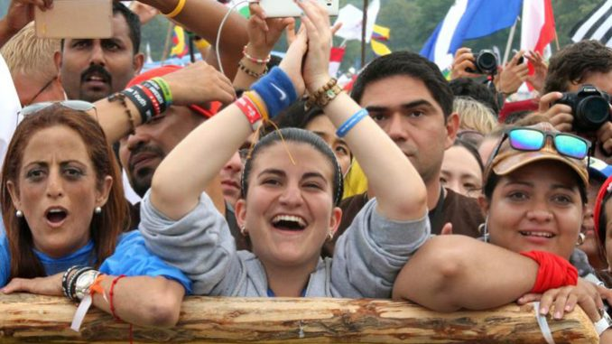
A quote from Pope Francis and his introduction to the Synod
I wanted you to be the centre of attention, because you are in my heart. Today, the Preparatory Document is being presented, a document which I am also entrusting to you as your “compass” on this synod journey.

Slide 5
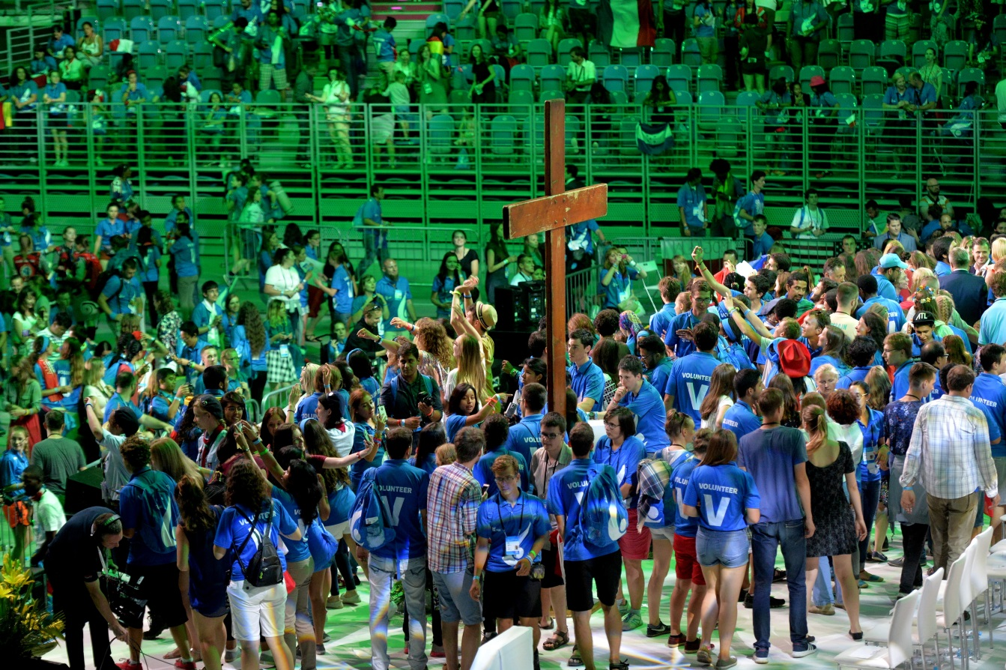
"The Church wishes to listen to your voice, your sensitivities and your faith; even your doubts and your criticism. Make your voice heard, let it resonate in communities and let it be heard by your shepherds of souls."

Slide 6
•The synod conference will take place next October 2018
•It will look at the results from the online questionnaire young people
from around the world have completed.
•Each view and opinion of the young people will be heard
•In the UK 10,000 questionnaires were completed online
The Synod initiative was started in January this year 2017

Slide 8
In this county we are fortunate to have a voice, a voice that is mostly heard, and we hear about the Youth Synod conference next year in which every young Catholics voice from around the world, we cannot help but feel fortunate that we are not persecuted for our faith in this country.

Slide 9
Have I listened to those who love me?
Have I listened to those who love me?

Slide 10
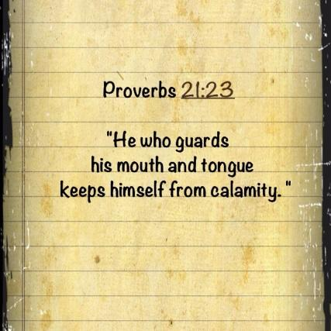
Have I said something of a negative nature to someone?

Slide 11
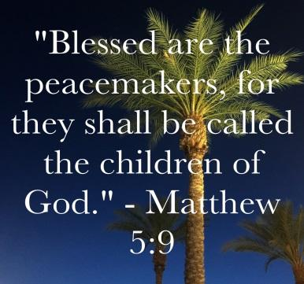
Have I tried to be the peacemaker?

Slide 12
Have I forgiven someone who’s hurt me?

Slide 13
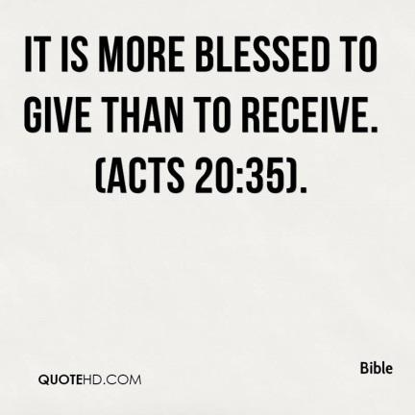
Could I give my time to someone who really needs it?

Slide 14
Have I shown respect?

Slide 15
Do I always think of others before myself?

Slide 16
Bidding prayers
Response
Hear our prayer

