Slide 1
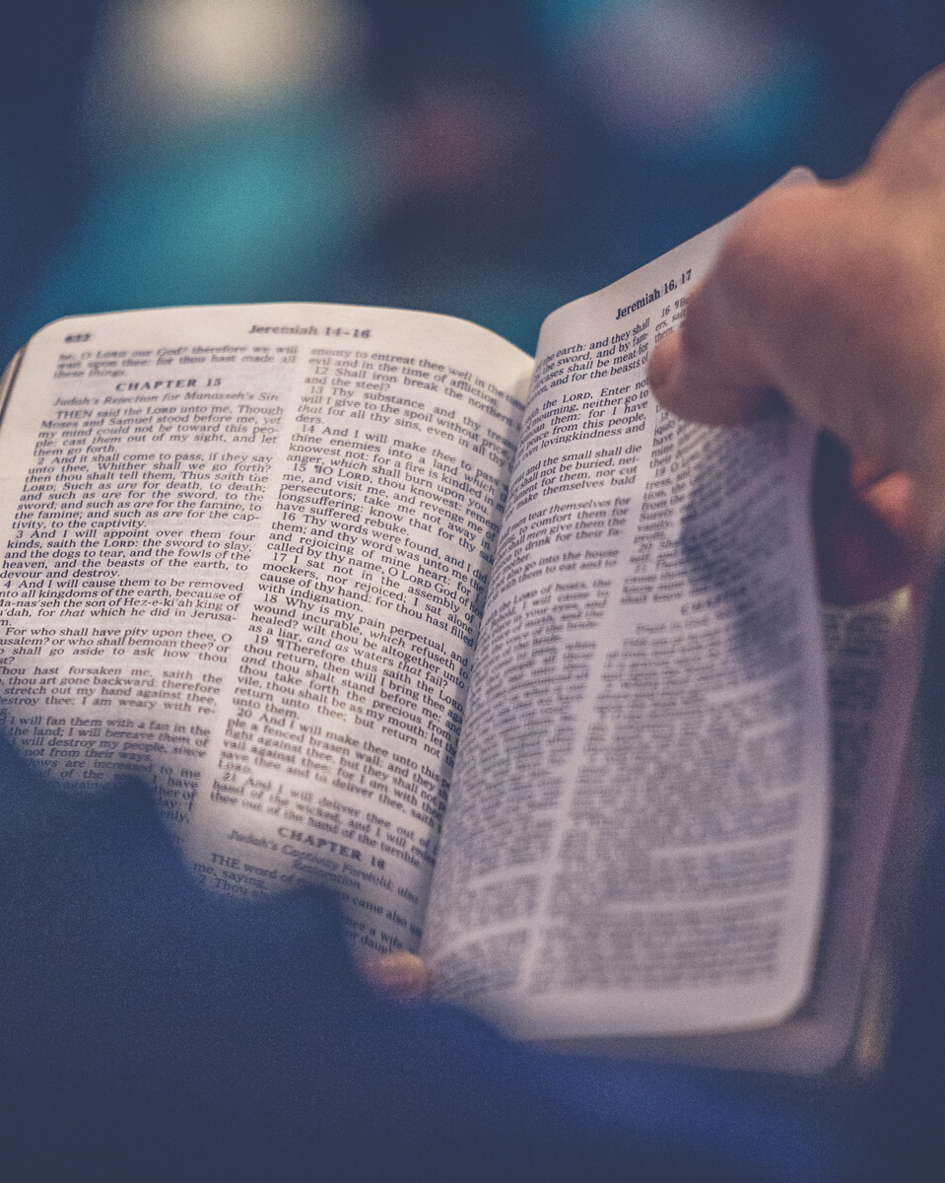
Journey with
fasting
Why do we fast during Lent?
Because Jesus tells us to:
'And when you fast, do not put on a sad face as the hypocrites do... When you go without food, wash your face and comb your hair, so that others cannot know that you are fasting... And your Father, who sees what you do in private, will reward you.' (Matthew 6:16-18)

Slide 2
Journey with
fasting
Why do we fast during Lent?
To follow in Jesus' footsteps:
Jesus Himself fasted for 40 days.
'Then the Spirit led Jesus into the desert to be tempted by the Devil. After spending forty days and nights without food,
Jesus was hungry.' (Matthew 4:1-2)
Denying ourselves something for
40 helps us journey with Jesus to the
Cross at Easter.

Slide 3
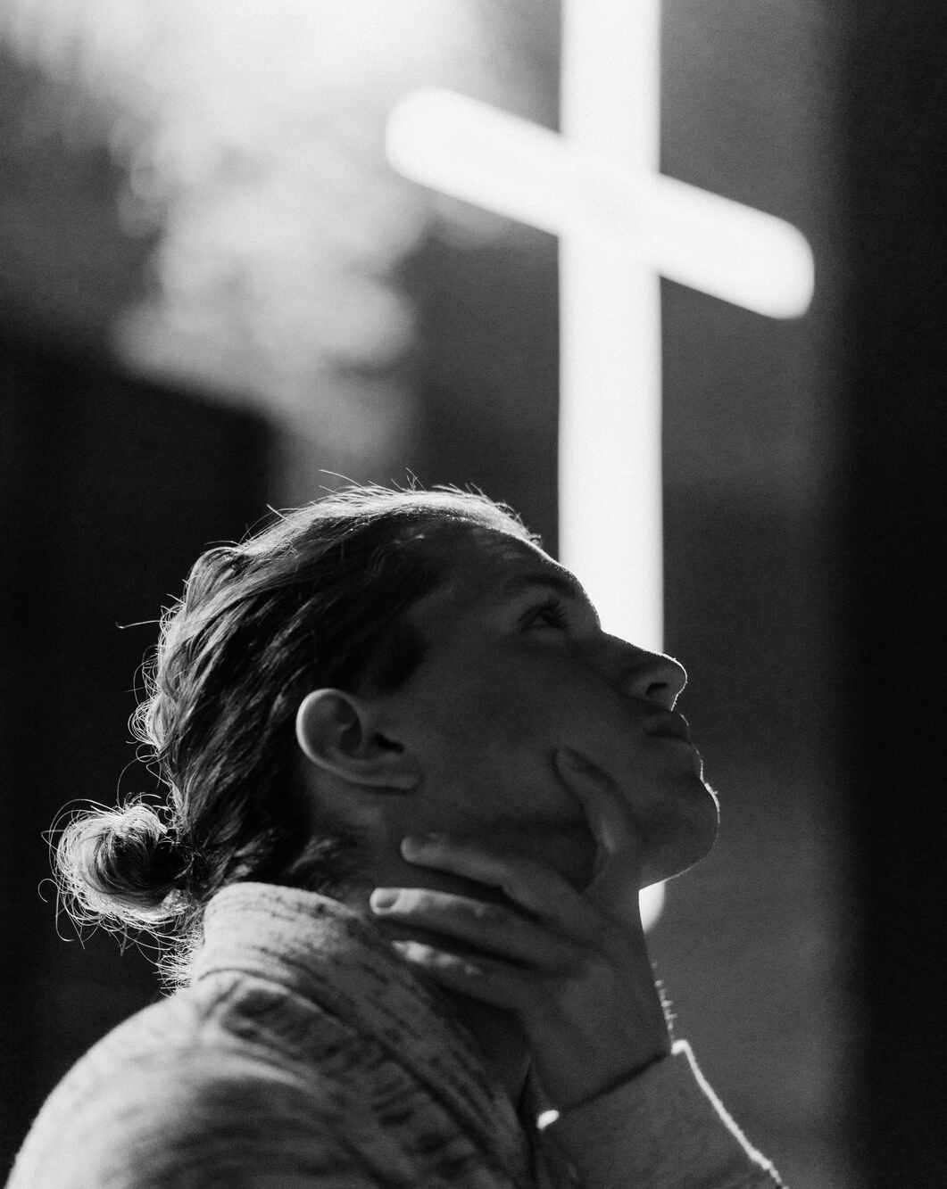
Journey with
fasting
Why do we fast during Lent?
To reflect on our priorities:
When we deny ourselves something that we like, and which isn't wrong to want, we can offer it to God.
Fasting in Lent helps us to put God first and realise what is really important in life.

Slide 4
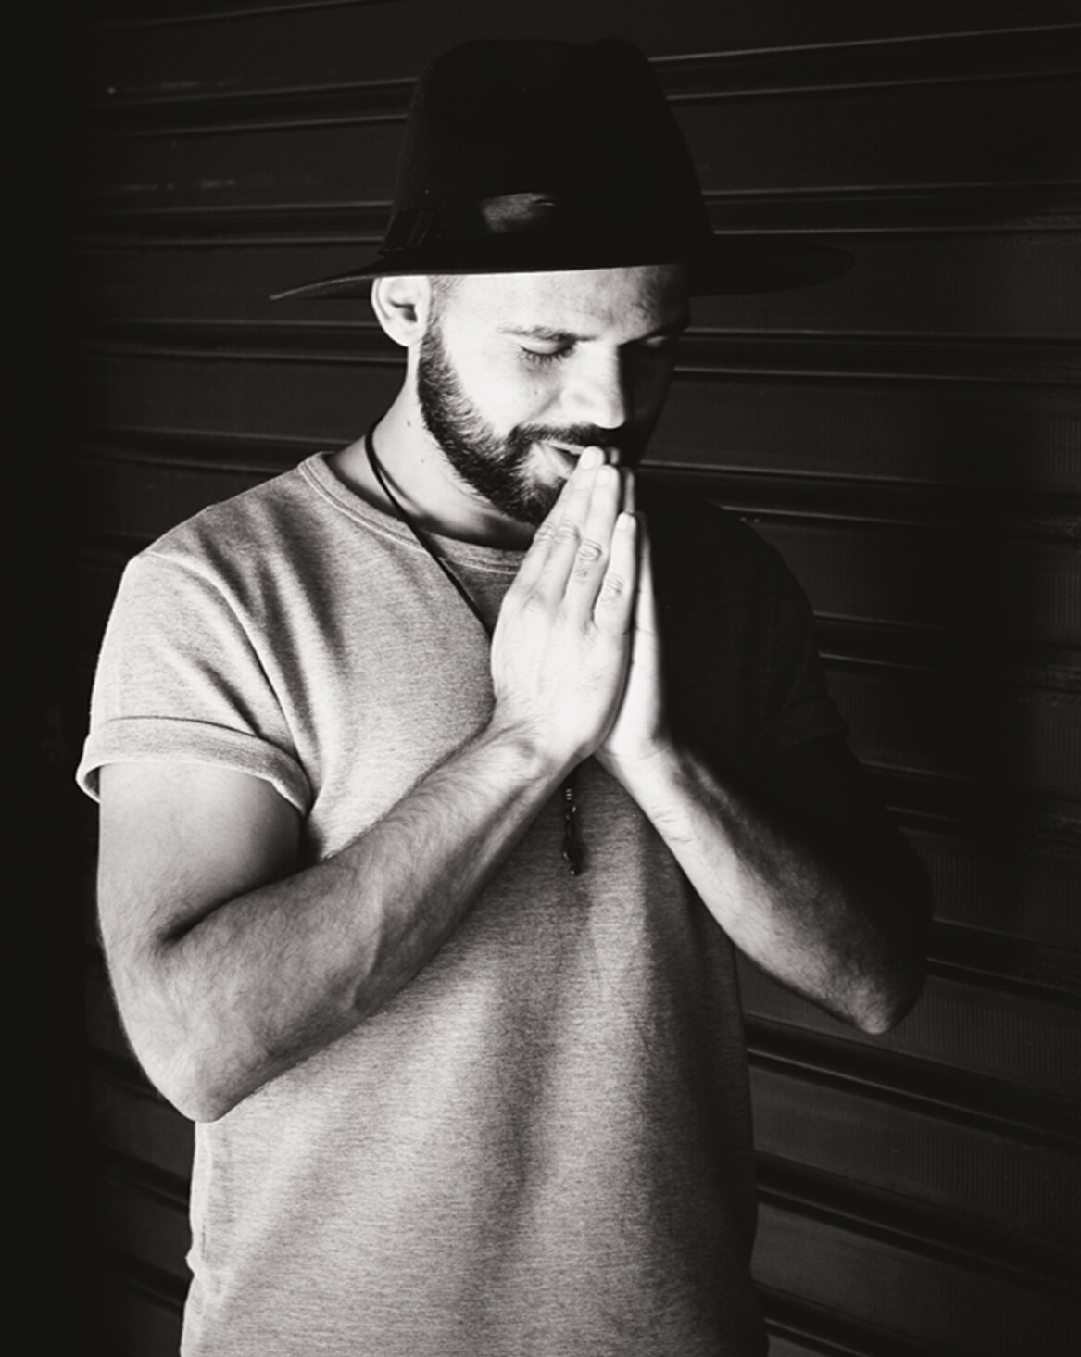
Journey with
fasting
Why do we fast during Lent?
To exercise spiritual discipline:
When we fast, we exercise our spiritual muscles. Just like training for a sport, the more we exercise, the stronger we become.
Fasting can help us to become stronger spiritually and strengthen our relationship with God.

