Slide 1
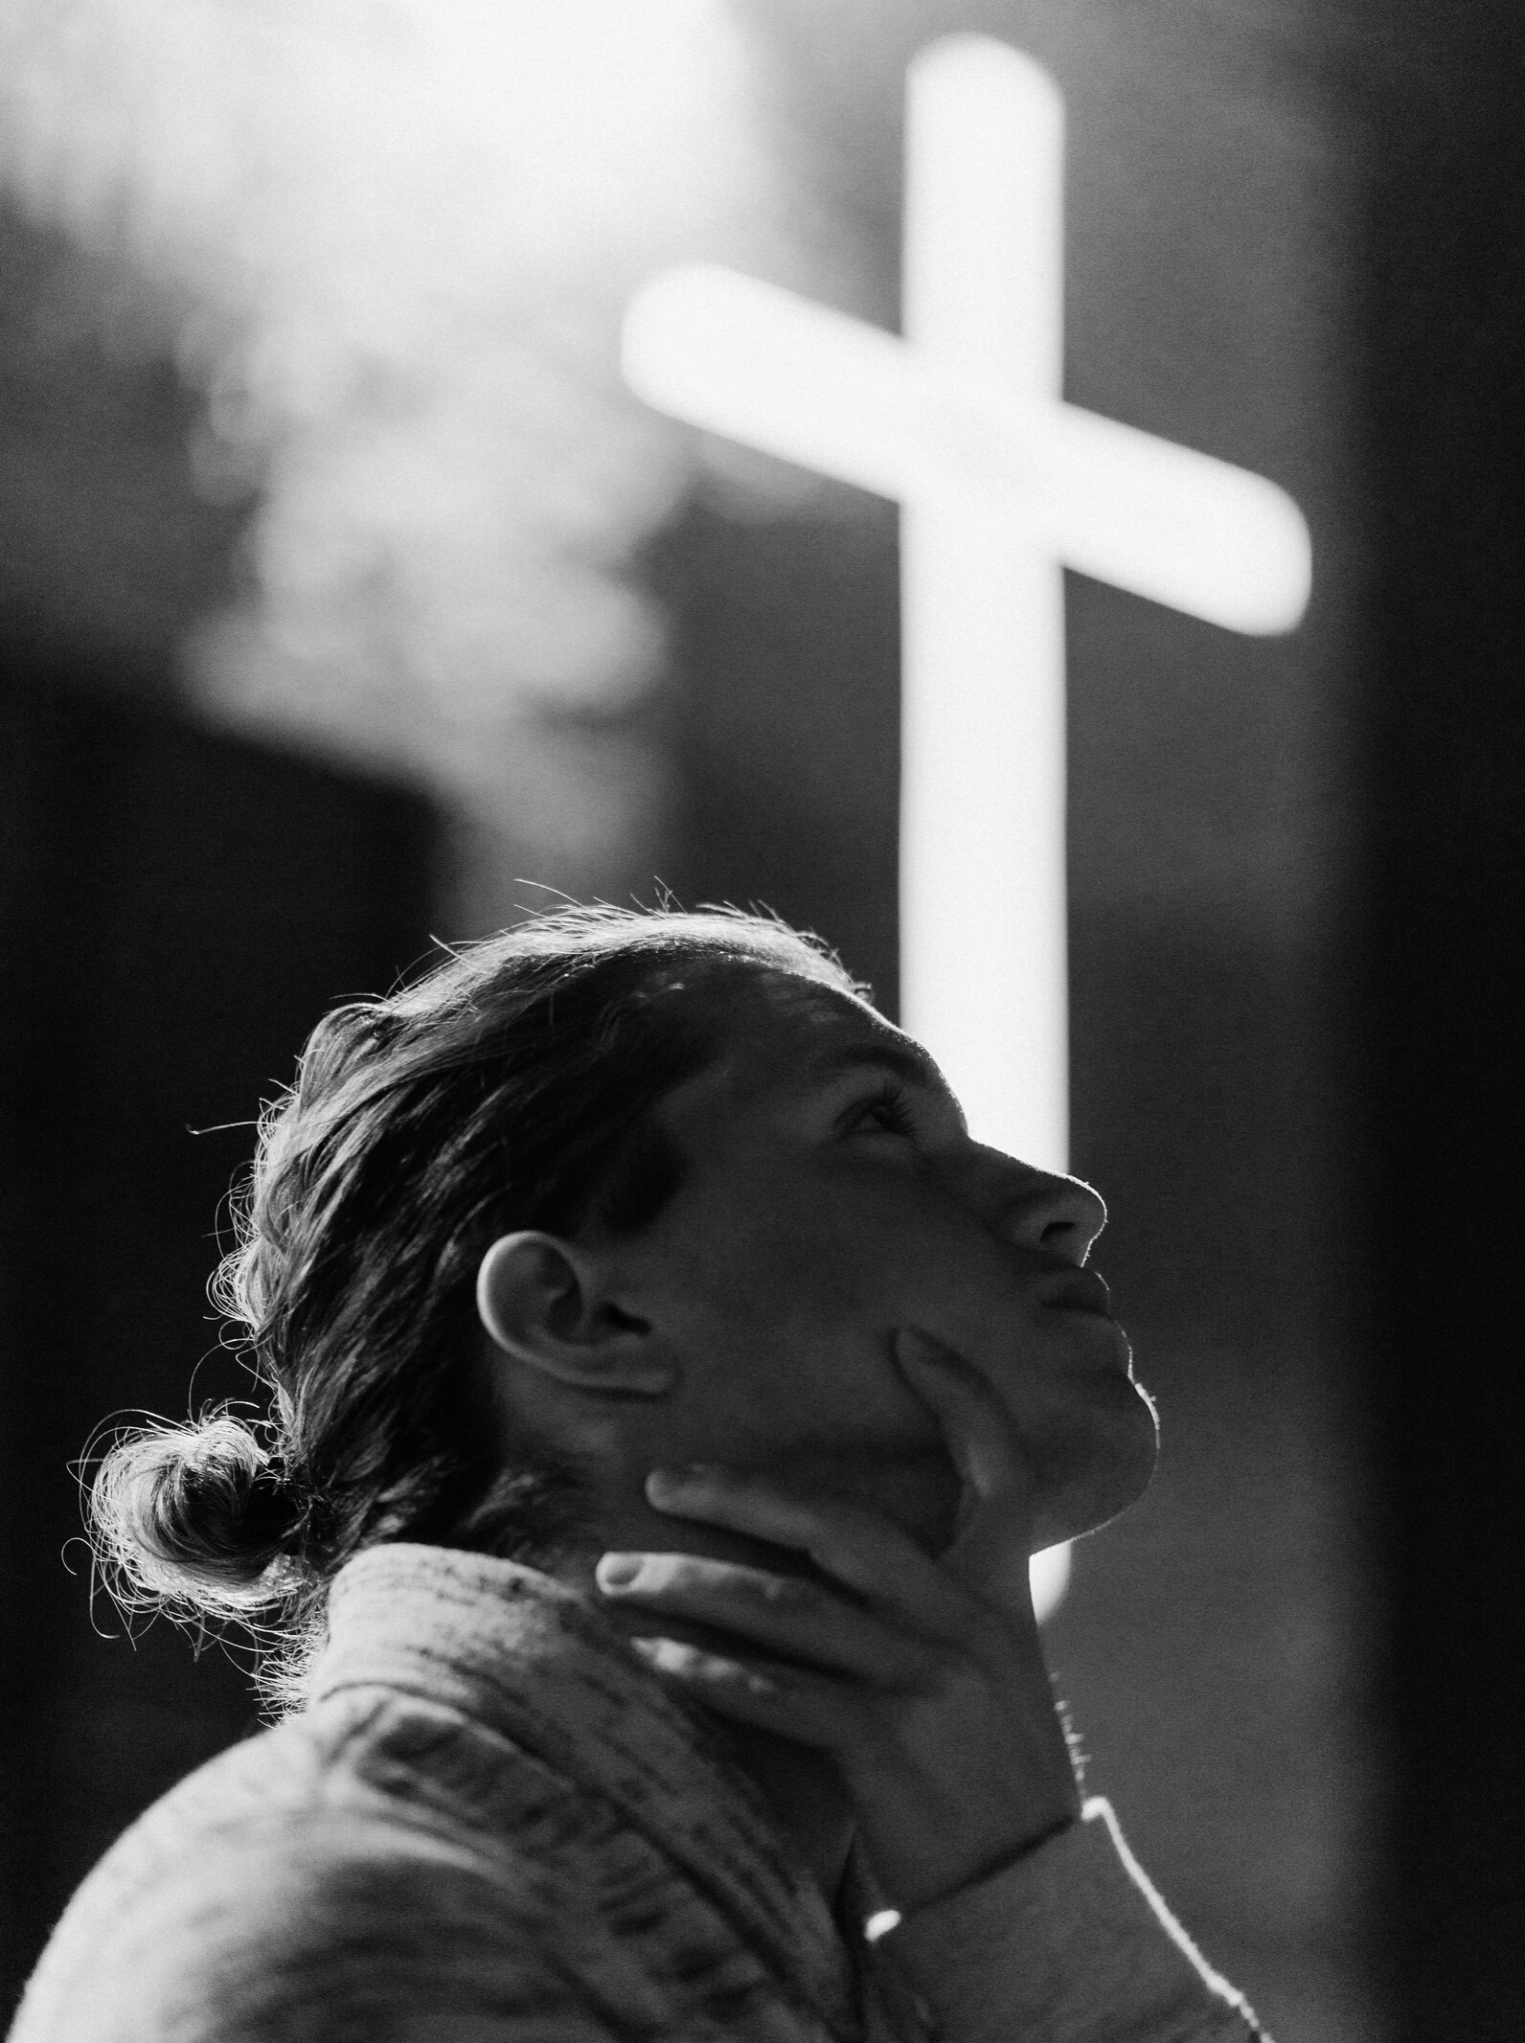
Journey with
giving
During lent we are invited to journey with Jesus.
We do this through prayer, fasting and almsgiving.
Giving during Lent reminds us to carry the burdens of others, just as Jesus did on the Cross for us.

Slide 2
Journey with
giving
Almsgiving doesn't always have to be giving money. Can you think of any other ways you could give to others this Lent?
Take an act of kindess. Once you have completed the action, give it to someone else.
Let's spread some compassion, hope and love this Lent.

